Slide 1
Curriculum Marketplace
Art
Mrs Chloe Foster

Slide 2
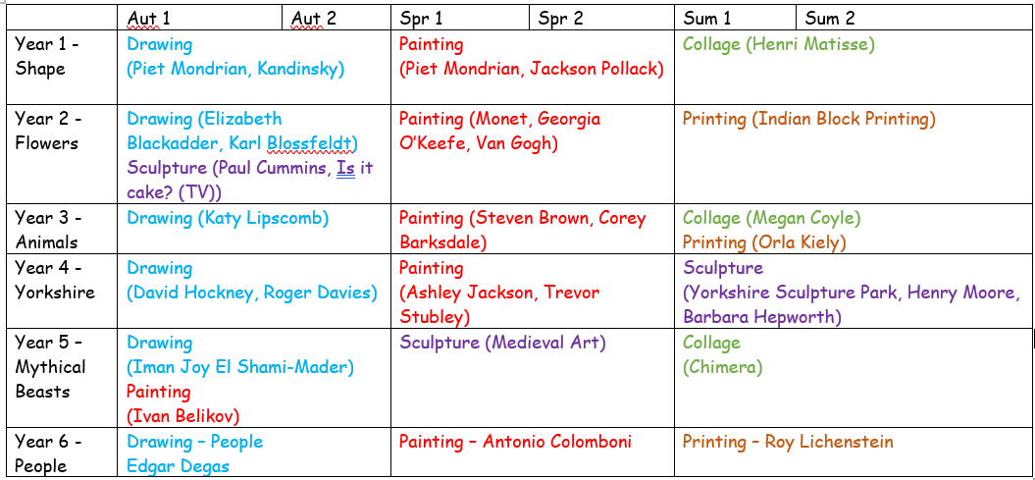
Long Term Planning

Slide 3
Art in EYFS
Art in Foundation Stage is covered in the Expressive Arts and Design and Physical Development parts of the EYFS curriculum. It is introduced indirectly through activities in continuous provision. Adults model key skills required i.e. colour mixing.
Term | Autumn 1 | Autumn 2 | Spring 1 | Spring 2 | Summer 1 | Summer 2
Theme | Who am I? All about me, my feelings, similarities and differences, my family, celebrations, past and present. |  | What am I? Evolution, human bodies, staying healthy, oral hygiene, amazing humans, plants vs humans, minibeasts and life cycles. |  | Where am I? Where I live, the UK, fossils/dinosaurs, the world, pirates, space, and how to care for the planet.
Expressive Arts and Design | Navigating key locations in school e.g. hall. Where do we live? Explore via google maps. Join in with a range of songs/nursery rhymes. Call and response songs. Use a variety of mark-making resources. Begin to select colours for a purpose. Beginning to mix colours. Create a collaborative art piece for display. Join in with role play games and use resources for props. Build models using construction equipment. Self portraits. Portraits of Family members. Junk modelling – houses. Movement dances (copy dance moves). Explore instruments. Firework pictures. Christmas decorations. Divas Christmas songs. Nativity. Listen to and talk about a range of different types of music – how does it make you feel. Stage in the outdoor area to engage in music making and dance. |  | Join in with role play and small world activities – incorporating stories into play. Join in with a range of songs/nursery rhymes. Movement dances. Explore instruments and begin to name some. Symmetrical Butterflies. Mix colours to create new ones. Observational Drawings of plants. Design homes for hibernating animals. Making lanterns for Chinese New Year. Watch and discuss Chinese New Year dragon dances – expressing feelings, likes/dislikes and responses. Drawing around each other. Shadow drawing. Junk Modelling Lifecycles. Printing patterns on Easter Eggs. Easter Cards. Mothers Day Cards. Stage in the outdoor area to engage in music making and dance. |  | Join in with role play and small world activities – incorporating stories into play. Join in with a range of songs/nursery rhymes. Movement Dances. Stage in the outdoor area to engage in music making and dance. Play an instrument to a simple beat. Design and make rockets. Creating outer space pictures. Design and make objects they need in space. Junk Modelling Exploration of other countries that have a contrasting life – dressing up in different costumes. Salt dough fossils. Treasure maps. Fathers Day Cards. Watercolour pictures – paint lines and circles to create an image. Making passports.

Slide 4
Art in EYFS
Art in Foundation Stage is covered in the Expressive Arts and Design and Physical Development parts of the EYFS curriculum. It is introduced indirectly through activities in continuous provision. Adults model key skills required i.e. colour mixing.
Term | Autumn 1 | Autumn 2 | Spring 1 | Spring 2 | Summer 1 | Summer 2
Theme | Who am I? All about me, my feelings, similarities and differences, my family, celebrations, past and present. |  | What am I? Evolution, human bodies, staying healthy, oral hygiene, amazing humans, plants vs humans, minibeasts and life cycles. |  | Where am I? Where I live, the UK, fossils/dinosaurs, the world, pirates, space, and how to care for the planet.
Physical Development | Dough Disco Squiggle whilst you wiggle Threading Cutting Weaving Playdough Funky fingers activities. Pencil grip. Letter formation. Drawing/Mark making. Model pencil grip. Daily movement breaks. Climbing outdoors Develop good personal hygiene. Trikes, two wheeled balance bikes and pedal bikes. Provide regular reminders about handwashing and toileting. |  | Climbing outdoors Dough Disco Threading Cutting – straight line Weaving Playdough Handling tools, objects etc with increasing control. Drawing Fastening zips and buttons independently. Funky fingers activities. Pencil grip. Letter formation. Daily movement breaks. Outdoor physical resources to support balance, agility. Healthy lifestyle. |  | Climbing outdoors Threading Cutting – start to cut along a curved line. Weaving Funky fingers activities – using one hand consistently. Dough Disco Develop pencil grip. Letter formation Start to draw recognisable pictures. Build things with smaller linking blocks such as Lego. Sports Day.

Slide 5
Curriculum Thread Documents

Slide 6
Curriculum Thread Documents

Slide 7
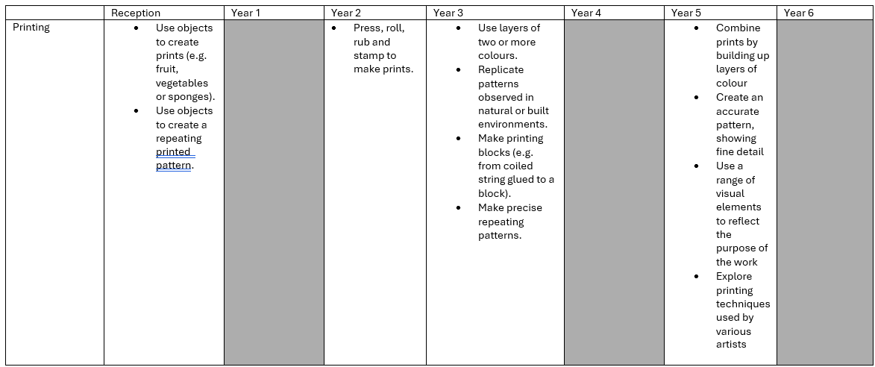
Curriculum Thread Documents

Slide 8
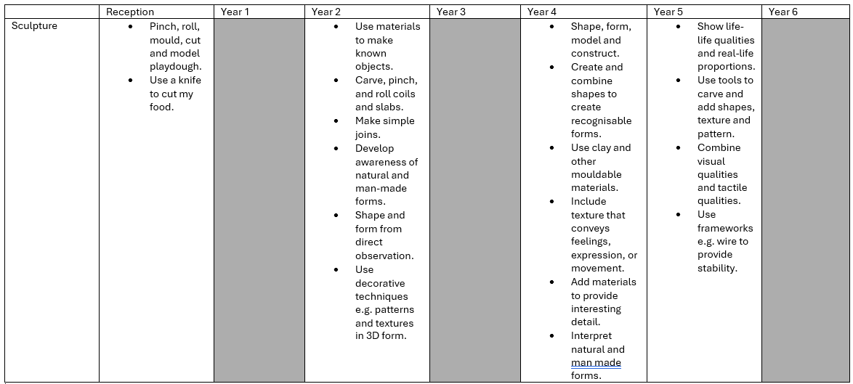
Curriculum Thread Documents

Slide 9
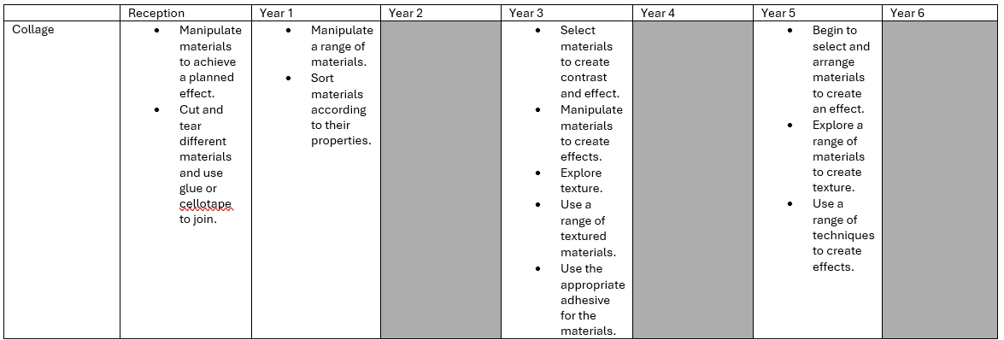
Curriculum Thread Documents

Slide 10
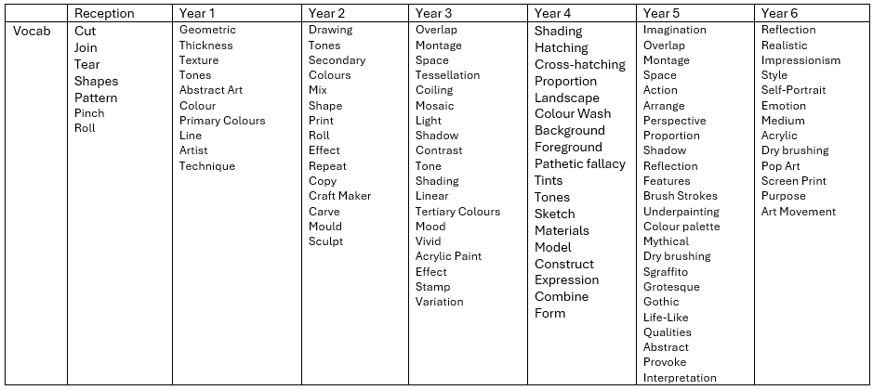
Vocabulary

Slide 11
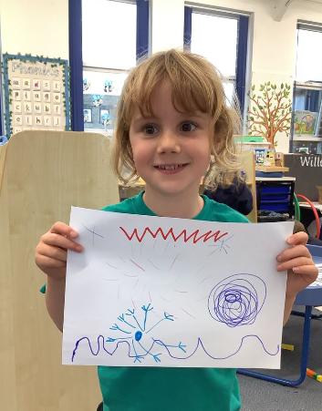
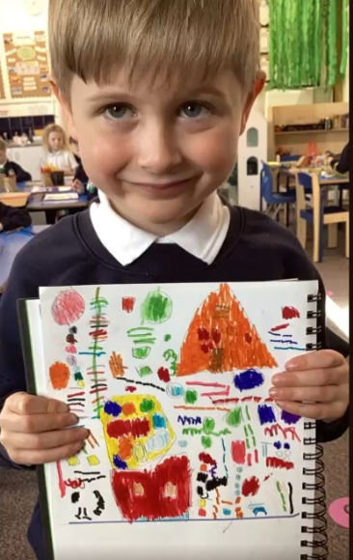
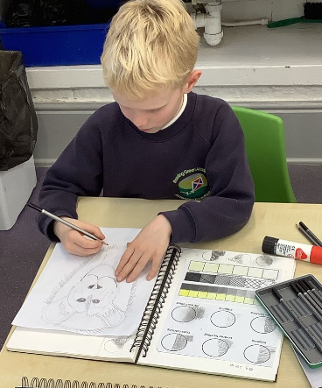
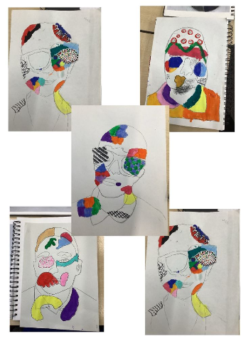
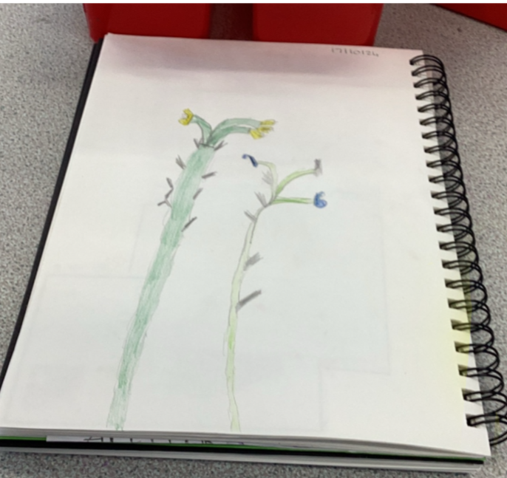
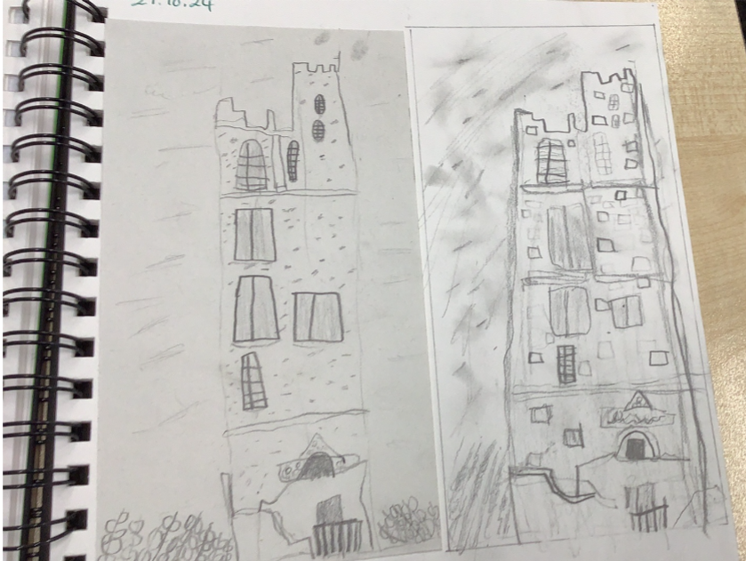
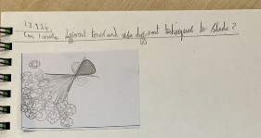
Examples of work

Slide 12
Assessment
At Bowling Green our curriculum is carefully planned to match the learning objectives set out in the National Curriculum for each year group. Therefore, we say that a child is ‘expected’ which means they are achieving their year groups objectives if they are keeping up with the learning detailed in our long term and medium term plans.
Whether a child is deemed to be keeping up with the learning is down to teacher judgement and knowledge of each individual child. To aid this decision each unit has a pre-learning task, this could check a child's understanding of the content up to this point i.e. have they recalled relevant information from previous year groups. This pre-learning task is used to inform planning, specifically thinking about additional support and challenge which may be needed in order to meet the needs of our pupils. Following the completion of a unit there is a post-learning task this checks a child's understanding of the content covered.
Each lesson has a flashback at the beginning of the lesson this is to support with retrieval of 'sticky knowledge' (knowledge we want children to remember).
Children are expected in each subject if they are keeping up with the learning detailed in the LTP/MTP.
Statutory Government assessments are undertaken in Year 1 with the Phonics Screening Check, Year 4 with the multiplication check and Year 6 with SATs.

Slide 13
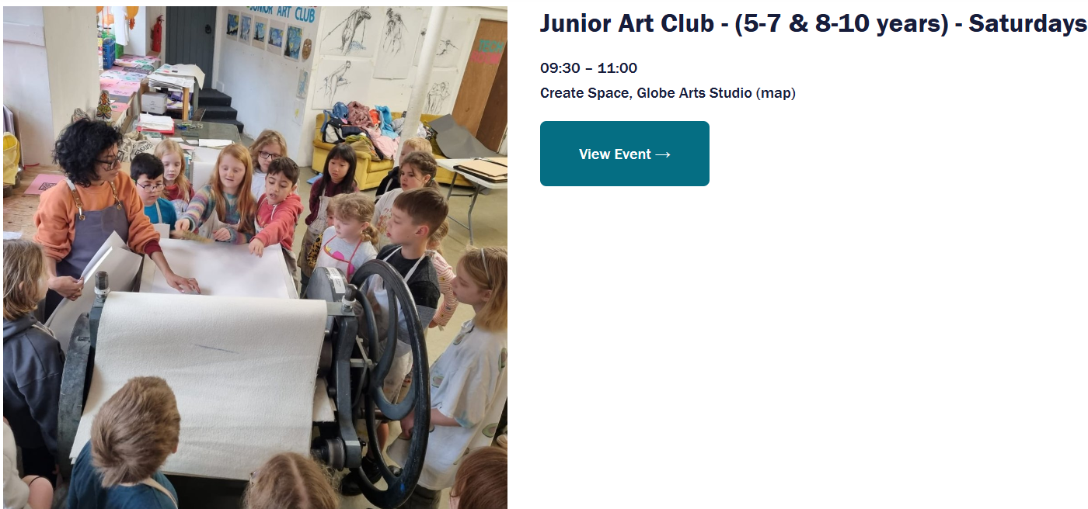
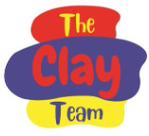
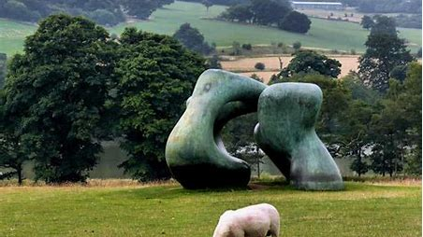
What can I do as a parent to support my child in this subject?
Globe Art Studio
Clay modelling after school club
Painting
Yorkshire Sculpture Park
Art Museum Visits

Slide 14
Career Ideas
Illustrator
Painter
Comic Strip Designer
Artist
Photographer
Graphic Designer
Fashion Designer
Art Teacher
Gallery Manager
Animator

