Slide 1
Curriculum Marketplace
Computing
Mr Callum Morris

Slide 2
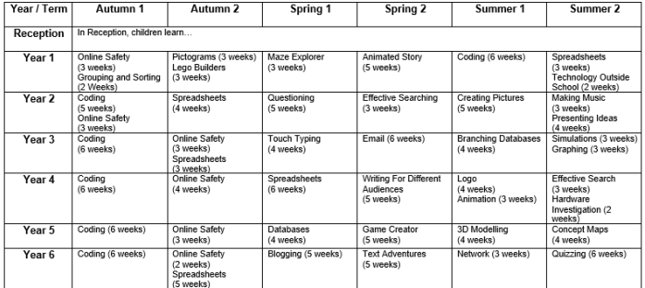
Long Term Planning

Slide 3
Computing in EYFS
Age of Development | Prime/Specific Area | Curriculum Link | Where might I see this at Bowling Green?
Reception | Personal, Social and Emotional Development | PSE.R.04 - Show resilience and perseverance in the face of a challenge. | Challenges in the classroom.
 | Physical Development | PD.R.04 - Develop their small motor skills so that they can use a range of tools competently, safely and confidently. PD.R.12 - Know and talk about the different factors that support their overall health and wellbeing:- sensible amounts of ‘screen time’ | PE Movement Dough Disco Fine motor area Playdough area
 | Expressive Arts and Design | EAD.R.01 - Explore, use and refine a variety of artistic effects to express their ideas and feelings. | Craft area.
ELG | Personal, Social and Emotional Development – Managing Self | Be confident to try new activities and show independence, resilience and perseverance in the face of challenge. Explain the reasons for rules, know right from wrong and try to behave accordingly.
 | Expressive Arts and Design – Creating with materials. | Safely use and explore a variety of materials, tools and techniques, experimenting with colour, design, texture, form and function.

Slide 4
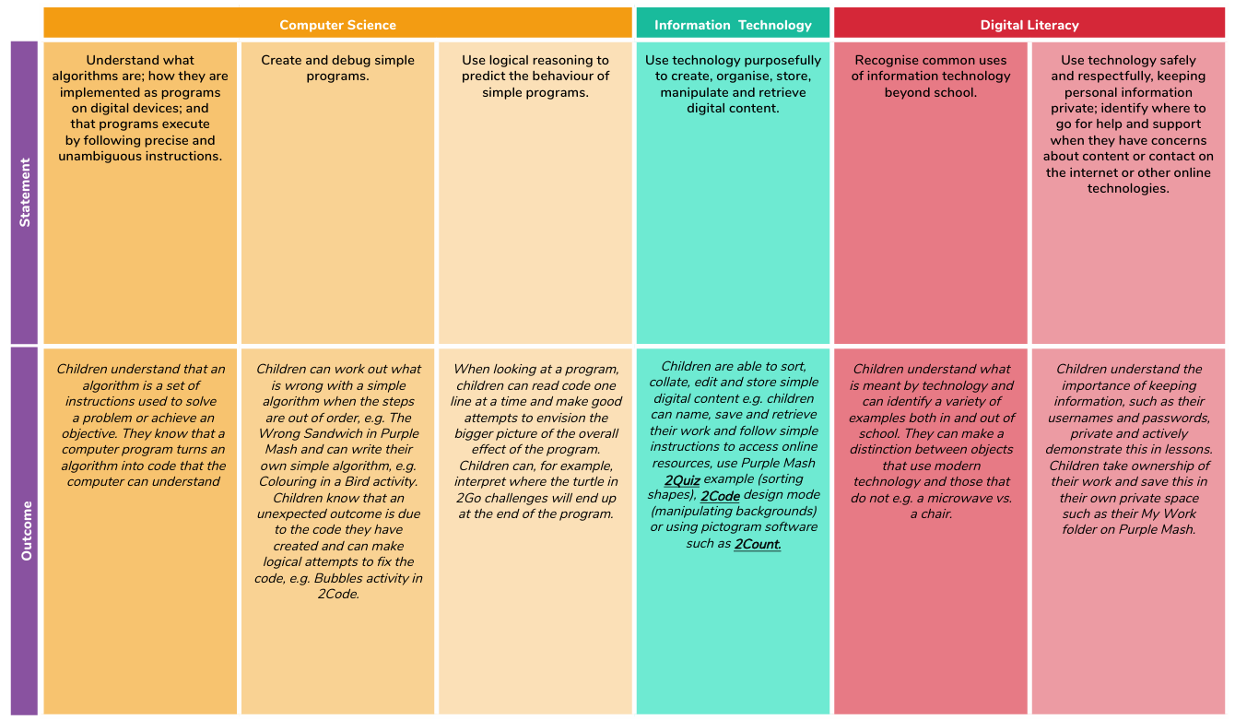
Curriculum Thread Documents – Year 1

Slide 5
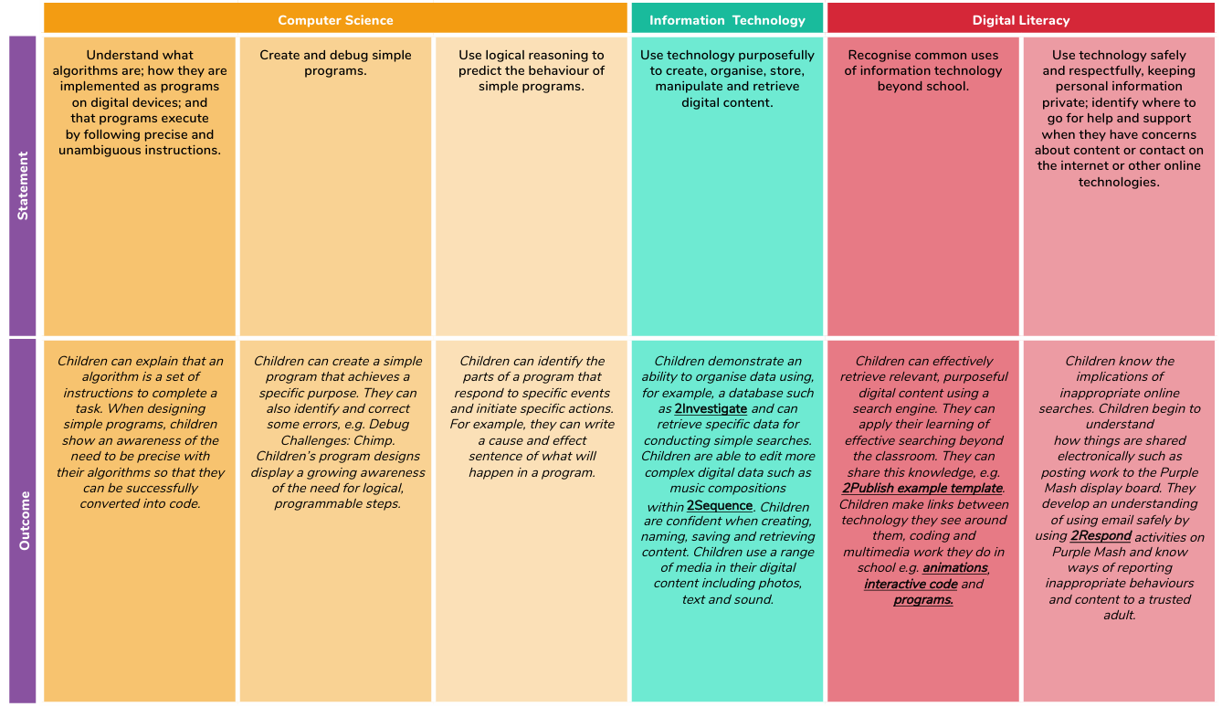
Curriculum Thread Documents – Year 2

Slide 6
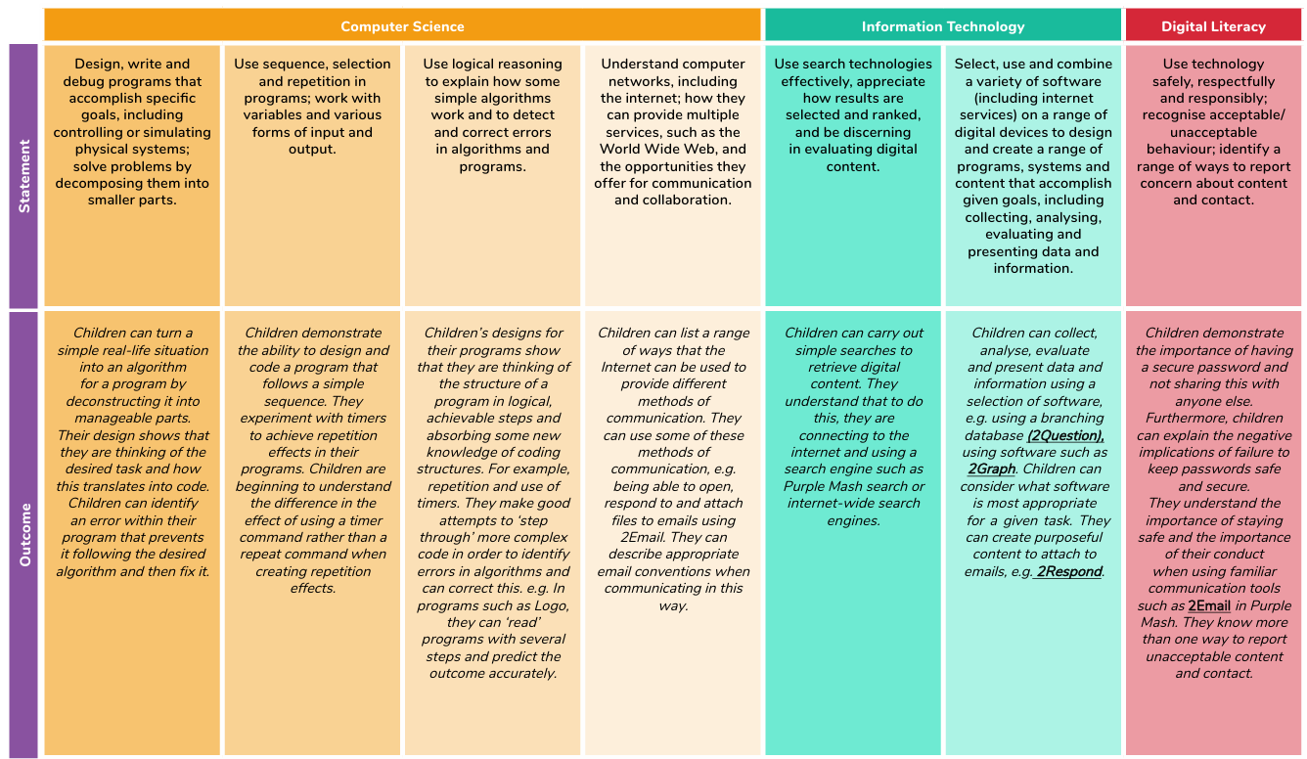
Curriculum Thread Documents – Year 3

Slide 7
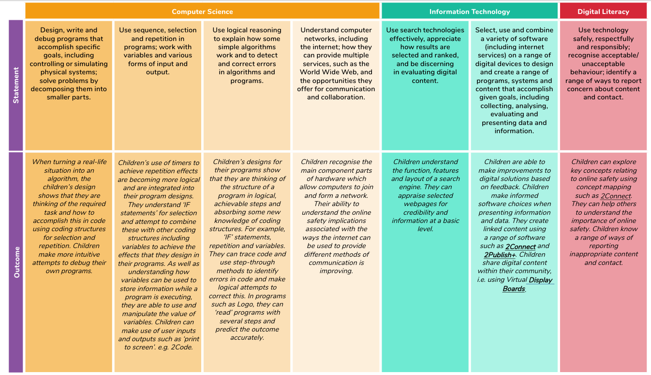
Curriculum Thread Documents – Year 4

Slide 8
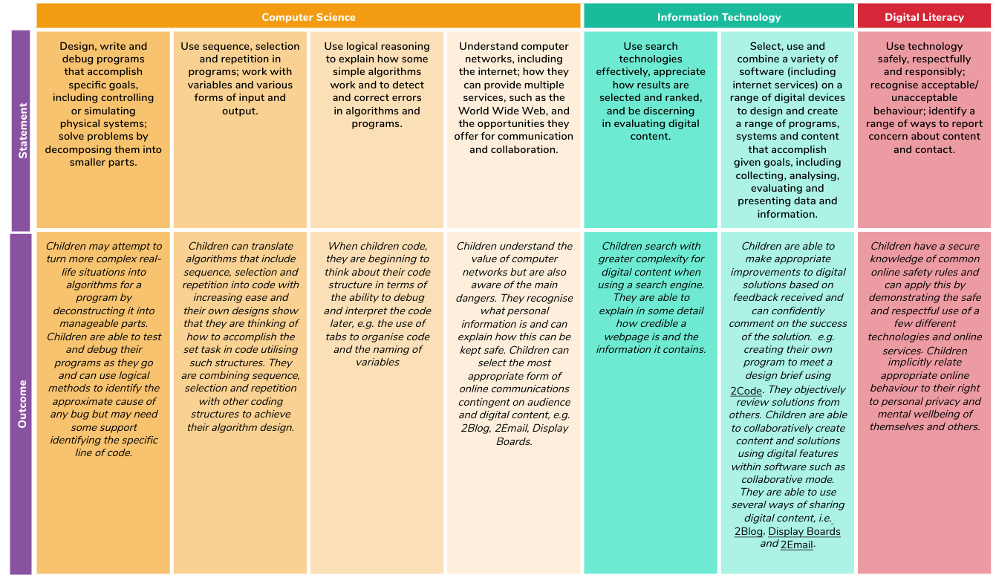
Curriculum Thread Documents – Year 5

Slide 9
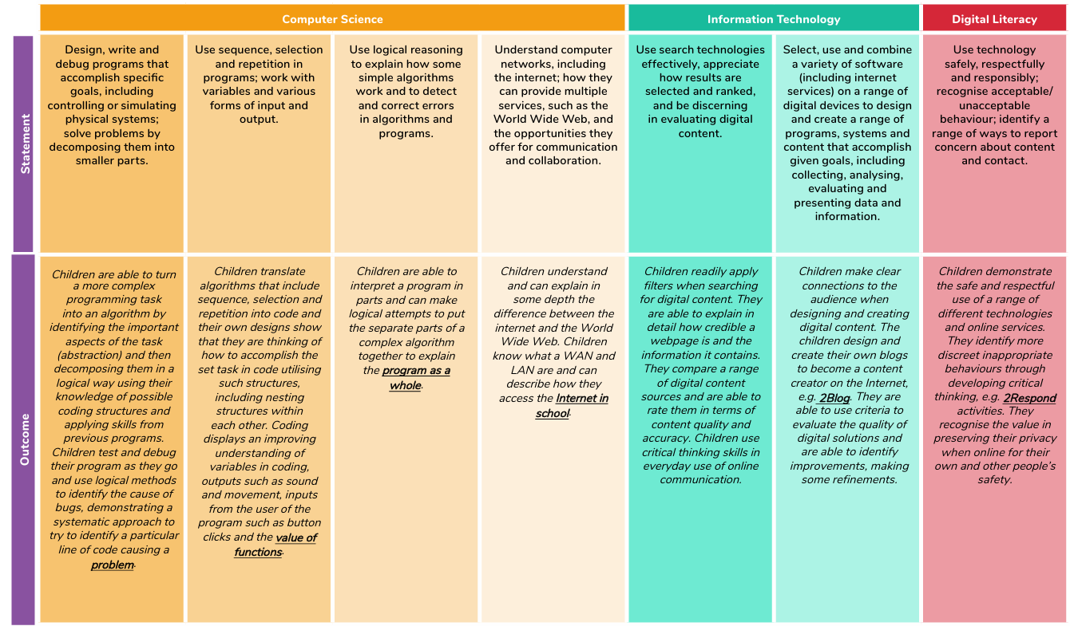
Curriculum Thread Documents – Year 6

Slide 10
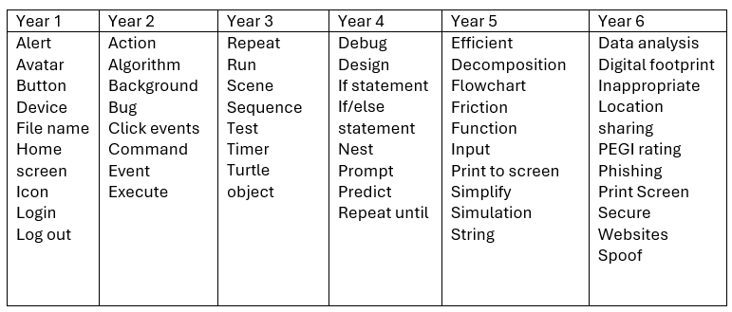
Vocabulary

Slide 11
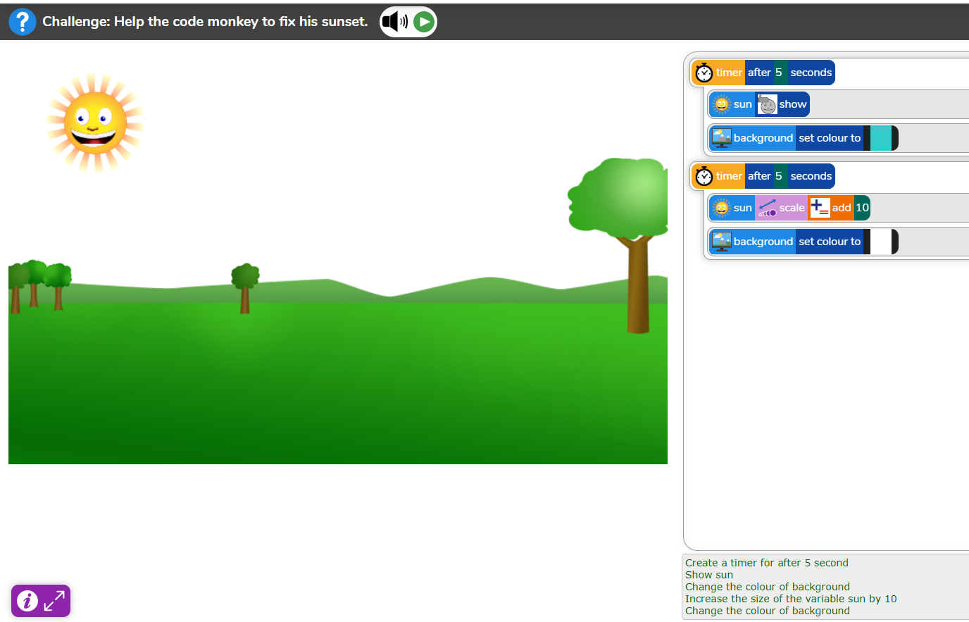
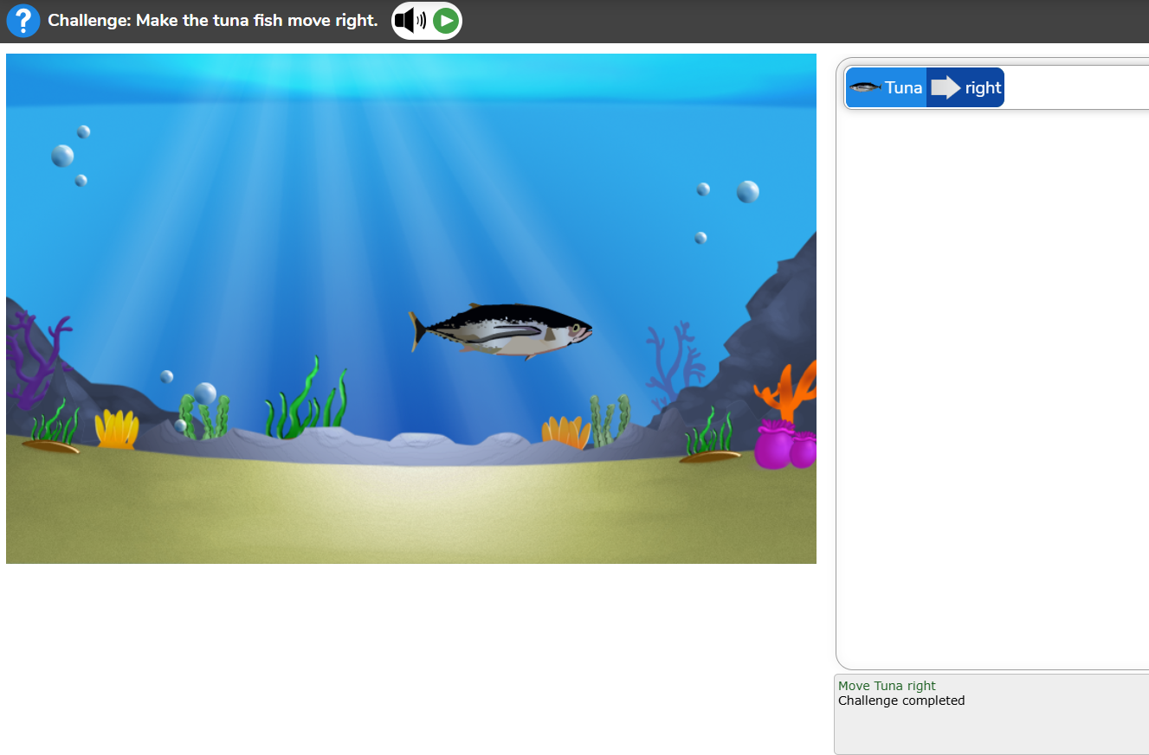
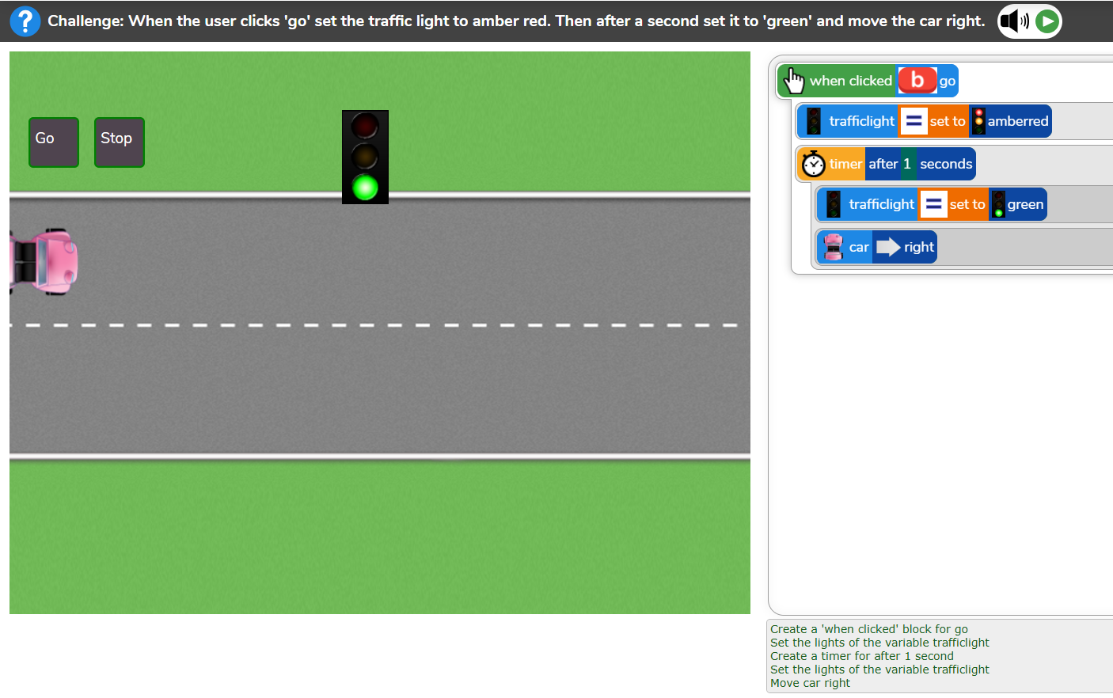
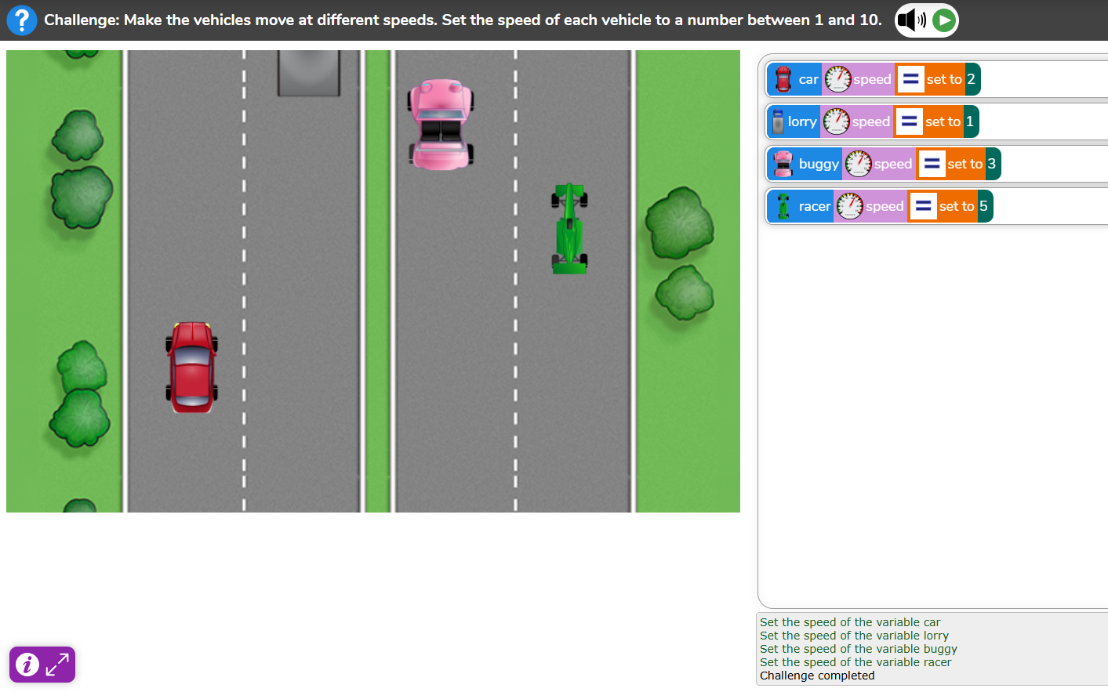
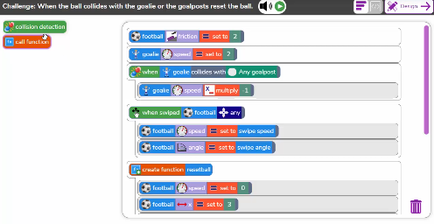
Examples of work

Slide 12
Assessment
At Bowling Green our curriculum is carefully planned to match the learning objectives set out in the National Curriculum for each year group. Therefore, we say that a child is ‘expected’ which means they are achieving their year groups objectives if they are keeping up with the learning detailed in our long term and medium term plans.
Whether a child is deemed to be keeping up with the learning is down to teacher judgement and knowledge of each individual child. To aid this decision each unit has a pre-learning task, this could check a child's understanding of the content up to this point i.e. have they recalled relevant information from previous year groups. This pre-learning task is used to inform planning, specifically thinking about additional support and challenge which may be needed in order to meet the needs of our pupils. Following the completion of a unit there is a post-learning task this checks a child's understanding of the content covered.
Each lesson has a flashback at the beginning of the lesson this is to support with retrieval of 'sticky knowledge' (knowledge we want children to remember).
Children are expected in each subject if they are keeping up with the learning detailed in the LTP/MTP.
Statutory Government assessments are undertaken in Year 1 with the Phonics Screening Check, Year 4 with the multiplication check and Year 6 with SATs.

Slide 13
What can I do as a parent to support my child in this subject?
As technology is everywhere around us, Online safety has never been more important. Reinforcing safe exploration of the internet, whether this be on an iPad or even gaming online.
Discussing setting up a routine, healthy screen time, privacy and being responsible on the internet outside of the platform of Purple Mash.
Collaborate on projects - purple mash can be accessed at home as well as school, many of the activities can be a shared experience to complement learning within the classroom.

Slide 14
Career Ideas
Web developer
Web developers build and maintain websites. They work on both the front-end (user interface) and back-end (server-side) components of websites and web applications.
Game developer
Game developers design and create video games, from concept to final product, for various platforms.
Software developer
Programming languages (like Python, Java, or C++)
problem-solving
Creativity
Attention to detail.
Cybersecurity specialist
Cybersecurity specialists protect networks, systems, and data from cyber threats like hacking and malware.

