Slide 1
Curriculum Marketplace
DT
Mr Callum Morris

Slide 2
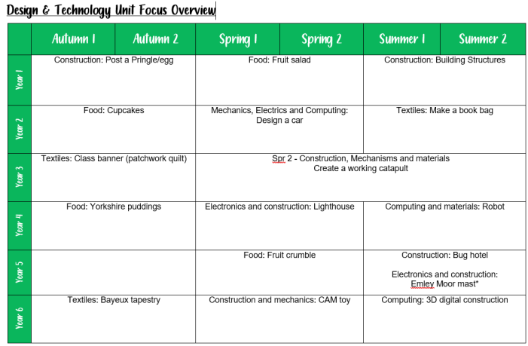
Long Term Planning

Slide 3
DT in EYFS
DT in Foundation Stage is covered in the Expressive Arts and Design, PSE, Physical Development and understanding the word parts of the EYFS curriculum. It is introduced indirectly through activities in continuous provision as well as, adult led activities such as exploring healthy and unhealthy food. Adults model key skills required i.e. Constructing from junk modelling.
Term | Autumn 1 | Autumn 2 | Spring 1 | Spring 2 | Summer 1 | Summer 2
Theme | Who am I? All about me, my feelings, similarities and differences, my family, celebrations, past and present. |  | What am I? Evolution, human bodies, staying healthy, oral hygiene, amazing humans, plants vs humans, minibeasts and life cycles. |  | Where am I? Where I live, the UK, fossils/dinosaurs, the world, pirates, space, and how to care for the planet.
Expressive Arts and Design | Join in with a range of songs/nursery rhymes. Call and response songs. Use a variety of mark-making resources. Begin to select colours for a purpose. Beginning to mix colours. Create a collaborative art piece for display. Join in with role play games and use resources for props. Build models using construction equipment. Self portraits. Portraits of Family members. Junk modelling – houses. Movement dances (copy dance moves). Explore instruments. Firework pictures. Christmas decorations. Divas Christmas songs. Nativity. Listen to and talk about a range of different types of music – how does it make you feel. Stage in the outdoor area to engage in music making and dance. |  | Join in with role play and small world activities – incorporating stories into play. Join in with a range of songs/nursery rhymes. Movement dances. Explore instruments and begin to name some. Symmetrical Butterflies. Mix colours to create new ones. Observational Drawings of plants. Design homes for hibernating animals. Making lanterns for Chinese New Year. Watch and discuss Chinese New Year dragon dances – expressing feelings, likes/dislikes and responses. Drawing around each other. Shadow drawing. Junk Modelling Lifecycles. Printing patterns on Easter Eggs. Easter Cards. Mothers Day Cards. Stage in the outdoor area to engage in music making and dance. |  | Join in with role play and small world activities – incorporating stories into play. Join in with a range of songs/nursery rhymes. Movement Dances. Stage in the outdoor area to engage in music making and dance. Play an instrument to a simple beat. Design and make rockets. Creating outer space pictures. Design and make objects they need in space. Junk Modelling Exploration of other countries that have a contrasting life – dressing up in different costumes. Salt dough fossils. Treasure maps. Fathers Day Cards. Watercolour pictures – paint lines and circles to create an image. Making passports.

Slide 4
DT in EYFS
DT in Foundation Stage is covered in the Expressive Arts and Design, PSE, Physical Development and understanding the word parts of the EYFS curriculum. It is introduced indirectly through activities in continuous provision as well as, adult led activities such as exploring healthy and unhealthy food. Adults model key skills required i.e. Constructing from junk modelling.
Term | Autumn 1 | Autumn 2 | Spring 1 | Spring 2 | Summer 1 | Summer 2
Theme | Who am I? All about me, my feelings, similarities and differences, my family, celebrations, past and present. |  | What am I? Evolution, human bodies, staying healthy, oral hygiene, amazing humans, plants vs humans, minibeasts and life cycles. |  | Where am I? Where I live, the UK, fossils/dinosaurs, the world, pirates, space, and how to care for the planet.
Personal, Social and Emotional Development | Managing Self: New beginnings See themselves as a valuable individual. Build constructive and respectful relationships with staff and peers. Being me in my world. Class rules and behaviours. Dreams and goals. Getting on and falling out How to deal with anger Feelings Self-confidence – to try new activities and experiences. Dealing with problems. Learning about qualities and differences. Celebrating differences. Manage their own needs (wants, hand washing, toileting, dressing). |  | Good to be me. Identify and moderate their own feelings socially and emotionally. Encourage them to think about their own feelings socially and emotionally. Encourage them to think about the feelings of others. What makes a good friend. Healthy me Random acts of kindness Giving children strategies to stay calm in the face of frustration. Talk them through why we take turns, wait politely, tidy up after ourselves and so on. Manage their own needs. Begin to be sensitive towards others needs. |  | Looking after our planet. Looking after others. Friendships – being sensitive towards others needs. Dreams and goals. Show resilience and perseverance in the face of challenge. Discuss why we take turns, wait politely, tidy up after ourselves and so on. Taking part in sport day – winning and losing. Look how far I have come.

Slide 5
DT in EYFS
DT in Foundation Stage is covered in the Expressive Arts and Design, PSE, Physical Development and understanding the word parts of the EYFS curriculum. It is introduced indirectly through activities in continuous provision as well as, adult led activities such as exploring healthy and unhealthy food. Adults model key skills required i.e. Constructing from junk modelling.
Term | Autumn 1 | Autumn 2 | Spring 1 | Spring 2 | Summer 1 | Summer 2
Theme | Who am I? All about me, my feelings, similarities and differences, my family, celebrations, past and present. |  | What am I? Evolution, human bodies, staying healthy, oral hygiene, amazing humans, plants vs humans, minibeasts and life cycles. |  | Where am I? Where I live, the UK, fossils/dinosaurs, the world, pirates, space, and how to care for the planet.
Physical Development | Dough Disco Squiggle whilst you wiggle Threading Cutting Weaving Playdough Funky fingers activities. Pencil grip. Letter formation. Drawing/Mark making. Model pencil grip. Daily movement breaks. Climbing outdoors Develop good personal hygiene. Trikes, two wheeled balance bikes and pedal bikes. Provide regular reminders about handwashing and toileting. |  | Climbing outdoors Dough Disco Threading Cutting – straight line Weaving Playdough Handling tools, objects etc with increasing control. Drawing Fastening zips and buttons independently. Funky fingers activities. Pencil grip. Letter formation. Daily movement breaks. Outdoor physical resources to support balance, agility. Healthy lifestyle. |  | Climbing outdoors Threading Cutting – start to cut along a curved line. Weaving Funky fingers activities – using one hand consistently. Dough Disco Develop pencil grip. Letter formation Start to draw recognisable pictures. Build things with smaller linking blocks such as Lego. Sports Day.

Slide 6
DT in EYFS
DT in Foundation Stage is covered in the Expressive Arts and Design, PSE, Physical Development and understanding the word parts of the EYFS curriculum. It is introduced indirectly through activities in continuous provision as well as, adult led activities such as exploring healthy and unhealthy food. Adults model key skills required i.e. Constructing from junk modelling.
Term | Autumn 1 | Autumn 2 | Spring 1 | Spring 2 | Summer 1 | Summer 2
Theme | Who am I? All about me, my feelings, similarities and differences, my family, celebrations, past and present. |  | What am I? Evolution, human bodies, staying healthy, oral hygiene, amazing humans, plants vs humans, minibeasts and life cycles. |  | Where am I? Where I live, the UK, fossils/dinosaurs, the world, pirates, space, and how to care for the planet.
Understanding the World | Navigating key locations in school e.g. hall. Where do we live? Explore via google maps. Identifying their family – commenting on photos of their family and naming who they can see and of what relation they are to them. Talk about what they do with their family and places they have been with their family. Introduce children to a range of fictional characters and creatures from stories to differentiate these characters from real people in their lives. Draw similarities and differences between other families. Life in the past – When I was a child book. Listen to fictional stories about families and start to tell the difference between real and fiction. SEASON – Autumn – explore the natural world looking for seasonal changes. Describe what they feel, see and hear whilst outside. Understand the effect of changing seasons on the natural world around them. Celebrations – birthdays, Christmas, Halloween, bonfire night, remembrance. Introduce children to places of worship and places of local importance to the community. Talk about experiences of past birthdays. Talk about what they have done with their families during Christmas’ past – using photographs. Show photos of how Christmas is celebrated all over the world – similarities and differences. Use the Jolly Postman to draw information from a map. |  | SEASON – Winter – explore the natural world looking for seasonal changes. Describe what they feel, see and hear whilst outside. Understand the effect of changing seasons on the natural world around them. Celebrations – epiphany, Chinese new year, valentines day, shivaratri, pancake day, Holi, Ramadan mothers day, easter. Listen to children describing and commenting on things they have seen whilst outside, including plants and animals. After close observation, draw pictures of the natural world, including animals and plants Care and concern for living things. Planting Sunflowers, beans and other flowers. Observing minibeasts. Looking after the caterpillars. Draw children’s attention to the immediate environment, introducing and modelling new vocabulary where appropriate. SEASON – Spring – explore the natural world looking for seasonal changes. Describe what they feel, see and hear whilst outside. Understand the effect of changing seasons on the natural world around them. |  | SEASON – Summer – explore the natural world looking for seasonal changes. Describe what they feel, see and hear whilst outside. Understand the effect of changing seasons on the natural world around them. Can children talk about their homes – where is it? and what there is to do near their homes? Look out for children drawing/painting or constructing their homes. Encourage them to comment on what their home is like. Show photos of the children’s homes and encourage them to draw comparisons. Environments – Physical and Human Features of local environment Maps of local area Comparing places on Google Earth – how are they similar/different? Introduce the children to NASA and America. Introduce children to significant figures who have been to space and begin to understand that these events happened before they were born. Celebrations – fathers day, pride month, eid, summer solstice. Life in the past - To understand where dinosaurs are now and begin to understand that they were alive a very long time ago. Learn about what a paleontologist is and how they explore really old artefacts. Introduce Mary Anning. Share non-fiction texts that offer an insight into contrasting environments. Create treasure hunts linking to pirates to find places/objects within the learning environment. Use bee-bots on simple maps. Encourage the children to use navigational language. Recognise the difference between life in this country and life in different countries. Introduce the children to recycling and how it can take care of our world. Look at what rubbish can do to our environment and animals. Create opportunities to discuss how we care for the natural world around us.

Slide 7
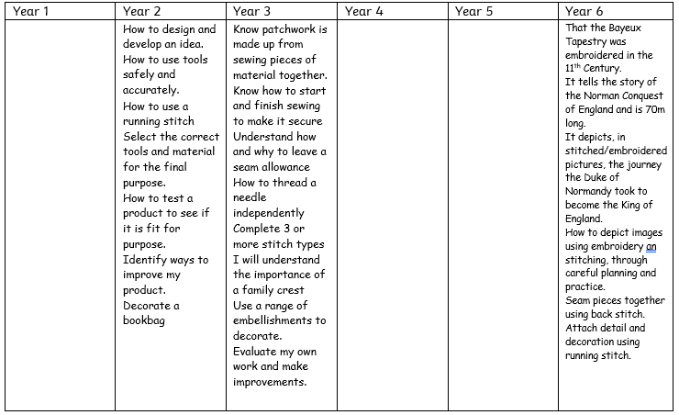
Curriculum Thread Documents - Textiles

Slide 8
Key Vocabulary

Slide 9
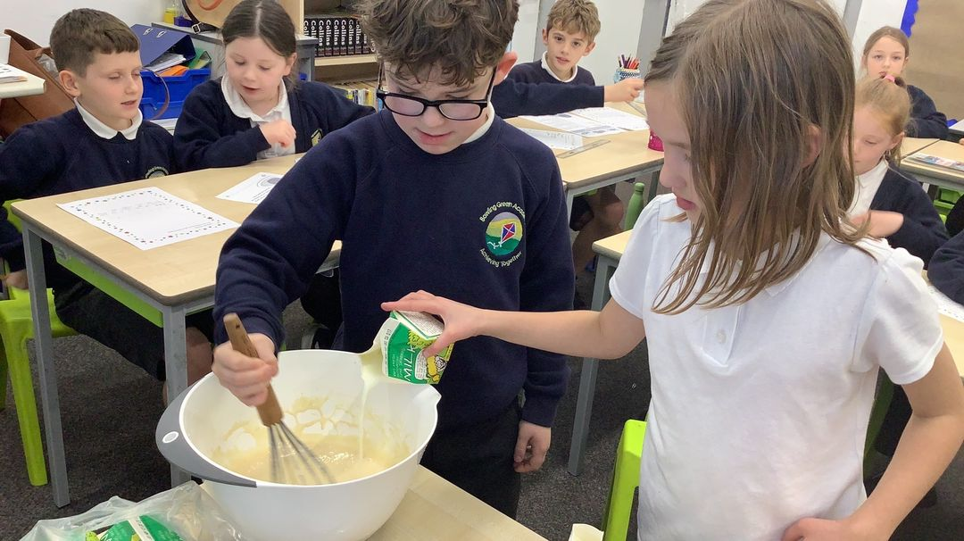
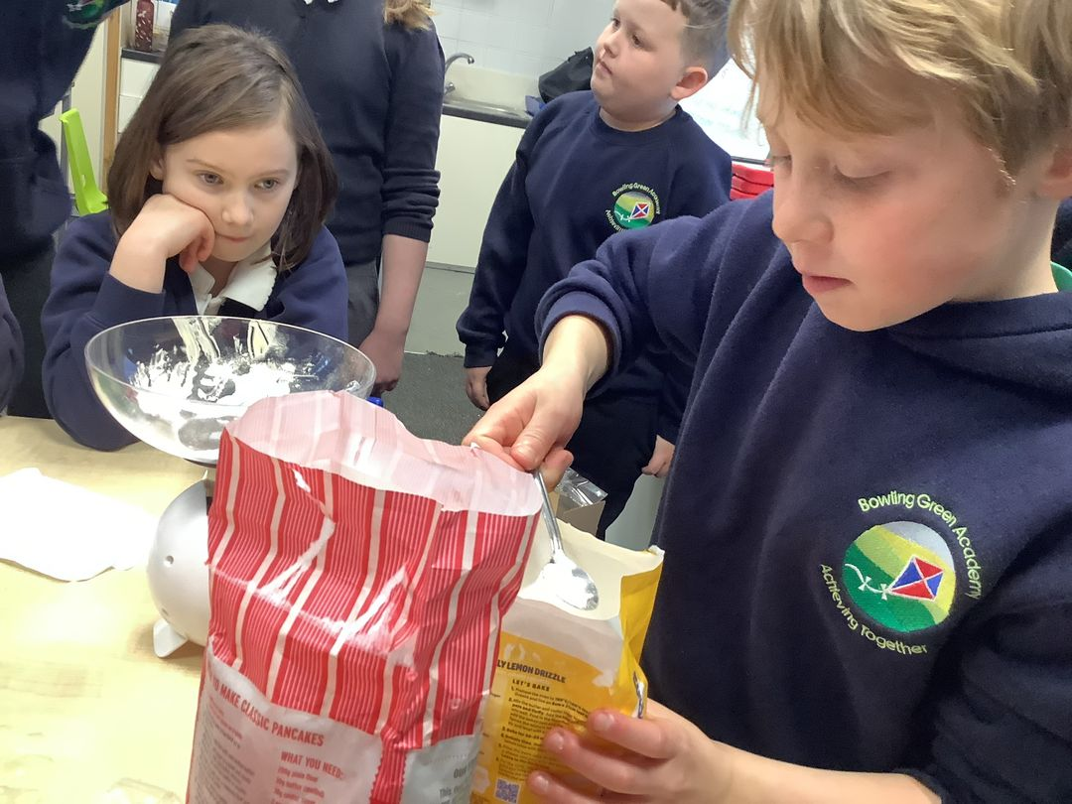
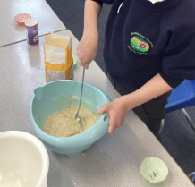
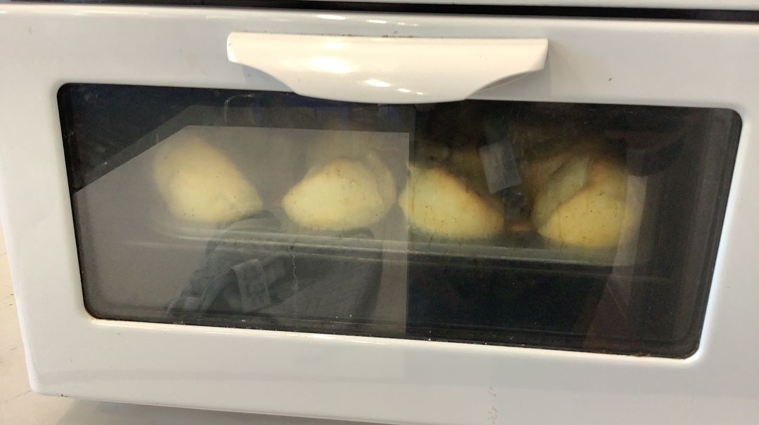
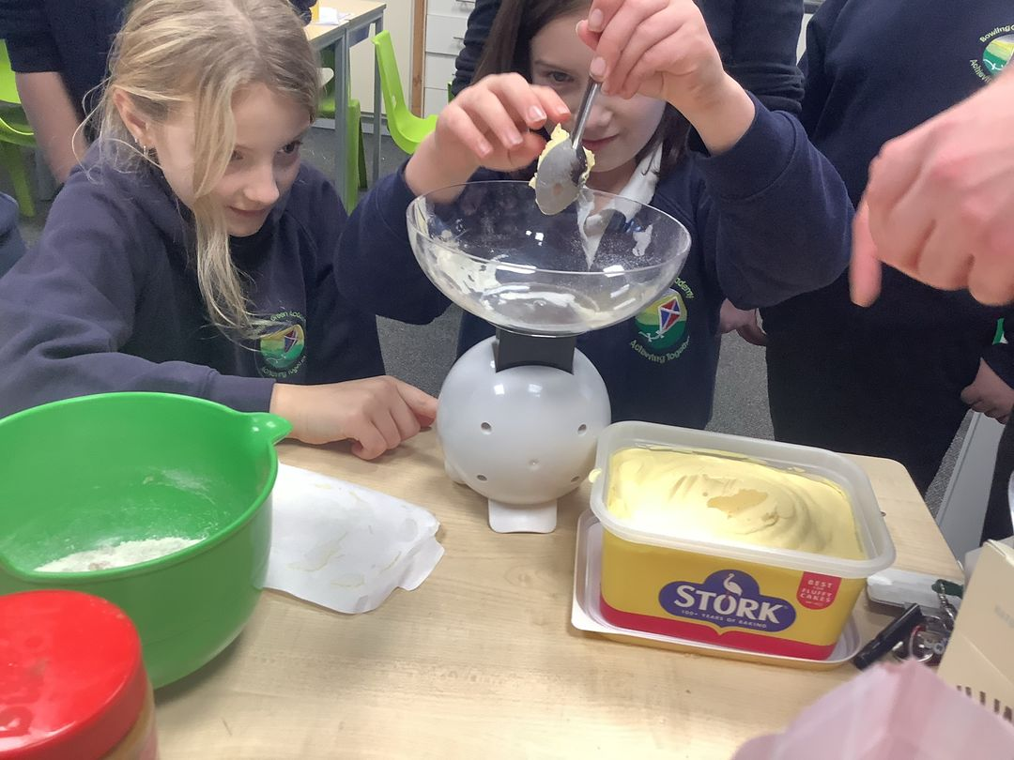
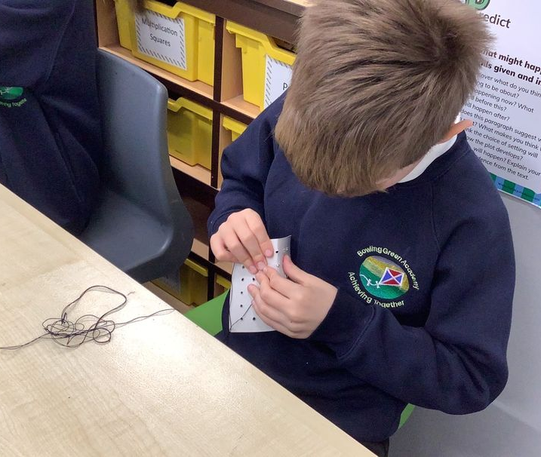
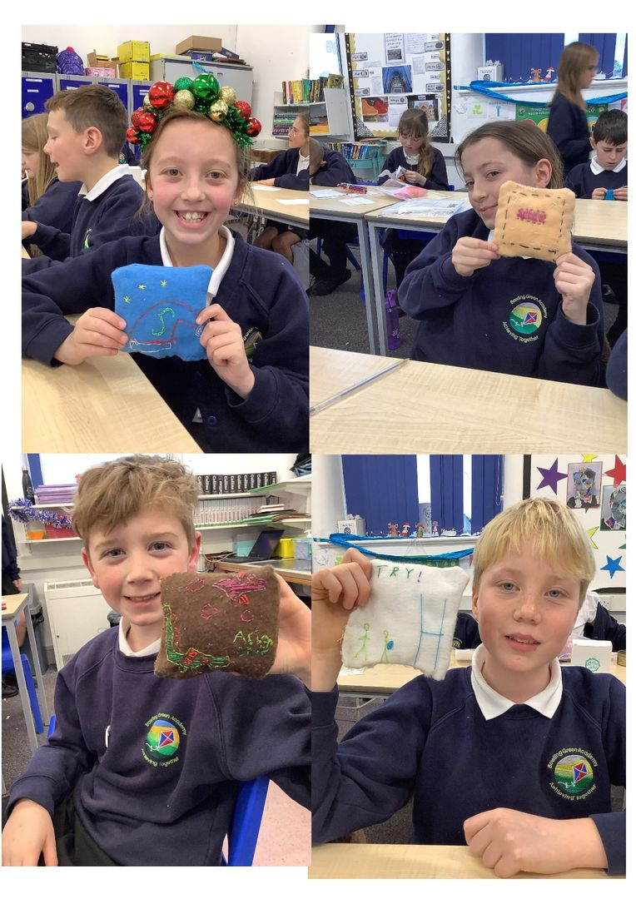
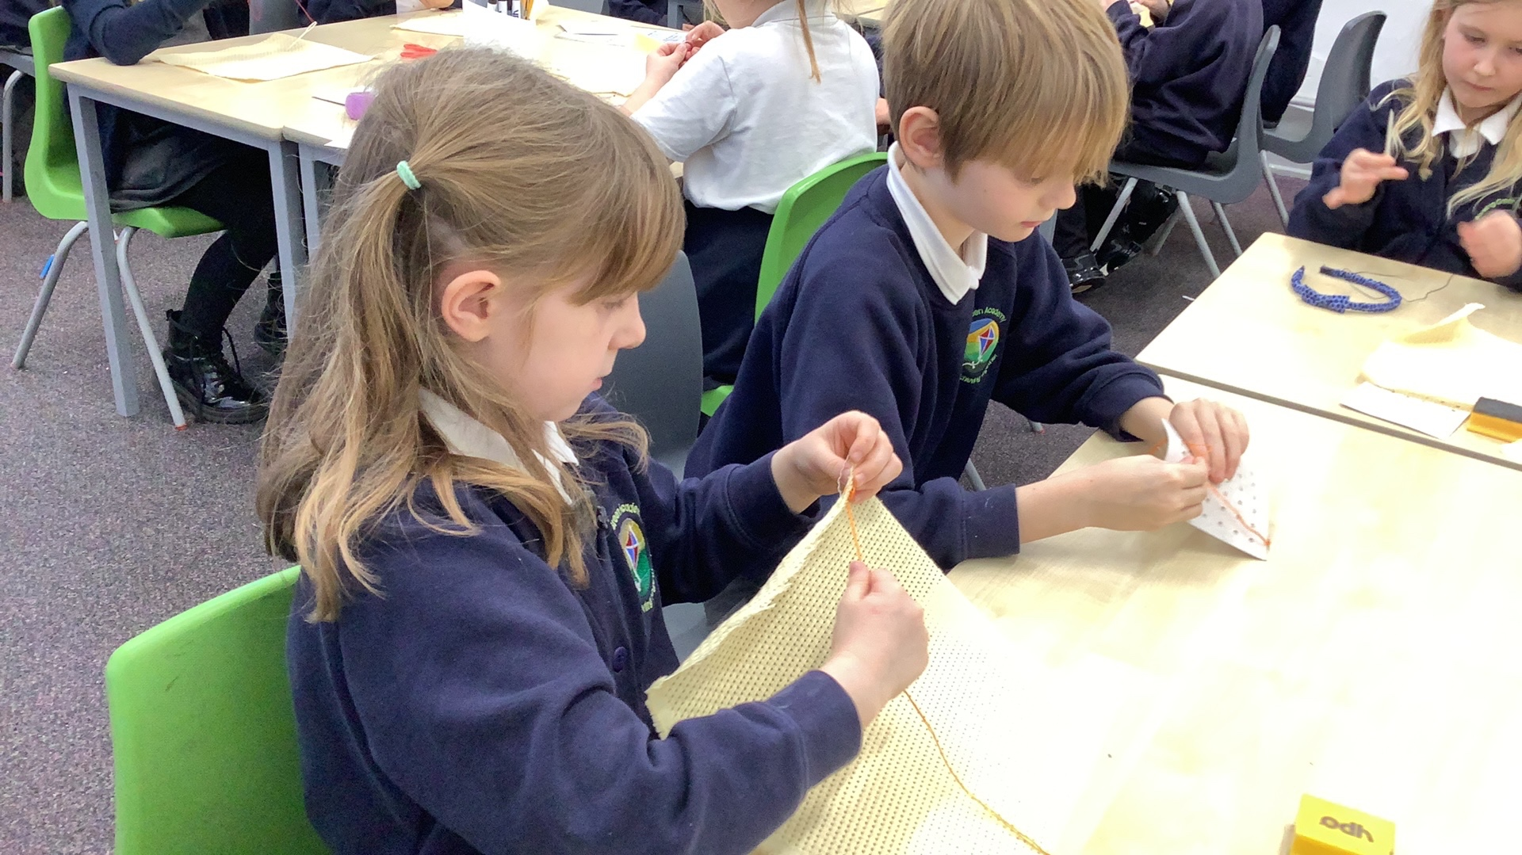
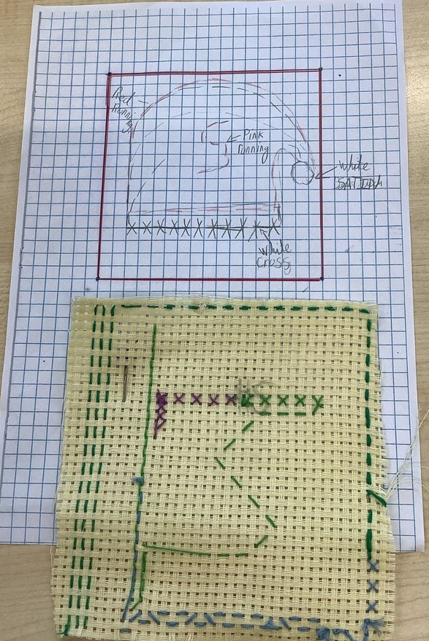
Examples of work
Y4
Y2
Y5
Y3
Y6

Slide 10
Assessment
At Bowling Green our curriculum is carefully planned to match the learning objectives set out in the National Curriculum for each year group. Therefore, we say that a child is ‘expected’ which means they are achieving their year groups objectives if they are keeping up with the learning detailed in our long term and medium term plans.
Whether a child is deemed to be keeping up with the learning is down to teacher judgement and knowledge of each individual child. To aid this decision each unit has a pre-learning task, this could check a child's understanding of the content up to this point i.e. have they recalled relevant information from previous year groups. This pre-learning task is used to inform planning, specifically thinking about additional support and challenge which may be needed in order to meet the needs of our pupils. Following the completion of a unit there is a post-learning task this checks a child's understanding of the content covered.
Each lesson has a flashback at the beginning of the lesson this is to support with retrieval of 'sticky knowledge' (knowledge we want children to remember).
Children are expected in each subject if they are keeping up with the learning detailed in the LTP/MTP.
Statutory Government assessments are undertaken in Year 1 with the Phonics Screening Check, Year 4 with the multiplication check and Year 6 with SATs.

Slide 11
What can I do as a parent to support my child in this subject?
Local Maker Spaces & Workshops: Look for local maker spaces, community centres, or workshops where families can participate in hands-on projects. Leeds, Sheffield, and York often host makers’ fairs or DIY workshops. Check local council websites or community boards for events related to crafting, woodworking, or digital design.
Hands-On Projects:
Encourage your child to experiment with DT-related activities at home. Try simple cooking recipes, explore basic woodworking or model building, or experiment with textile crafts like sewing or knitting. These activities echo what they learn at school and help develop practical skills.
Museums and Exhibitions:
Visit local museums or galleries that feature design and technology exhibits. For example, the Yorkshire Sculpture Park or local art galleries often showcase innovative design works, sparking creativity and discussion.
Local Libraries and Community Groups:
Many libraries host events or clubs that focus on crafts, DIY, or even coding and robotics. These can be a great way to connect with other families interested in DT and find new project ideas.
Online Resources and Tutorials: There are many online tutorials and project ideas that can supplement your child’s learning. Websites and platforms like YouTube, Pinterest, and maker blogs provide a wealth of ideas and step-by-step guides that you can try together.

Slide 12
Career Ideas
Manufacturing engineer
Designing and improving machines or production processes.
Chef
Innovating in the culinary arts, combining creativity with technical skills in cooking and presentation.
Architect
Designing buildings or managing construction projects.
Fashion designer
Creating clothing, accessories, or innovative textile designs.
Product designer
Creating everyday products, from furniture to gadgets.

