Slide 1
Curriculum Marketplace
HISTORY
Mrs Jane Mellor

Slide 2
EYFS and Key Stage 1 - Long Term Planning

Slide 3
Key Stage 2 – Long Term Planning

Slide 4
Curriculum Thread Documents Exploring the theme of Continuity and Change

Slide 5
Vocabulary

Slide 6
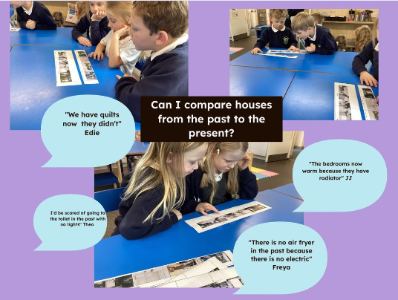
Examples of work
Year 1 finding changes to houses in the past and houses today.

Slide 7
Assessment

Slide 8
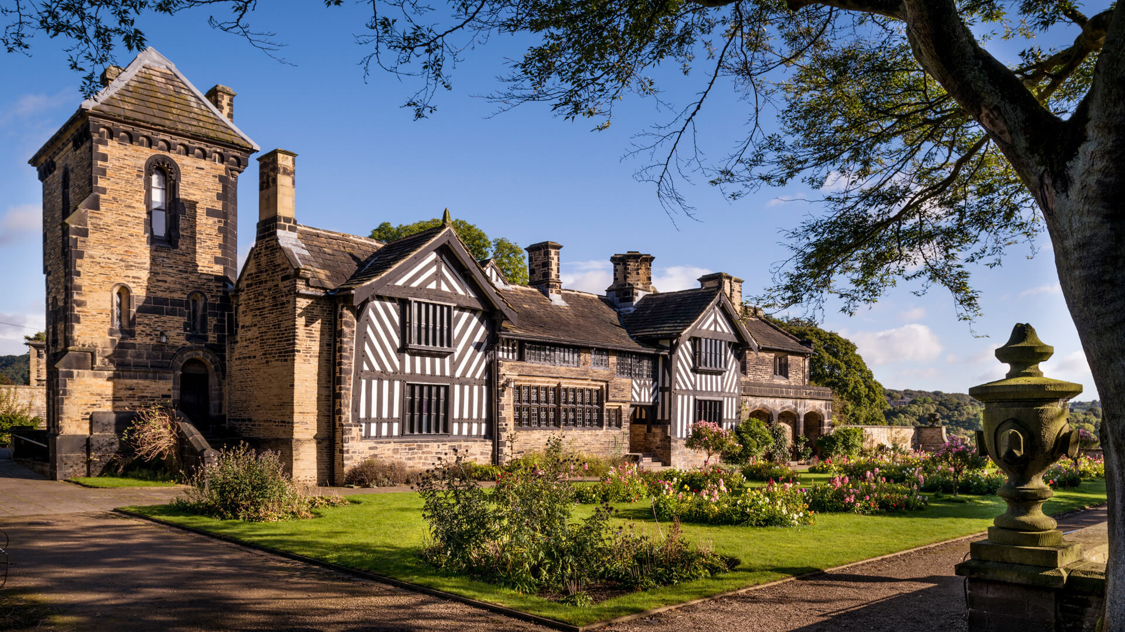
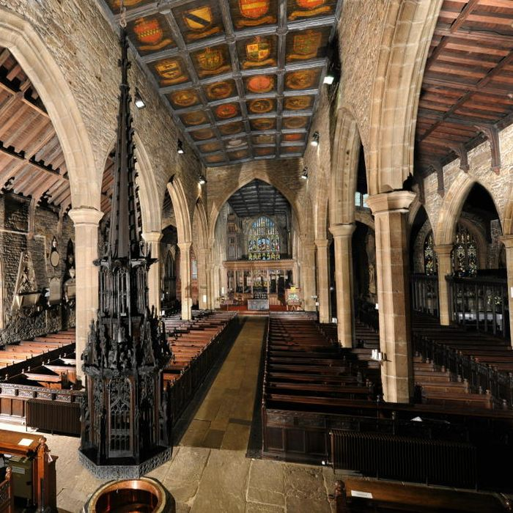
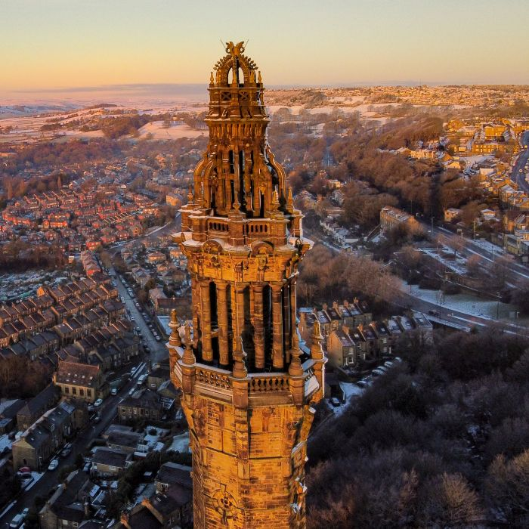
What can I do as a parent to support my child in this subject?
Calderdale Industrial Museum
Local Visits
Shibden Hall
Halifax Minster
Bankfield Museum
Wainhouse Tower
The Piece Hall

Slide 9
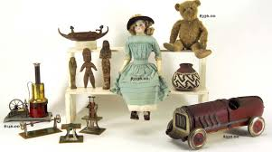
What can I do as a parent to support my child in this subject?
Talk with your child about your childhood.
Read books set in the past
Look at artifacts from the past and talk about continuity and change

Slide 10
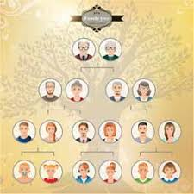
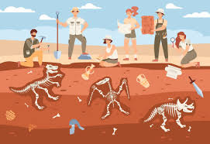
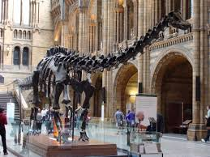
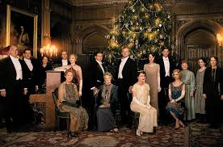
Career Ideas
Genealogist – someone who studies family history.
Politician
Archaeologist
Working in a museum
TV and Film History Researcher
History Teacher

