Slide 1
Curriculum Marketplace
Music
Mrs Jen Ellis supported by Calderdale Music

Slide 2
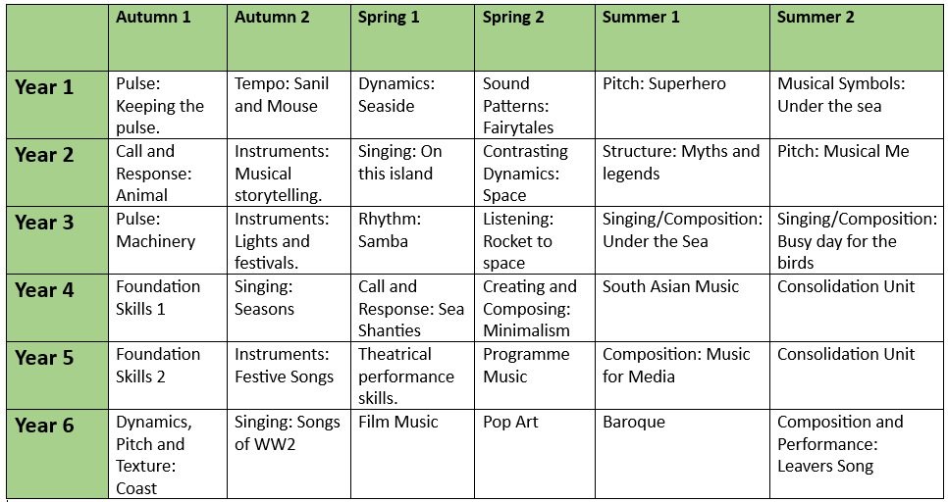
Long Term Planning

Slide 3
Music in EYFS
Music in Foundation Stage is covered in the Expressive Arts and Design part of the EYFS curriculum. It is introduced indirectly through activities in continuous provision as well as, adult led activities such as singing songs and discussing how music makes you feel. Adults model key skills required i.e. playing instruments in the correct way.
Term | Autumn 1 | Autumn 2 | Spring 1 | Spring 2 | Summer 1 | Summer 2
Theme | Who am I? All about me, my feelings, similarities and differences, my family, celebrations, past and present. |  | What am I? Evolution, human bodies, staying healthy, oral hygiene, amazing humans, plants vs humans, minibeasts and life cycles. |  | Where am I? Where I live, the UK, fossils/dinosaurs, the world, pirates, space, and how to care for the planet.
Expressive Arts and Design | Join in with a range of songs/nursery rhymes. Call and response songs. Use a variety of mark-making resources. Begin to select colours for a purpose. Beginning to mix colours. Create a collaborative art piece for display. Join in with role play games and use resources for props. Build models using construction equipment. Self portraits. Portraits of Family members. Junk modelling – houses. Movement dances (copy dance moves). Explore instruments. Firework pictures. Christmas decorations. Divas Christmas songs. Nativity. Listen to and talk about a range of different types of music – how does it make you feel. Stage in the outdoor area to engage in music making and dance. |  | Join in with role play and small world activities – incorporating stories into play. Join in with a range of songs/nursery rhymes. Movement dances. Explore instruments and begin to name some. Symmetrical Butterflies. Mix colours to create new ones. Observational Drawings of plants. Design homes for hibernating animals. Making lanterns for Chinese New Year. Watch and discuss Chinese New Year dragon dances – expressing feelings, likes/dislikes and responses. Drawing around each other. Shadow drawing. Junk Modelling Lifecycles. Printing patterns on Easter Eggs. Easter Cards. Mothers Day Cards. Stage in the outdoor area to engage in music making and dance. |  | Join in with role play and small world activities – incorporating stories into play. Join in with a range of songs/nursery rhymes. Movement Dances. Stage in the outdoor area to engage in music making and dance. Play an instrument to a simple beat. Design and make rockets. Creating outer space pictures. Design and make objects they need in space. Junk Modelling Exploration of other countries that have a contrasting life – dressing up in different costumes. Salt dough fossils. Treasure maps. Fathers Day Cards. Watercolour pictures – paint lines and circles to create an image. Making passports.

Slide 4
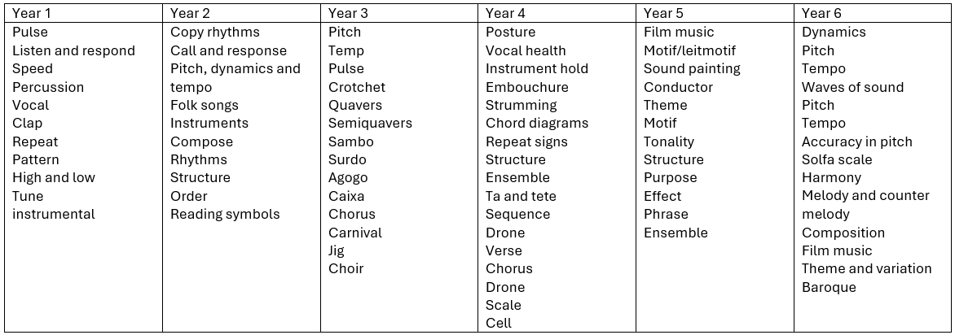
Vocabulary

Slide 5
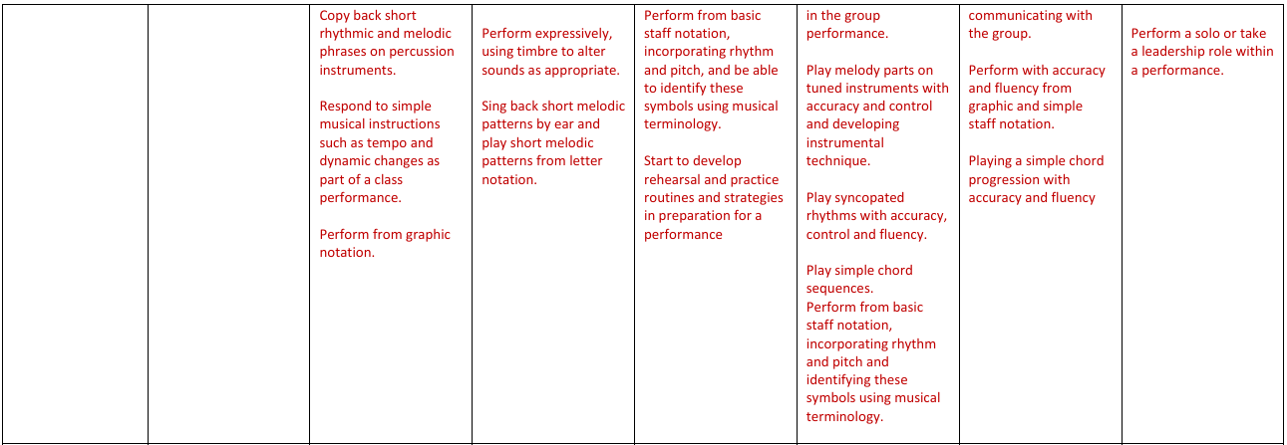
Curriculum Thread Documents

Slide 6
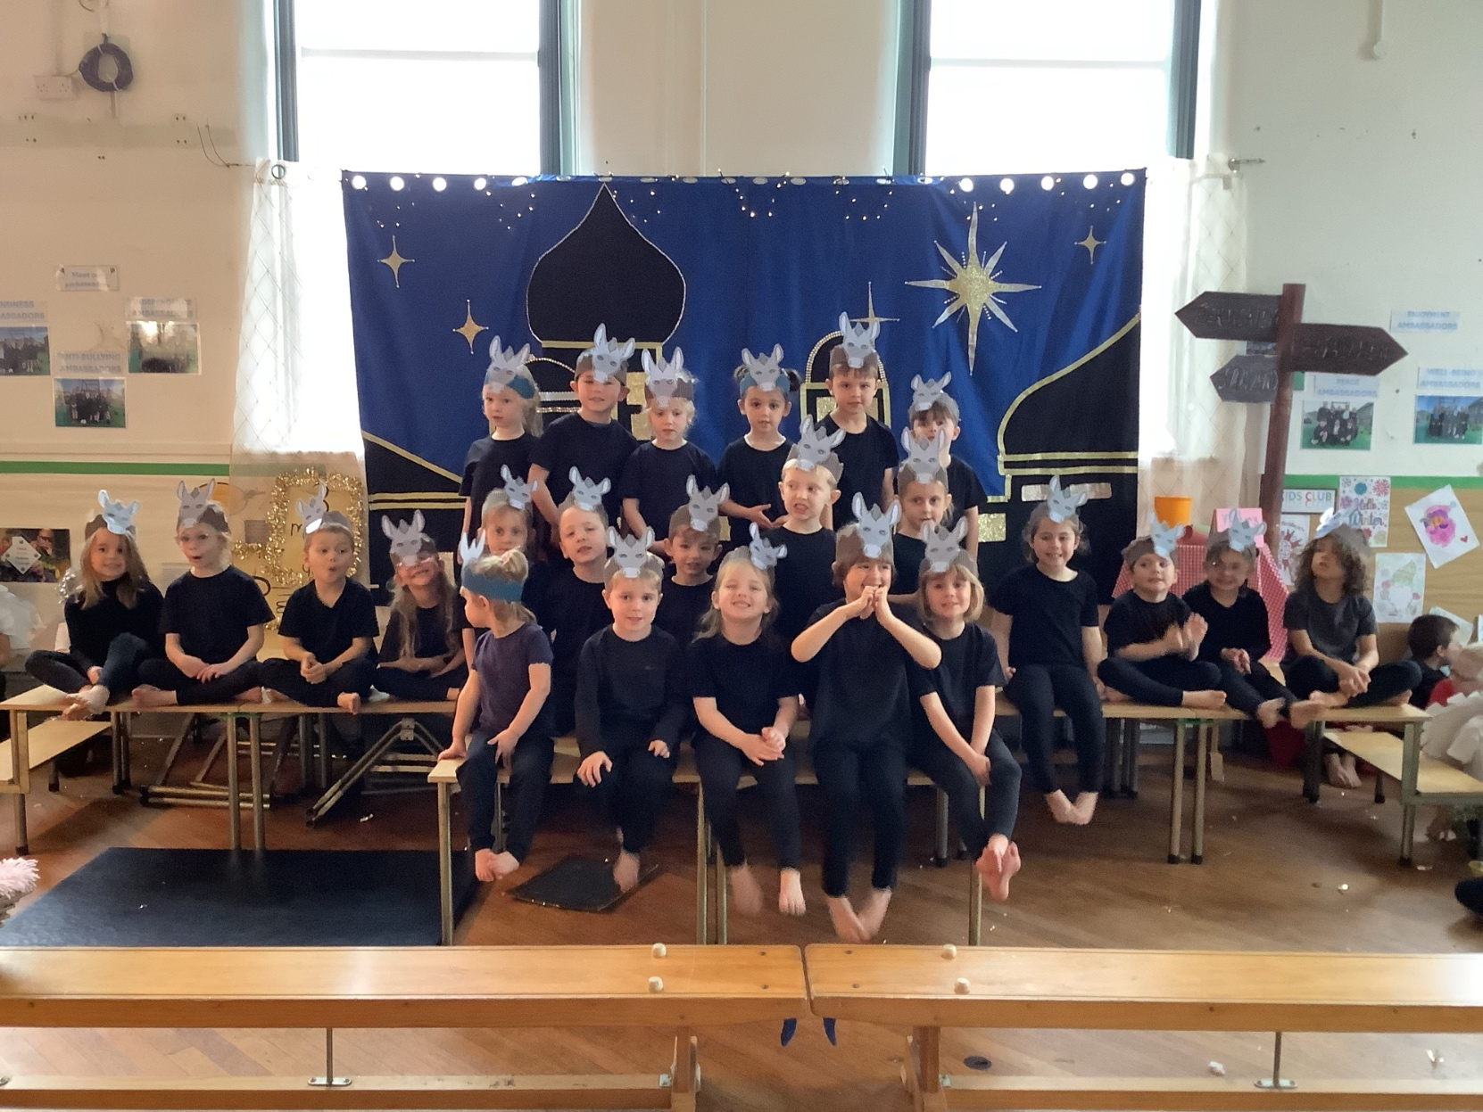
Examples of work: Reception
2024 Nativity

Slide 7
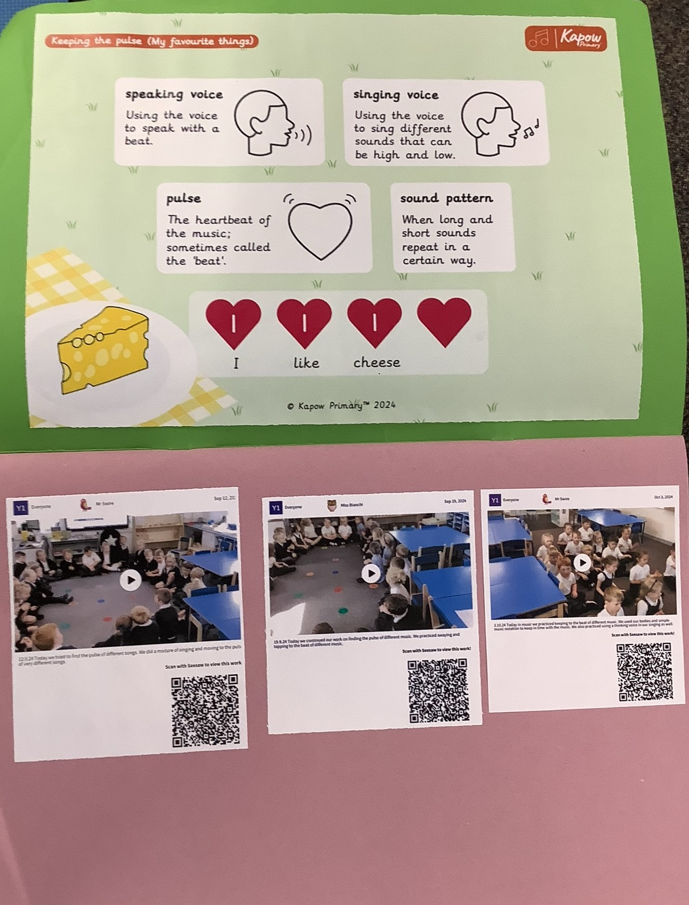
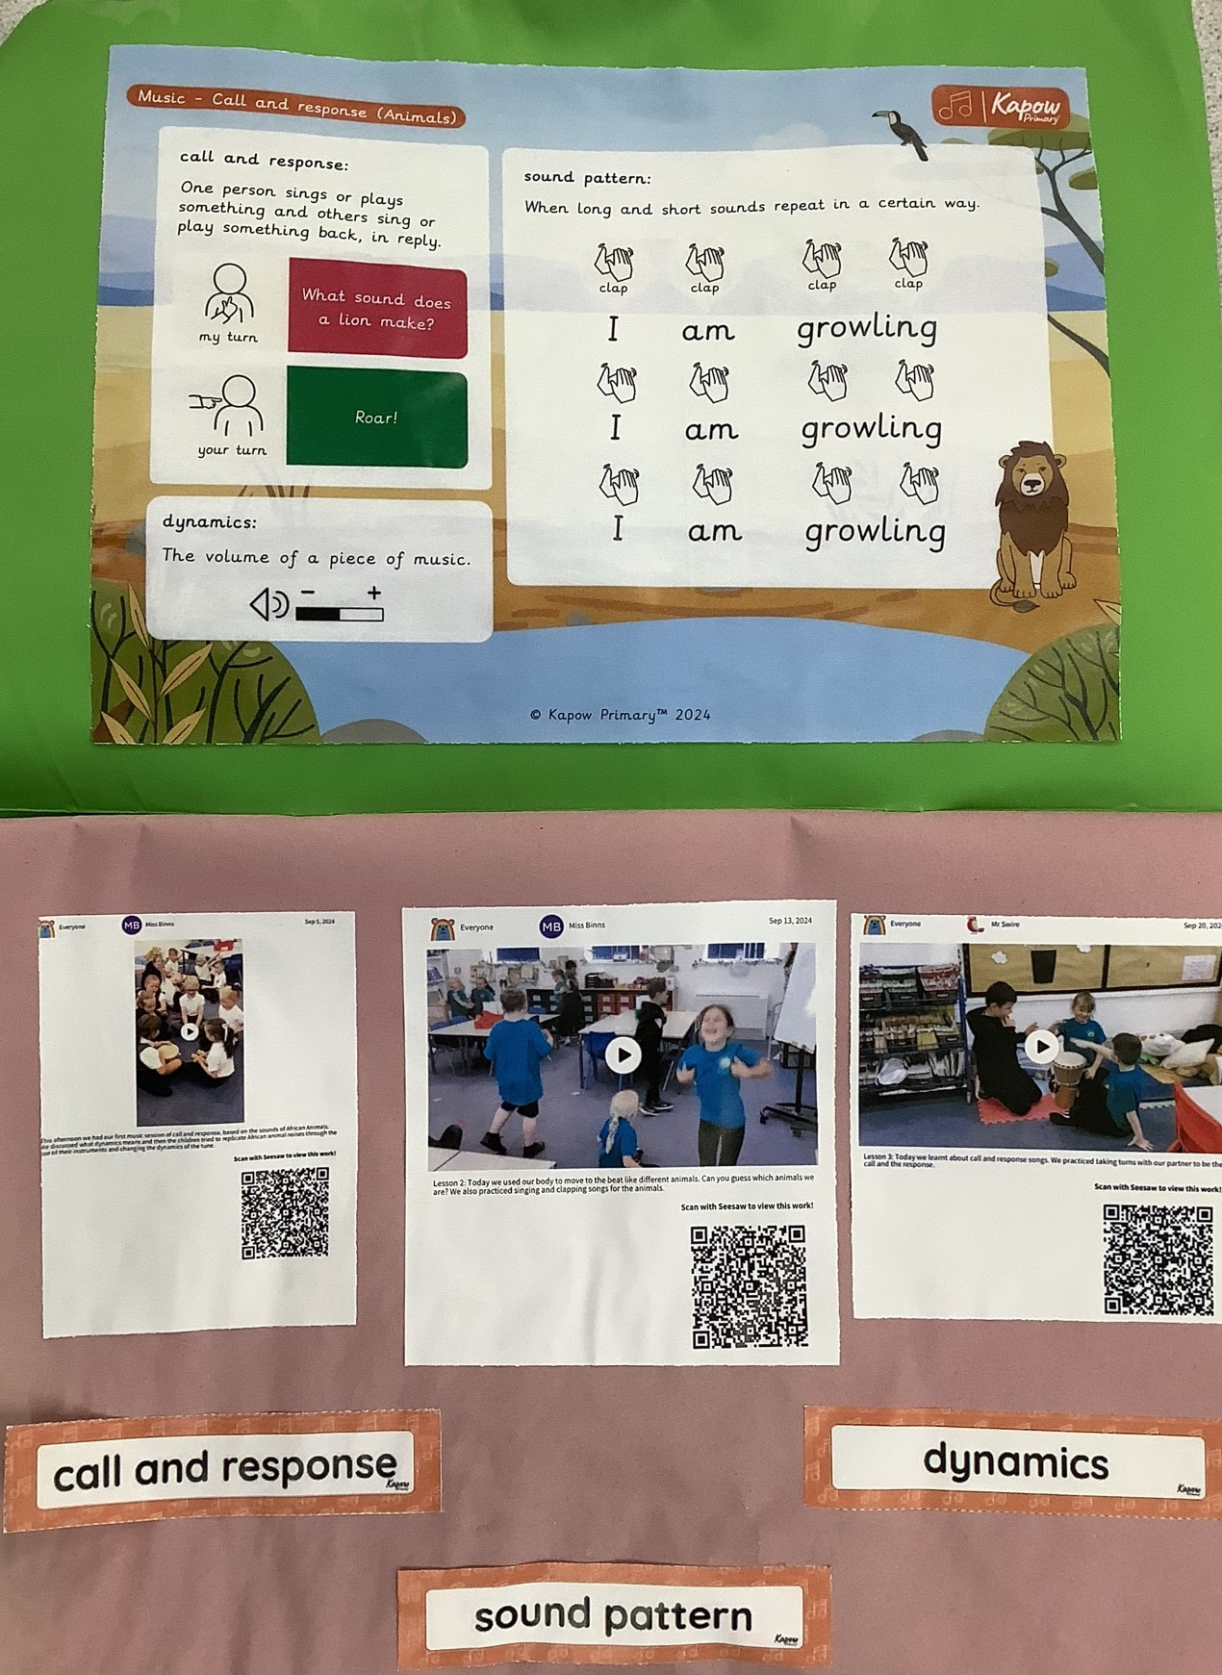
Examples of work

Slide 8
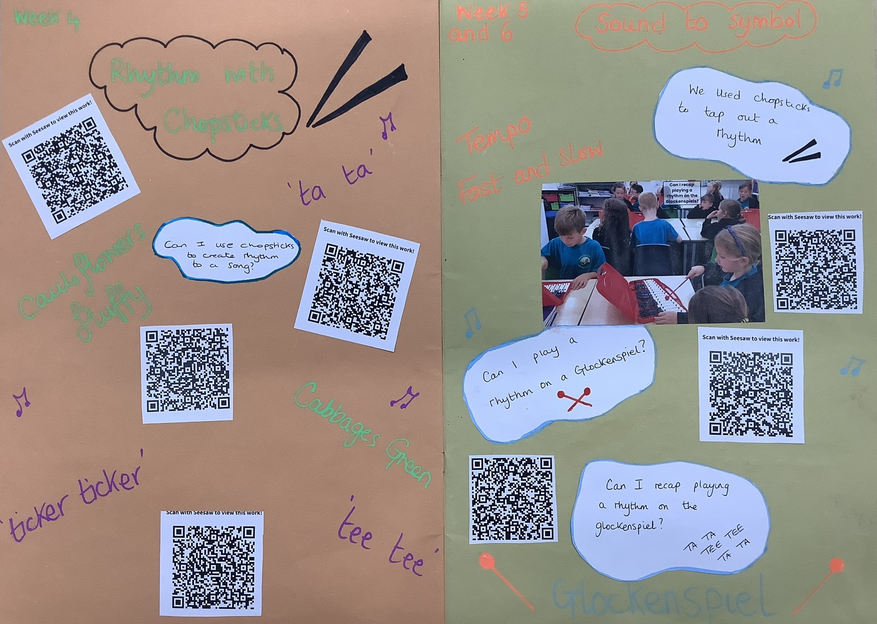
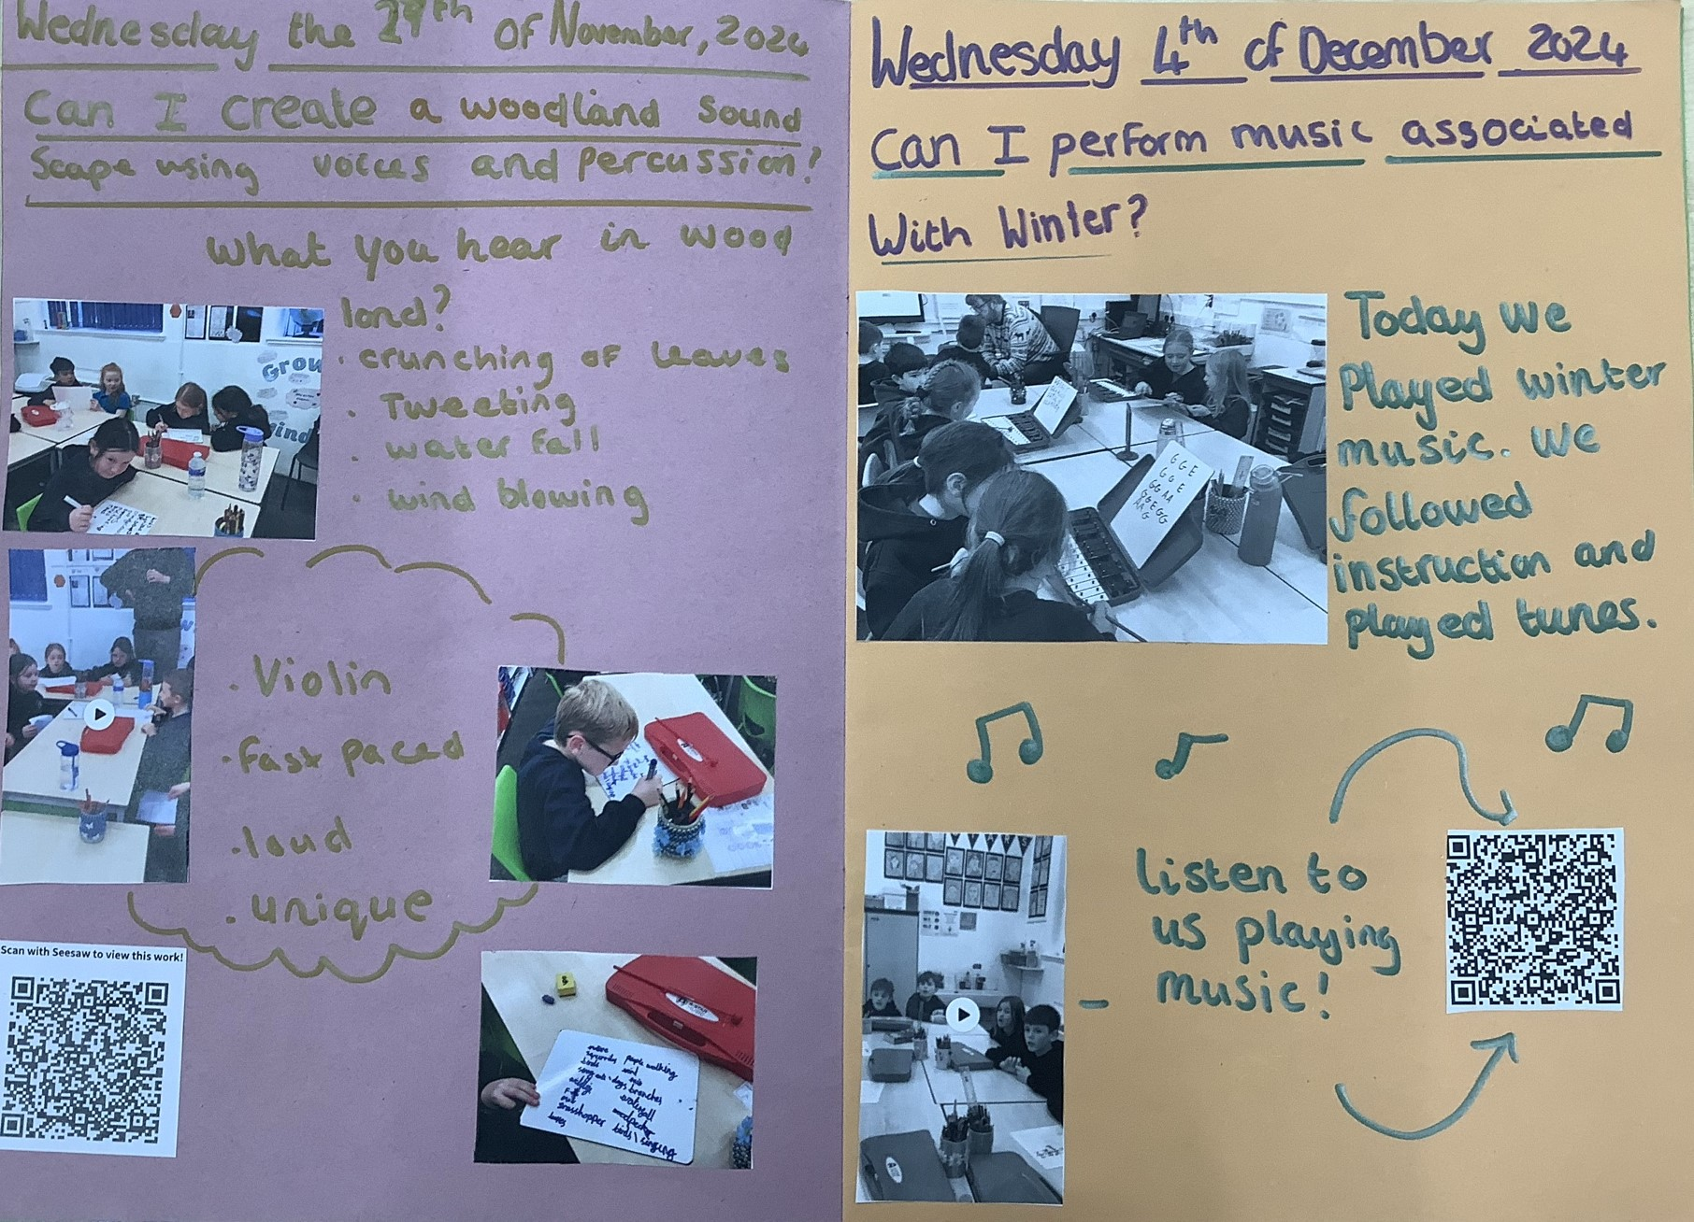
Examples of work

Slide 9
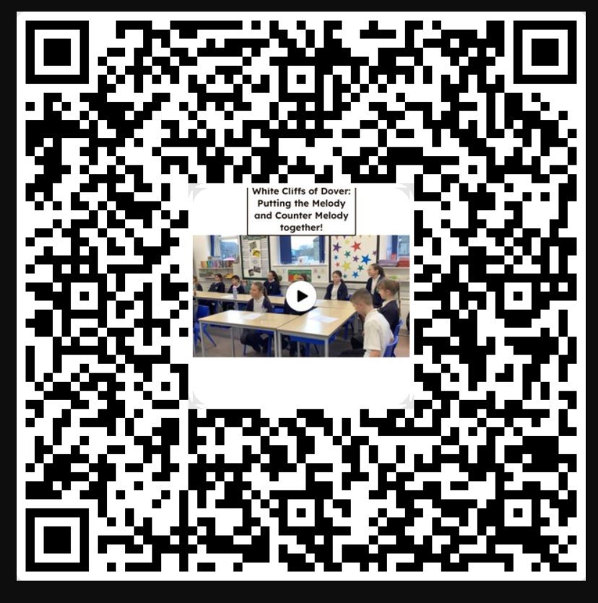
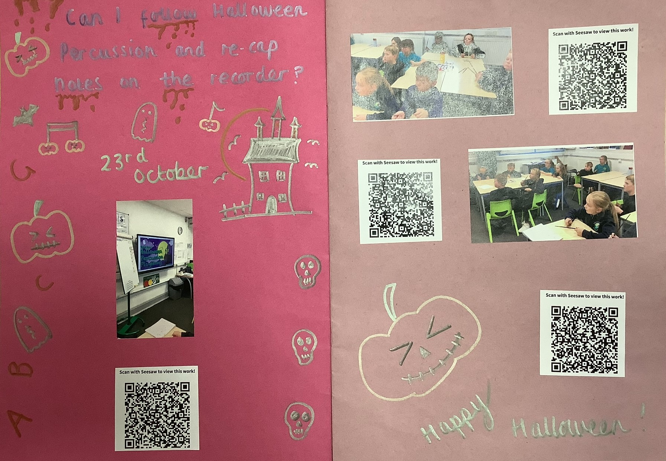
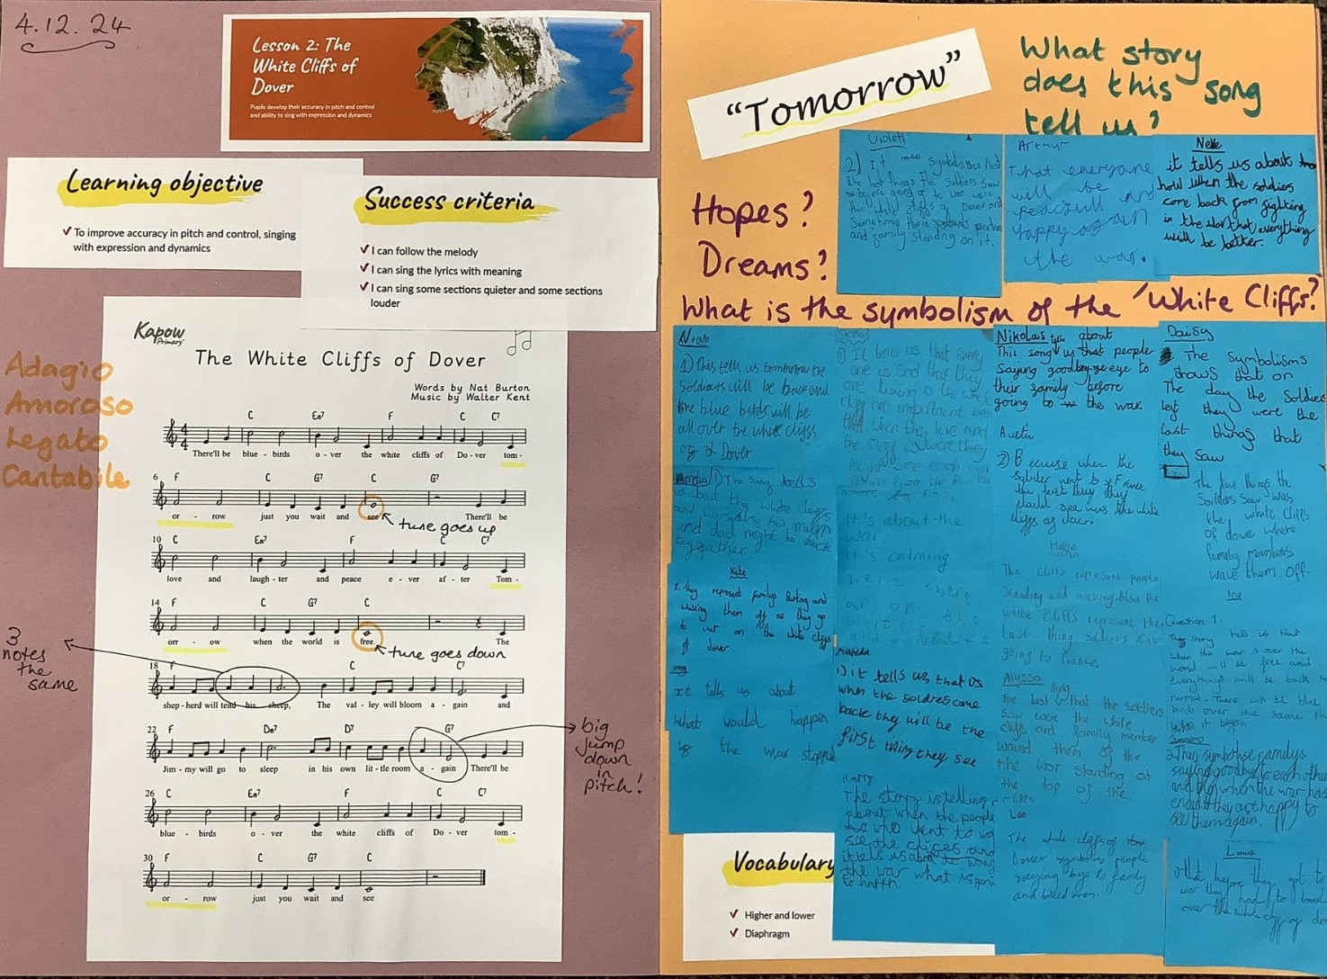
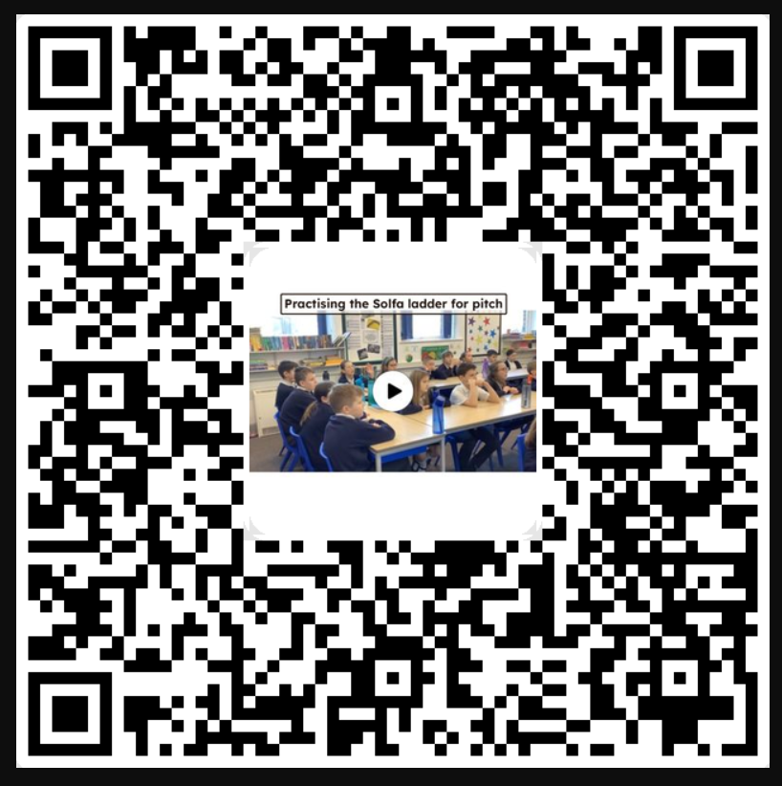
Examples of work

Slide 10
What can I do as a parent to support my child in this subject?
Take your child to musical events: concerts, carol services, pantomimes, street festivals and other performances.
Look out for music programmes on the TV.
Share your favourite music with your child. Talk about the style and why you like it!
Enjoy singing songs with your child.
If your children shows an interest in music, why not invest in some lessons for them. They can learn at school in a 20 minute one-to-one lesson with our Calderdale music teacher, Mitchell.
Look out on seesaw for what’s going on in school and in class!
Ask your child what music they have learnt this week in school. Test them to see if they can remember the details!

Slide 11
Career Ideas
Music Producer
Music Therapist
Musician
Private music teacher
Secondary school music teacher
Sound Designer
Sound Engineer
Sound Technician

