Slide 1
Curriculum Marketplace
PE
Mr Kouros Ghaznavi

Slide 2
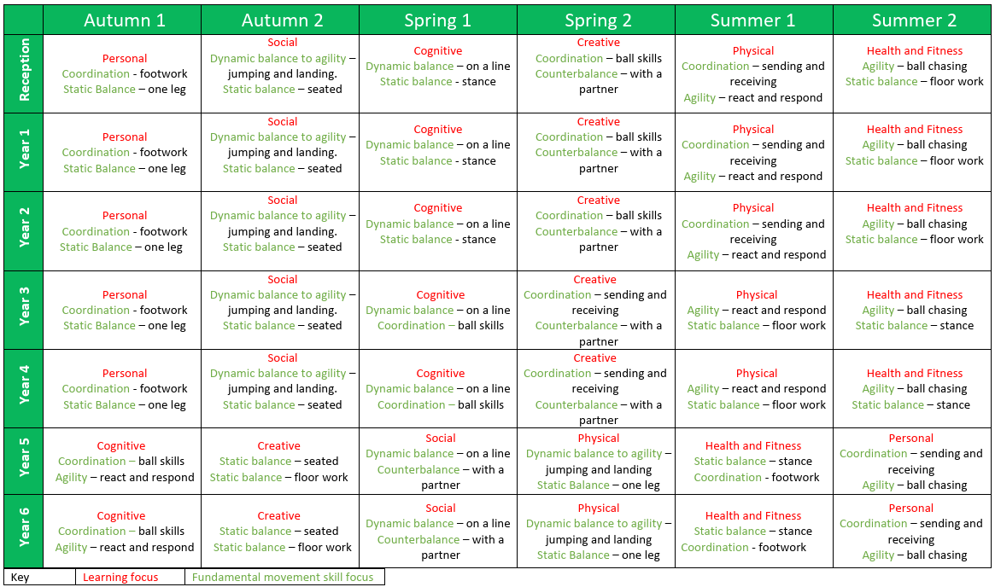
Long Term Planning

Slide 3
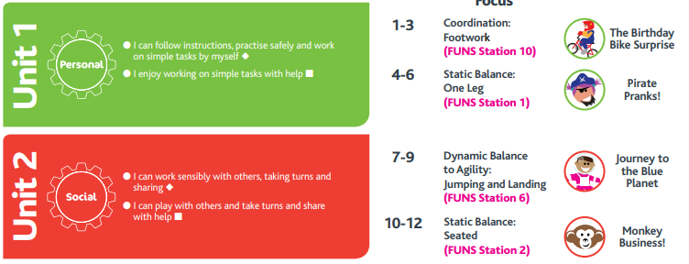
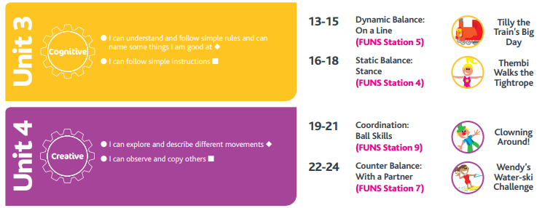
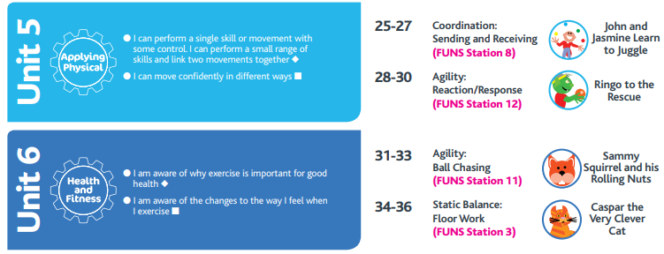
PE in EYFS
PE in Foundation Stage is directly taught by an adult using the Real PE scheme. It is also covered in the Physical Development part of the EYFS curriculum. It is directly taught through dough disco and handwriting sessions. It is indirectly taught through continuous provision i.e. finger gym activities. Adults model the key skills required.
Term | Autumn 1 | Autumn 2 | Spring 1 | Spring 2 | Summer 1 | Summer 2
Theme | Who am I? All about me, my feelings, similarities and differences, my family, celebrations, past and present. |  | What am I? Evolution, human bodies, staying healthy, oral hygiene, amazing humans, plants vs humans, minibeasts and life cycles. |  | Where am I? Where I live, the UK, fossils/dinosaurs, the world, pirates, space, and how to care for the planet.
Physical Development – Real PE (Gross Motor)

Slide 4
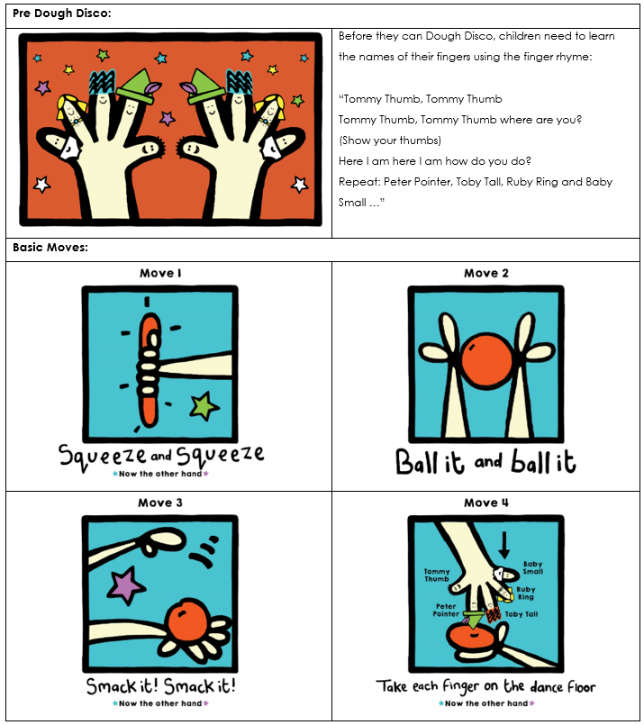
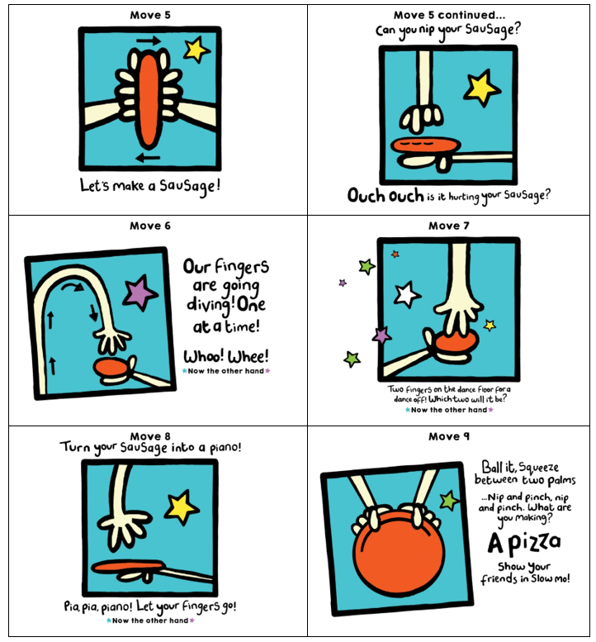
PE in EYFS
PE in Foundation Stage is directly taught by an adult using the Real PE scheme. It is also covered in the Physical Development part of the EYFS curriculum. It is directly taught through dough disco and handwriting sessions. It is indirectly taught through continuous provision i.e. finger gym activities. Adults model the key skills required.
Term | Autumn 1 | Autumn 2 | Spring 1 | Spring 2 | Summer 1 | Summer 2
Theme | Who am I? All about me, my feelings, similarities and differences, my family, celebrations, past and present. |  | What am I? Evolution, human bodies, staying healthy, oral hygiene, amazing humans, plants vs humans, minibeasts and life cycles. |  | Where am I? Where I live, the UK, fossils/dinosaurs, the world, pirates, space, and how to care for the planet.
Physical Development – Dough Disco |  |  | Climbing outdoors Dough Disco Threading Cutting – straight line Weaving Playdough Handling tools, objects etc with increasing control. Drawing Fastening zips and buttons independently. Funky fingers activities. Pencil grip. Letter formation. Daily movement breaks. Outdoor physical resources to support balance, agility. Healthy lifestyle. |  | Climbing outdoors Threading Cutting – start to cut along a curved line. Weaving Funky fingers activities – using one hand consistently. Dough Disco Develop pencil grip. Letter formation Start to draw recognisable pictures. Build things with smaller linking blocks such as Lego. Sports Day.

Slide 5
PE in EYFS
PE in Foundation Stage is directly taught by an adult using the Real PE scheme. It is also covered in the Physical Development part of the EYFS curriculum. It is directly taught through dough disco and handwriting sessions. It is indirectly taught through continuous provision i.e. finger gym activities. Adults model the key skills required.
Term | Autumn 1 | Autumn 2 | Spring 1 | Spring 2 | Summer 1 | Summer 2
Theme | Who am I? All about me, my feelings, similarities and differences, my family, celebrations, past and present. |  | What am I? Evolution, human bodies, staying healthy, oral hygiene, amazing humans, plants vs humans, minibeasts and life cycles. |  | Where am I? Where I live, the UK, fossils/dinosaurs, the world, pirates, space, and how to care for the planet.
Physical Development | Dough Disco Squiggle whilst you wiggle Threading Cutting Weaving Playdough Funky fingers activities. Pencil grip. Letter formation. Drawing/Mark making. Model pencil grip. Daily movement breaks. Climbing outdoors Develop good personal hygiene. Trikes, two wheeled balance bikes and pedal bikes. Provide regular reminders about handwashing and toileting. |  | Climbing outdoors Dough Disco Threading Cutting – straight line Weaving Playdough Handling tools, objects etc with increasing control. Drawing Fastening zips and buttons independently. Funky fingers activities. Pencil grip. Letter formation. Daily movement breaks. Outdoor physical resources to support balance, agility. Healthy lifestyle. |  | Climbing outdoors Threading Cutting – start to cut along a curved line. Weaving Funky fingers activities – using one hand consistently. Dough Disco Develop pencil grip. Letter formation Start to draw recognisable pictures. Build things with smaller linking blocks such as Lego. Sports Day.

Slide 6
Curriculum Thread Documents

Slide 7
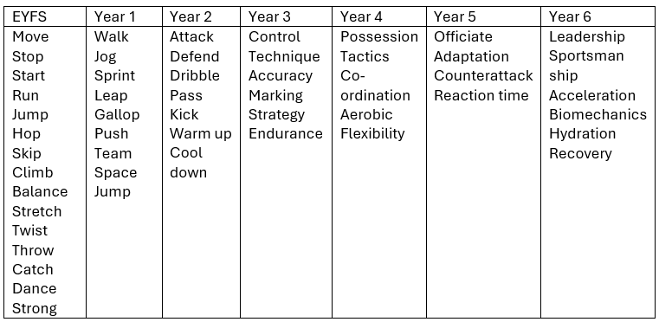
Vocabulary

Slide 8
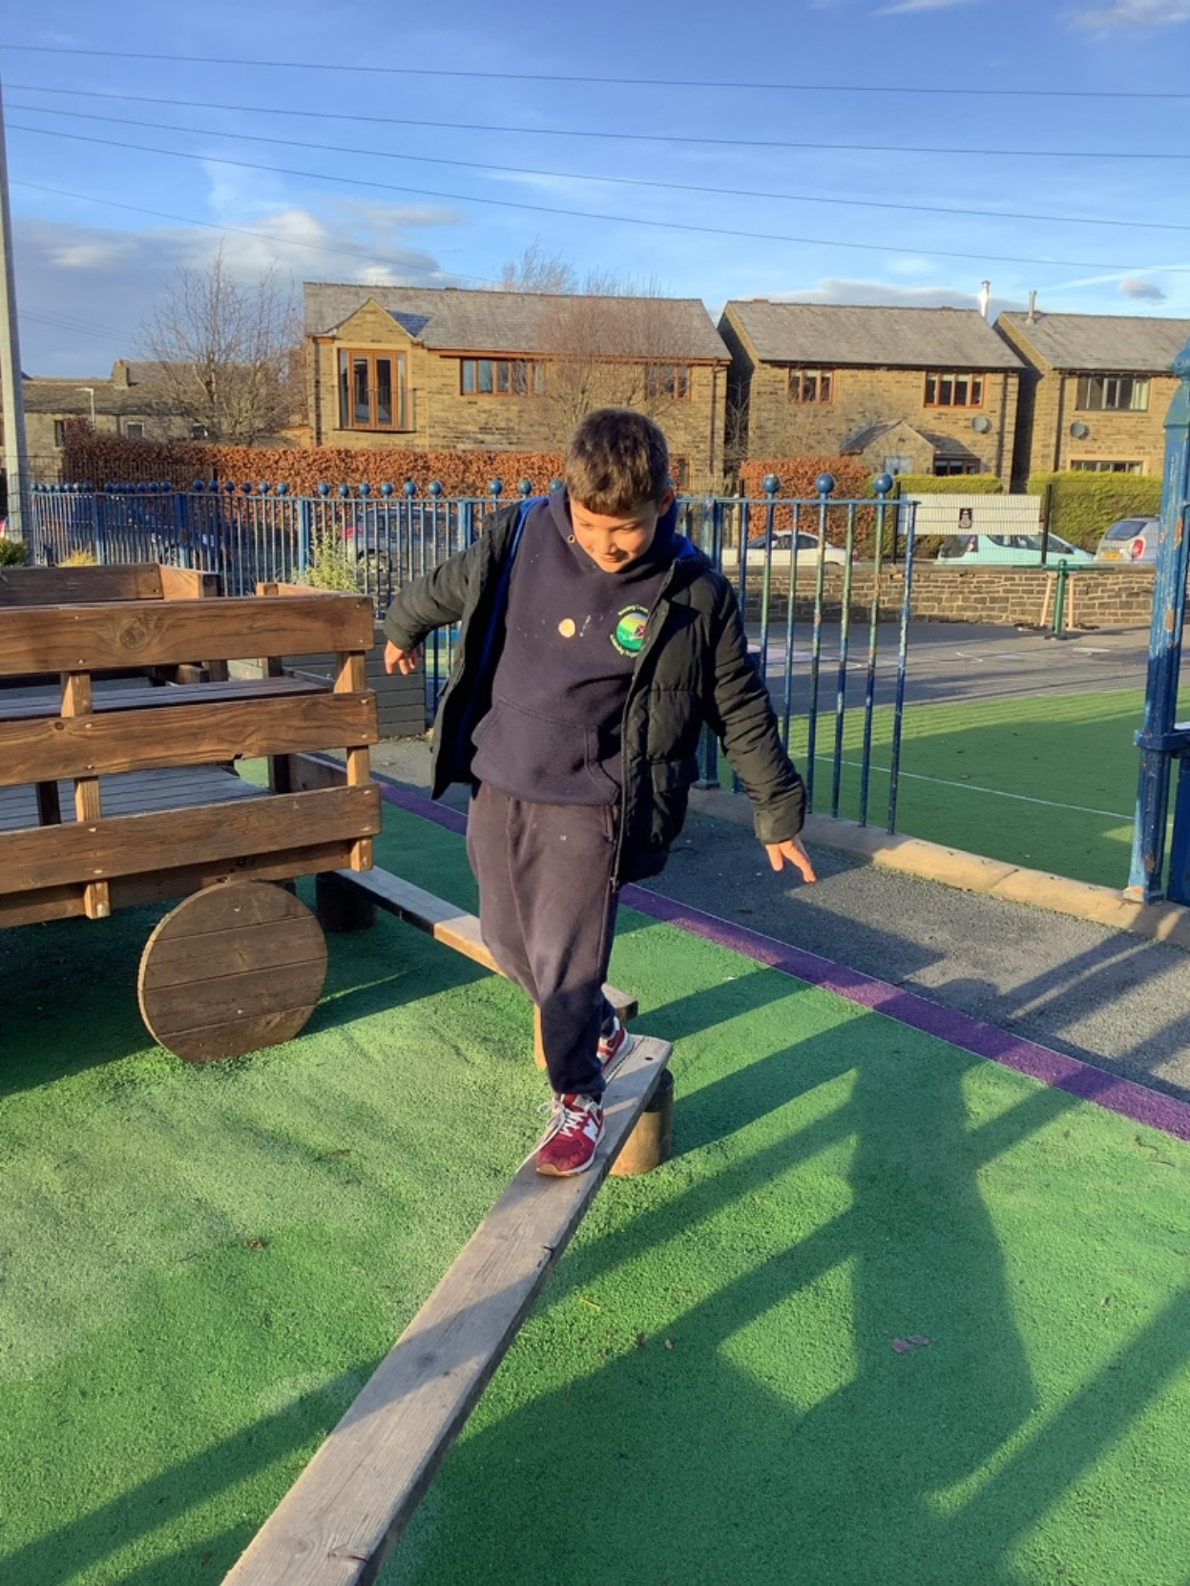
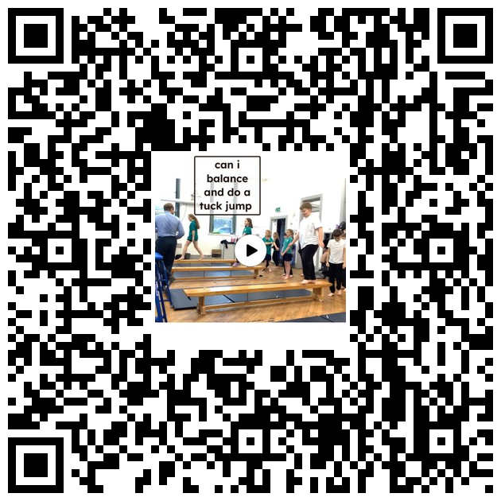
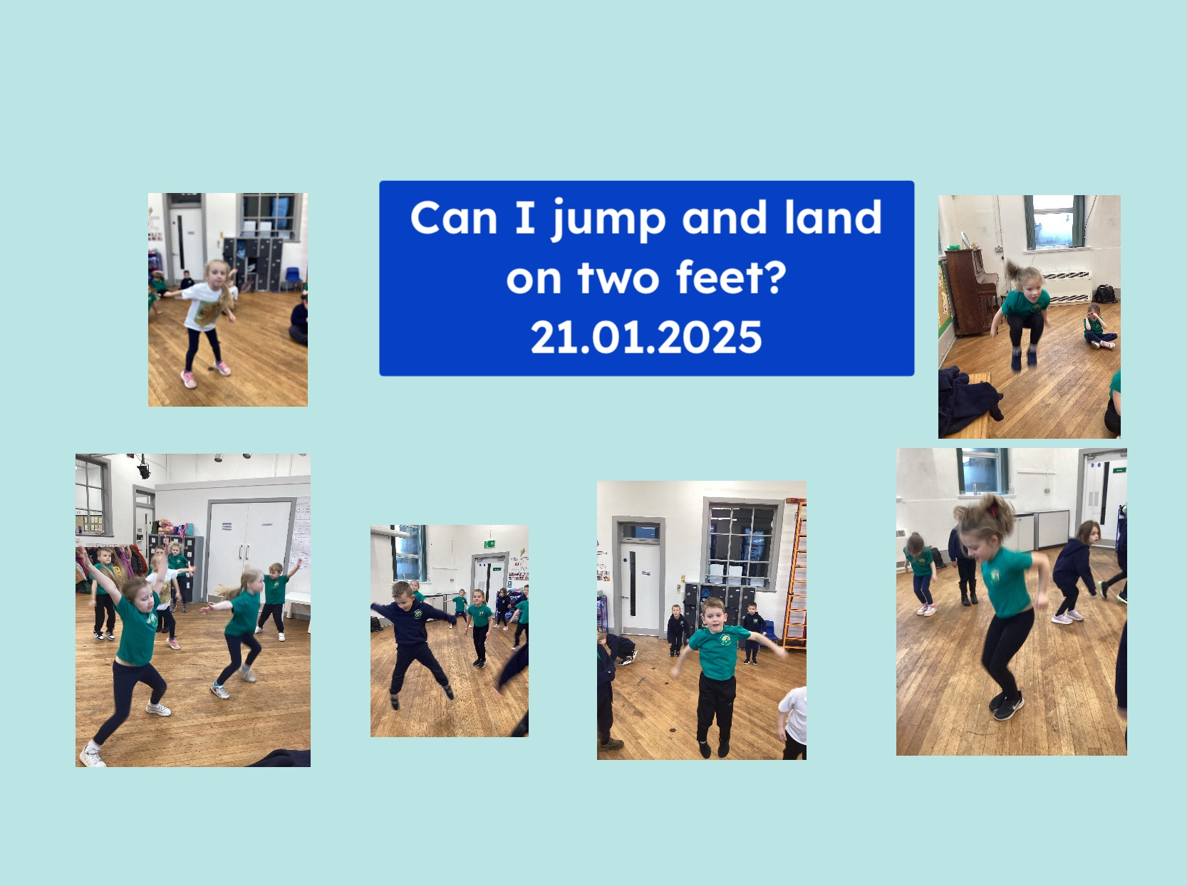
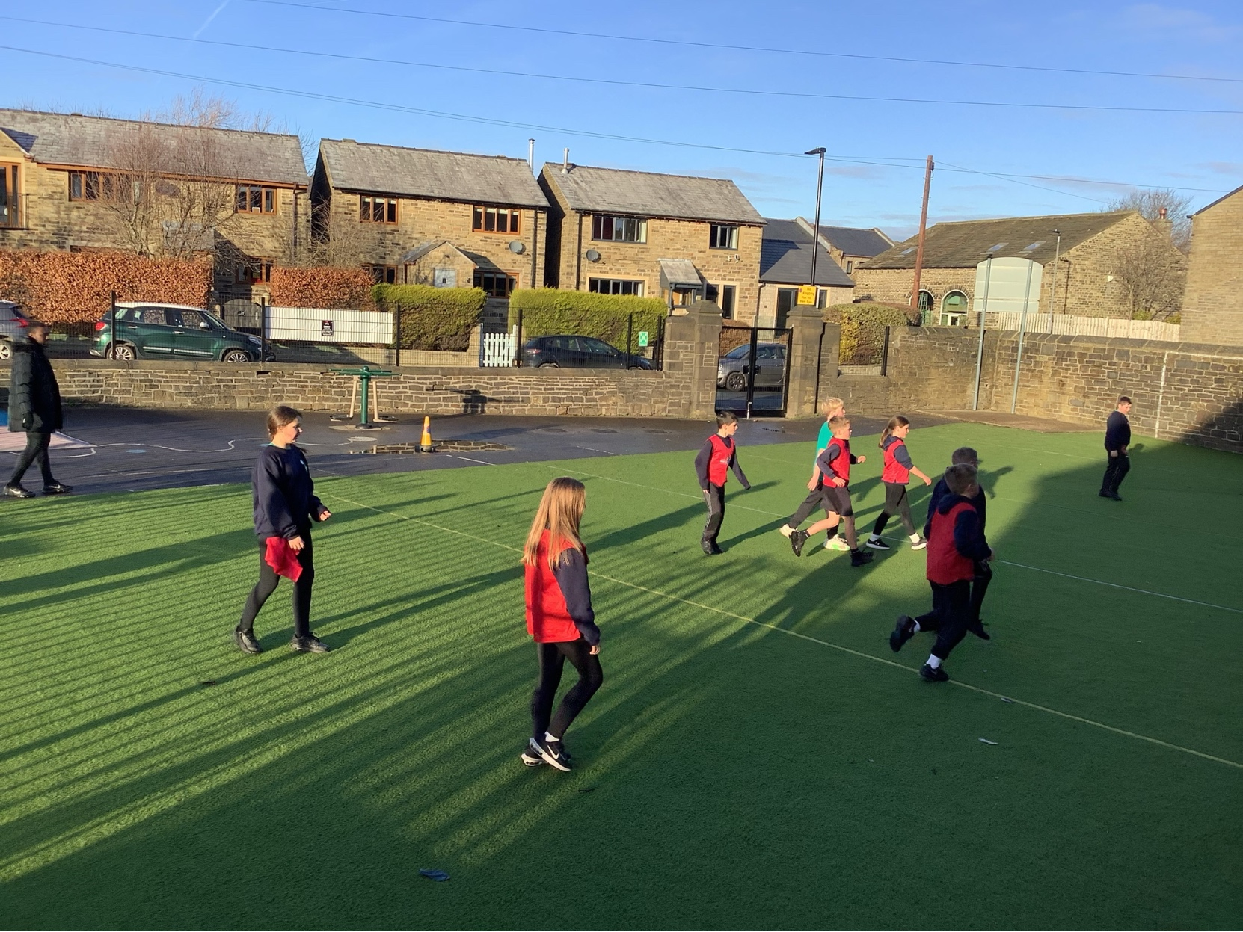
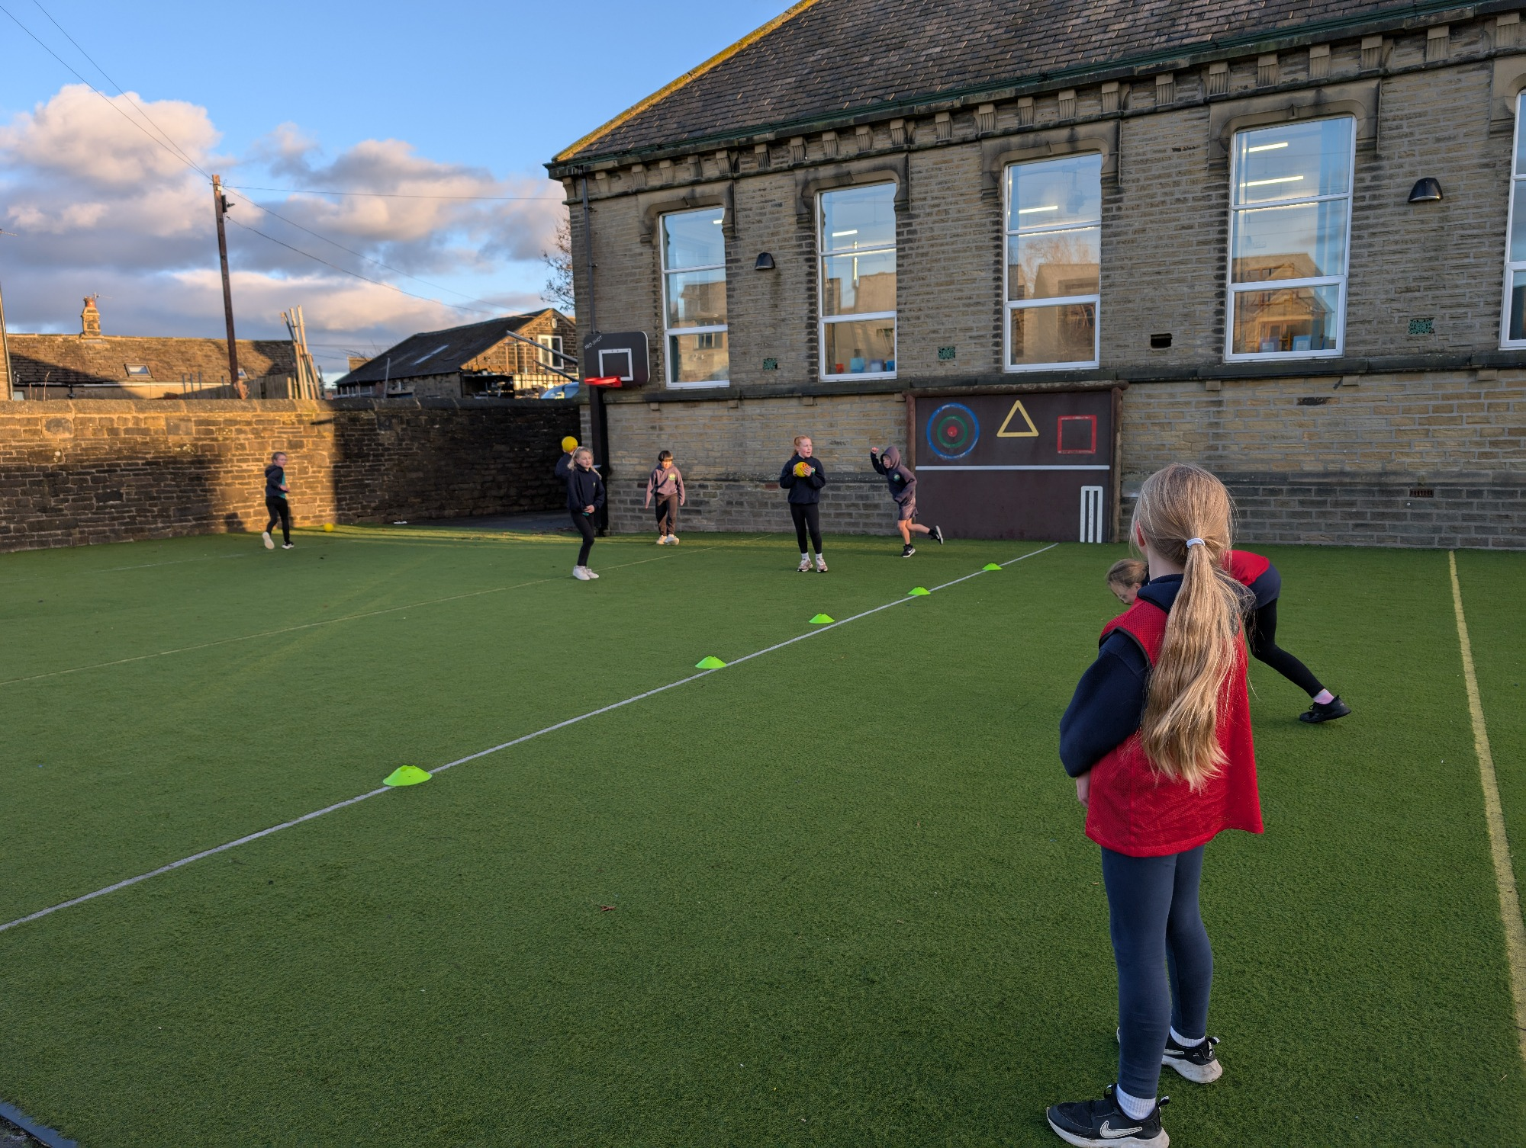
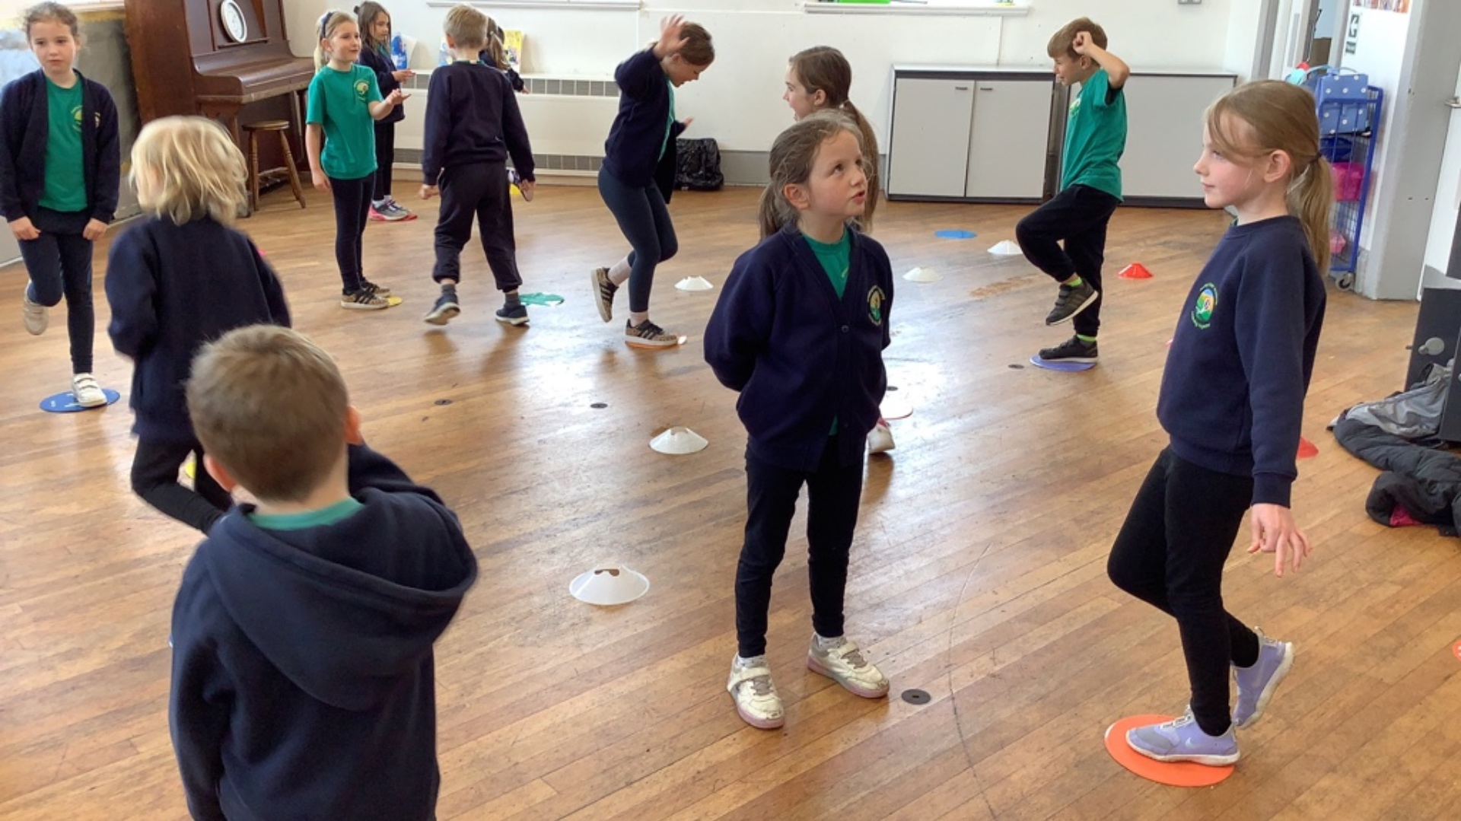
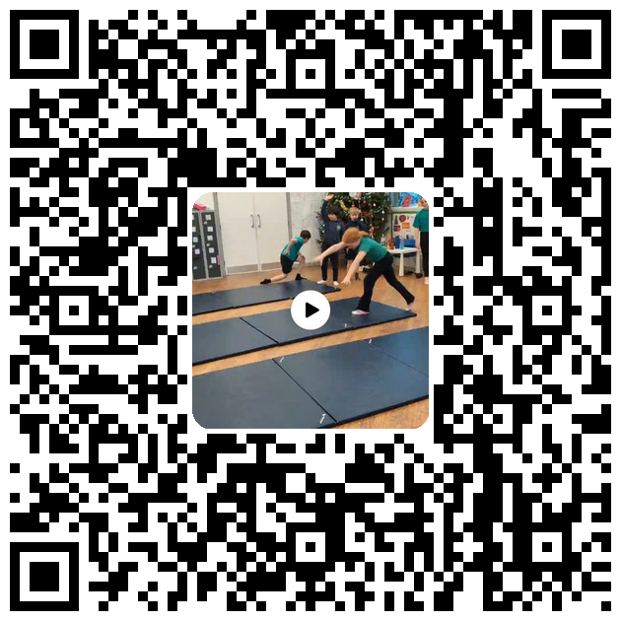
Examples of work

Slide 9
Assessment
At Bowling Green our curriculum is carefully planned to match the learning objectives set out in the National Curriculum for each year group. Therefore, we say that a child is ‘expected’ which means they are achieving their year groups objectives if they are keeping up with the learning detailed in our long term and medium term plans.
Whether a child is deemed to be keeping up with the learning is down to teacher judgement and knowledge of each individual child. To aid this decision each unit has a pre-learning task, this could check a child's understanding of the content up to this point i.e. have they recalled relevant information from previous year groups. This pre-learning task is used to inform planning, specifically thinking about additional support and challenge which may be needed in order to meet the needs of our pupils. Following the completion of a unit there is a post-learning task this checks a child's understanding of the content covered.
Each lesson has a flashback at the beginning of the lesson this is to support with retrieval of 'sticky knowledge' (knowledge we want children to remember).
Children are expected in each subject if they are keeping up with the learning detailed in the LTP/MTP.
Statutory Government assessments are undertaken in Year 1 with the Phonics Screening Check, Year 4 with the multiplication check and Year 6 with SATs.

Slide 10
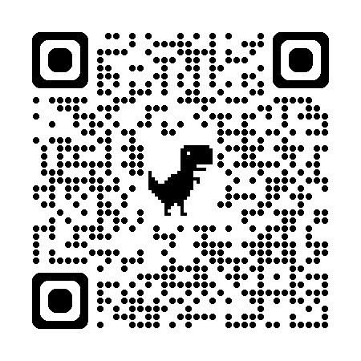
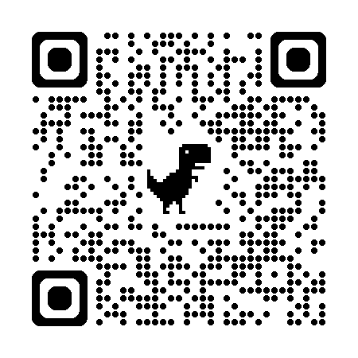
What can I do as a parent to support my child in this subject?

Slide 11
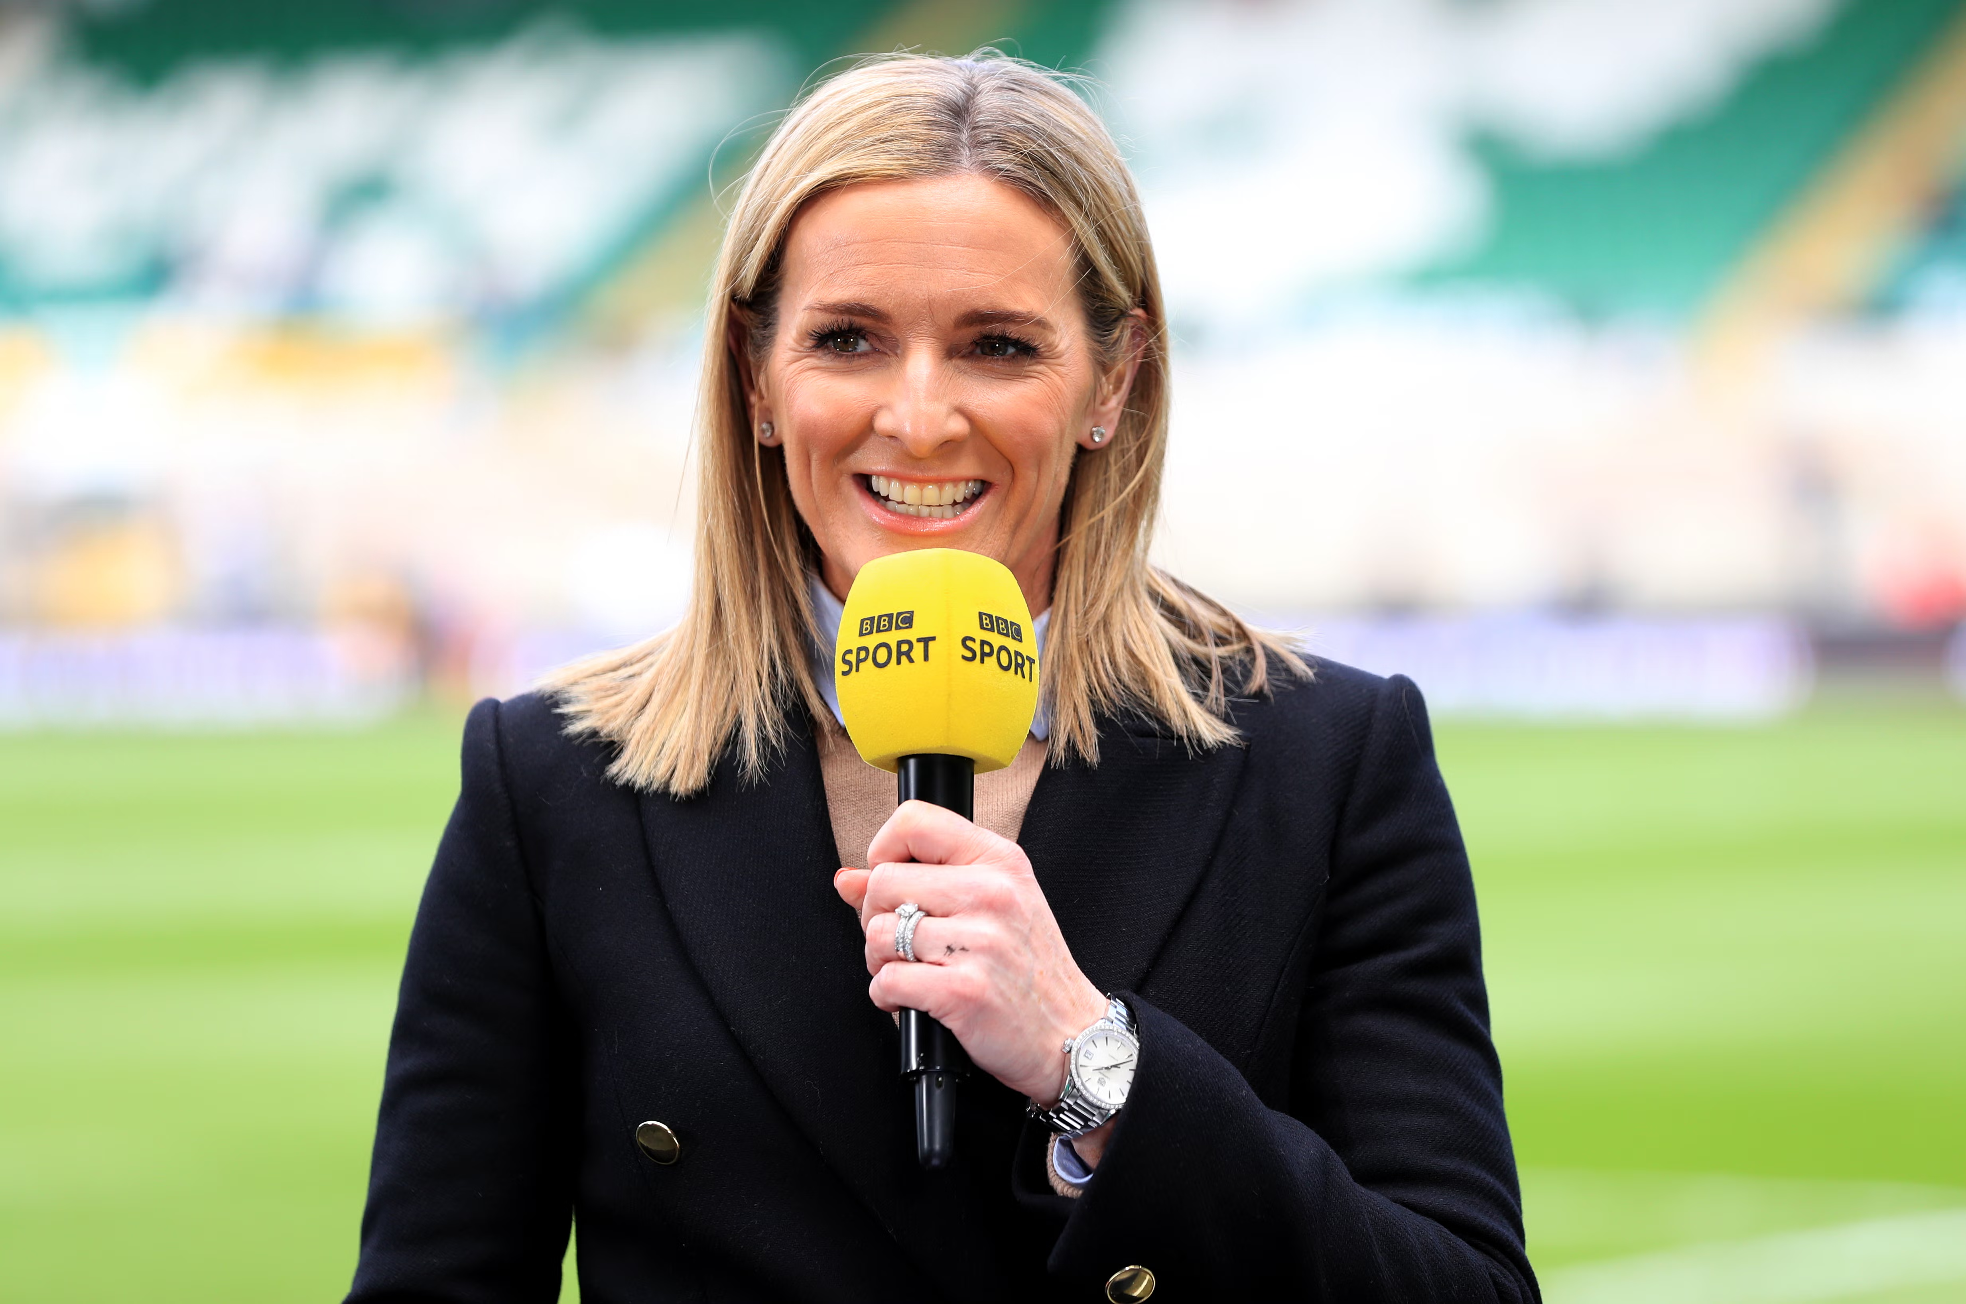
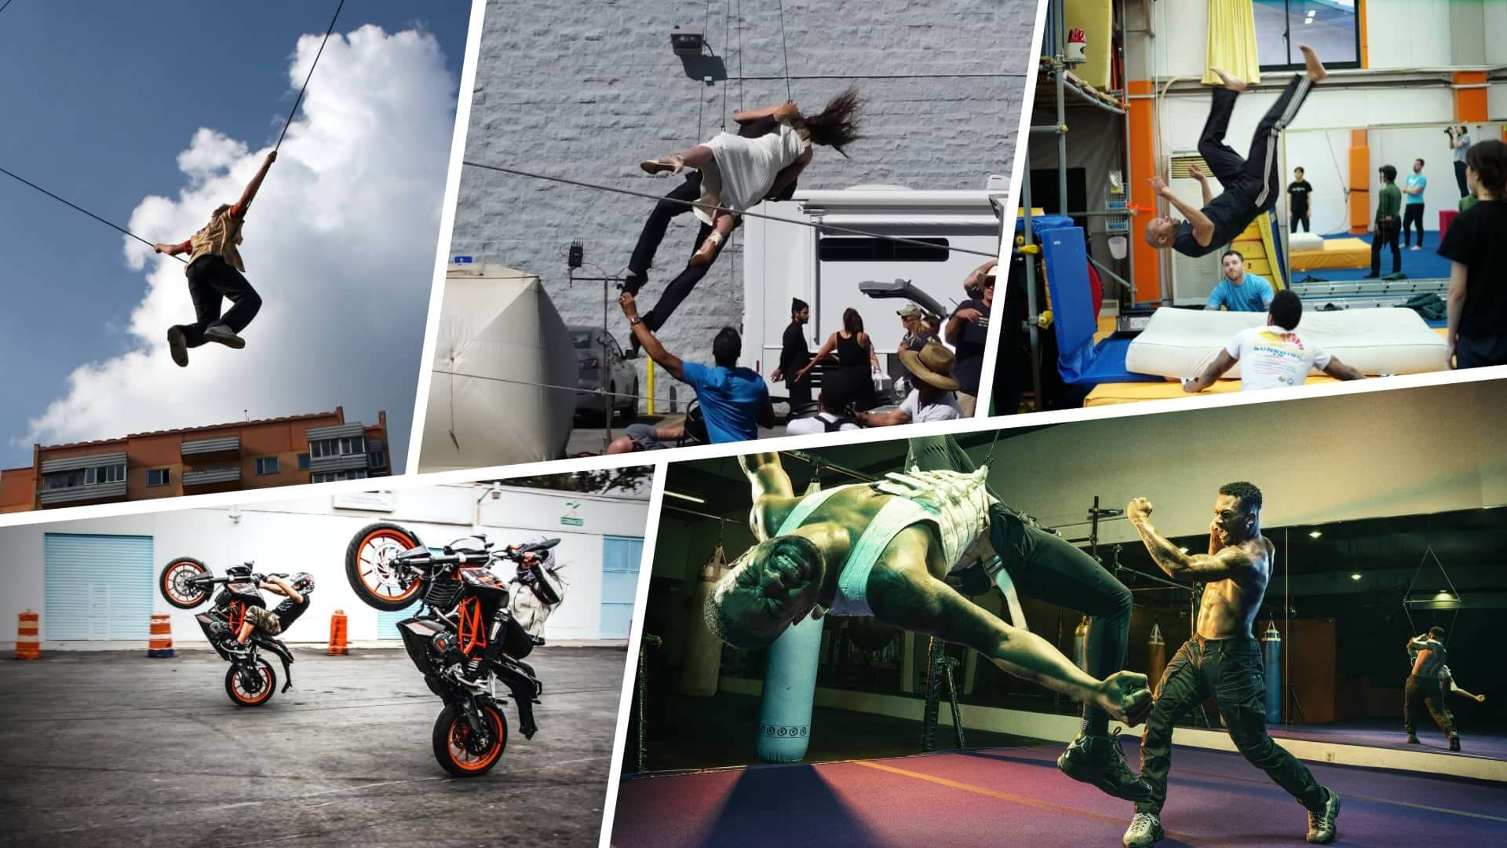
Career Ideas
Dance Choreographer 💃🕺
Create amazing dance routines for music videos, theatre, or competitions.
Express emotions through movement and music.
Example: Choreographing for West End musicals or TV shows.
Professional Athlete 🏅
Compete in sports like football, tennis, gymnastics, or athletics.
Train hard, stay healthy, and aim for medals!
Example: Competing in the Olympics or the Premier League.
Sports Journalist 📰🎤
Write or talk about sports for newspapers, TV, or online.
Interview top athletes and report on major sporting events.
Example: Commentating at the World Cup or Wimbledon.
Stunt Performer 🎬
Perform exciting action scenes in movies and TV shows.
Use gymnastics, parkour, and martial arts to create amazing stunts.
Example: Being in action films like Marvel or James Bond!

