Slide 1
Curriculum Marketplace
PSHE
Miss Ellie Binns

Slide 2
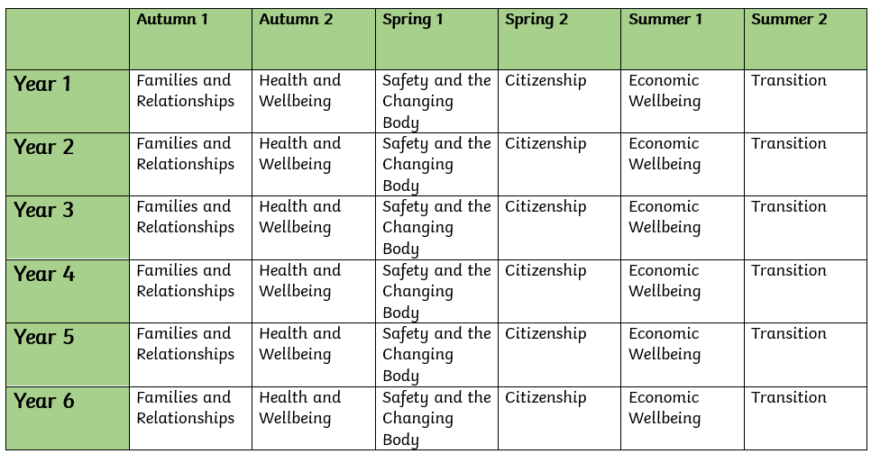
Long Term Planning

Slide 3
PSE in EYFS
PSE in Foundation Stage is covered in many areas of the EYFS curriculum; communication and language, PSE, Physical Development and Understanding the World. PSE is developed through the expectations of staff i.e good listening, good sitting, sharing, turn taking etc. PSE is directly introduced through adult led discussions and activities i.e. how to care for the environment. It is also, introduced indirectly through continuous provision where adults model key skills i.e. tooth brushing.
Term | Autumn 1 | Autumn 2 | Spring 1 | Spring 2 | Summer 1 | Summer 2
Theme | Who am I? All about me, my feelings, similarities and differences, my family, celebrations, past and present. |  | What am I? Evolution, human bodies, staying healthy, oral hygiene, amazing humans, plants vs humans, minibeasts and life cycles. |  | Where am I? Where I live, the UK, fossils/dinosaurs, the world, pirates, space, and how to care for the planet.
Communication and Language | Settling in Activities (Carpet Times, Getting to know you). Making friends Developing listening skills. Following instructions. Listening to stories. Super 6 – Repeated Texts. Talk through Stories – building vocabulary. Using new vocabulary. Retelling Stories orally. Discussing the curiosity cube – making observations. Children talking about things that are familiar to them: home, family, pets. Discussing similarities and differences. Talking about aspirations for the future. Talking about events that may be familiar: Halloween, Bonfire Night, Christmas. Taking part in the Nativity: listening to and singing songs. Listening to and joining in the Nursery Rhymes – Nursery Rhyme Week. Show and Tell Comparing life for us to life for Grandparents. |  | Listening to stories. Good Listening Skills. Super 6 – Repeated Texts – Building familiarity, understanding and increasing vocabulary. Talk through stories – building vocabulary, using new vocabulary, building familiarity with stories, retelling stories. Discussing the curiosity cube – asking what, where and who questions. Describing events in detail. Discussing how to stay healthy and what they do at home to stay healthy. Talking about how to keep teeth clean. Discussing the life cycle of a butterfly – asking questions to find out more. Using new vocabulary in different contexts. Story Invention – Talk it. Show and Tell Sharing Christmas Holiday news. Classifying Animals. Sharing our own ideas and opinions. |  | Listening to stories. Good Listening Skills. Super 6 – Repeated Texts – Building familiarity, understanding and increasing vocabulary. Talk through stories – building vocabulary, using new vocabulary, building familiarity with stories, retelling stories. Discussing the curiosity cube – asking how and why questions. Describing events in detail using connectives – Weekend News. Making up their own stories with a beginning, a middle and an end. Sharing Easter Holiday News. Discussing where we live. Comparing the UK to different countries. Talk around how to care for the environment. Sharing our own ideas and opinions and being able to give a reason why we think something.

Slide 4
PSE in EYFS
PSE in Foundation Stage is covered in many areas of the EYFS curriculum; communication and language, PSE, Physical Development and Understanding the World. PSE is developed through the expectations of staff i.e good listening, good sitting, sharing, turn taking etc. PSE is directly introduced through adult led discussions and activities i.e. how to care for the environment. It is also, introduced indirectly through continuous provision where adults model key skills i.e. tooth brushing.
Term | Autumn 1 | Autumn 2 | Spring 1 | Spring 2 | Summer 1 | Summer 2
Theme | Who am I? All about me, my feelings, similarities and differences, my family, celebrations, past and present. |  | What am I? Evolution, human bodies, staying healthy, oral hygiene, amazing humans, plants vs humans, minibeasts and life cycles. |  | Where am I? Where I live, the UK, fossils/dinosaurs, the world, pirates, space, and how to care for the planet.
Personal, Social and Emotional Development | Managing Self: New beginnings See themselves as a valuable individual. Build constructive and respectful relationships with staff and peers. Being me in my world. Class rules and behaviours. Dreams and goals. Getting on and falling out How to deal with anger Feelings Self-confidence – to try new activities and experiences. Dealing with problems. Learning about qualities and differences. Celebrating differences. Manage their own needs (wants, toileting, dressing). Stranger Danger |  | Good to be me. Identify and moderate their own feelings socially and emotionally. Encourage them to think about their own feelings socially and emotionally. Encourage them to think about the feelings of others. What makes a good friend. Healthy me Random acts of kindness Giving children strategies to stay calm in the face of frustration. Talk them through why we take turns, wait politely, tidy up after ourselves and so on. Manage their own needs. Begin to be sensitive towards others needs. What to do if you get lost. |  | Looking after our planet. Looking after others. Friendships – being sensitive towards others needs. Dreams and goals. Show resilience and perseverance in the face of challenge. Discuss why we take turns, wait politely, tidy up after ourselves and so on. Taking part in sport day – winning and losing. Look how far I have come. PANTS.

Slide 5
PSE in EYFS
PSE in Foundation Stage is covered in many areas of the EYFS curriculum; communication and language, PSE, Physical Development and Understanding the World. PSE is developed through the expectations of staff i.e good listening, good sitting, sharing, turn taking etc. PSE is directly introduced through adult led discussions and activities i.e. how to care for the environment. It is also, introduced indirectly through continuous provision where adults model key skills i.e. tooth brushing.
Term | Autumn 1 | Autumn 2 | Spring 1 | Spring 2 | Summer 1 | Summer 2
Theme | Who am I? All about me, my feelings, similarities and differences, my family, celebrations, past and present. |  | What am I? Evolution, human bodies, staying healthy, oral hygiene, amazing humans, plants vs humans, minibeasts and life cycles. |  | Where am I? Where I live, the UK, fossils/dinosaurs, the world, pirates, space, and how to care for the planet.
Physical Development | Dough Disco Squiggle whilst you wiggle Threading Cutting Weaving Playdough Funky fingers activities. Pencil grip. Letter formation. Drawing/Mark making. Model pencil grip. Daily movement breaks. Climbing outdoors Develop good personal hygiene. Trikes, two wheeled balance bikes and pedal bikes. Provide regular reminders about handwashing and toileting. |  | Climbing outdoors Dough Disco Threading Cutting – straight line Weaving Playdough Handling tools, objects etc with increasing control. Drawing Fastening zips and buttons independently. Funky fingers activities. Pencil grip. Letter formation. Daily movement breaks. Outdoor physical resources to support balance, agility. Healthy lifestyle. |  | Climbing outdoors Threading Cutting – start to cut along a curved line. Weaving Funky fingers activities – using one hand consistently. Dough Disco Develop pencil grip. Letter formation Start to draw recognisable pictures. Build things with smaller linking blocks such as Lego. Sports Day.

Slide 6
PSE in EYFS
PSE in Foundation Stage is covered in many areas of the EYFS curriculum; communication and language, PSE, Physical Development and Understanding the World. PSE is developed through the expectations of staff i.e good listening, good sitting, sharing, turn taking etc. PSE is directly introduced through adult led discussions and activities i.e. how to care for the environment. It is also, introduced indirectly through continuous provision where adults model key skills i.e. tooth brushing.
Term | Autumn 1 | Autumn 2 | Spring 1 | Spring 2 | Summer 1 | Summer 2
Theme | Who am I? All about me, my feelings, similarities and differences, my family, celebrations, past and present. |  | What am I? Evolution, human bodies, staying healthy, oral hygiene, amazing humans, plants vs humans, minibeasts and life cycles. |  | Where am I? Where I live, the UK, fossils/dinosaurs, the world, pirates, space, and how to care for the planet.
Understanding the World | Navigating key locations in school e.g. hall. Where do we live? Explore via google maps. Identifying their family – commenting on photos of their family and naming who they can see and of what relation they are to them. Talk about what they do with their family and places they have been with their family. Introduce children to a range of fictional characters and creatures from stories to differentiate these characters from real people in their lives. Draw similarities and differences between other families. Life in the past – When I was a child book. Listen to fictional stories about families and start to tell the difference between real and fiction. SEASON – Autumn – explore the natural world looking for seasonal changes. Describe what they feel, see and hear whilst outside. Understand the effect of changing seasons on the natural world around them. Celebrations – birthdays, Christmas, Halloween, bonfire night, remembrance. Introduce children to places of worship and places of local importance to the community. Talk about experiences of past birthdays. Talk about what they have done with their families during Christmas’ past – using photographs. Show photos of how Christmas is celebrated all over the world – similarities and differences. Use the Jolly Postman to draw information from a map. |  | SEASON – Winter – explore the natural world looking for seasonal changes. Describe what they feel, see and hear whilst outside. Understand the effect of changing seasons on the natural world around them. Celebrations – epiphany, Chinese new year, valentines day, shivaratri, pancake day, Holi, Ramadan mothers day, easter. Listen to children describing and commenting on things they have seen whilst outside, including plants and animals. After close observation, draw pictures of the natural world, including animals and plants Care and concern for living things. Planting Sunflowers, beans and other flowers. Observing minibeasts. Looking after the caterpillars. Draw children’s attention to the immediate environment, introducing and modelling new vocabulary where appropriate. SEASON – Spring – explore the natural world looking for seasonal changes. Describe what they feel, see and hear whilst outside. Understand the effect of changing seasons on the natural world around them. |  | SEASON – Summer – explore the natural world looking for seasonal changes. Describe what they feel, see and hear whilst outside. Understand the effect of changing seasons on the natural world around them. Can children talk about their homes – where is it? and what there is to do near their homes? Look out for children drawing/painting or constructing their homes. Encourage them to comment on what their home is like. Show photos of the children’s homes and encourage them to draw comparisons. Environments – Physical and Human Features of local environment Maps of local area Comparing places on Google Earth – how are they similar/different? Introduce the children to NASA and America. Introduce children to significant figures who have been to space and begin to understand that these events happened before they were born. Celebrations – fathers day, pride month, eid, summer solstice. Life in the past - To understand where dinosaurs are now and begin to understand that they were alive a very long time ago. Learn about what a paleontologist is and how they explore really old artefacts. Introduce Mary Anning. Share non-fiction texts that offer an insight into contrasting environments. Create treasure hunts linking to pirates to find places/objects within the learning environment. Use bee-bots on simple maps. Encourage the children to use navigational language. Recognise the difference between life in this country and life in different countries. Introduce the children to recycling and how it can take care of our world. Look at what rubbish can do to our environment and animals. Create opportunities to discuss how we care for the natural world around us.

Slide 7
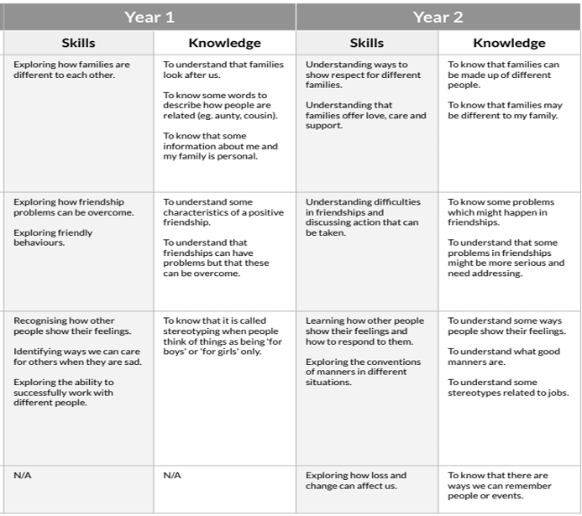
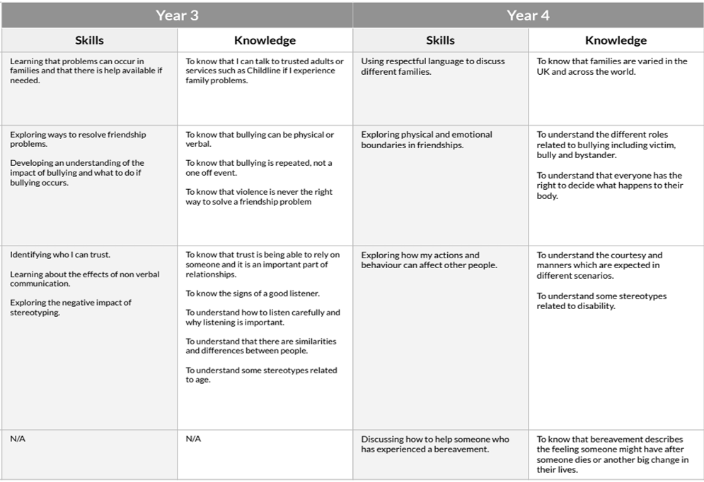
Curriculum Thread Documents – Family and Relationships

Slide 8
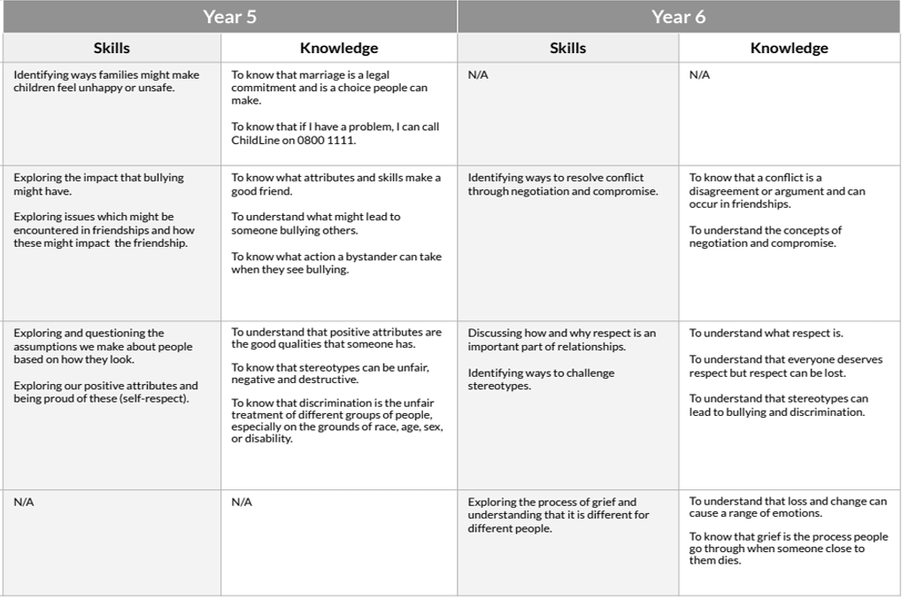
Curriculum Thread Documents – Family and Relationships

Slide 9
Vocabulary
Year 1 behaviour care emotions family feelings friend friendly problem stereotype | Year 2 friendship love manners feelings emotions family stereotype respect | Year 3 bullying communicate empathy open questions similar solve stereotype sympathy trust
Year 4 act of kindness authority bereavement boundaries bystander permission | Year 5 attributes bullying bystander cyberbullying marriage secret wedding | Year 6 authority conflict earn expectation grief grieving resolve respect stereotype

Slide 10
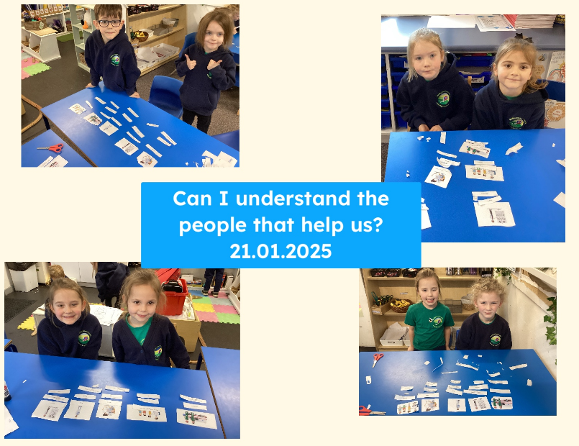
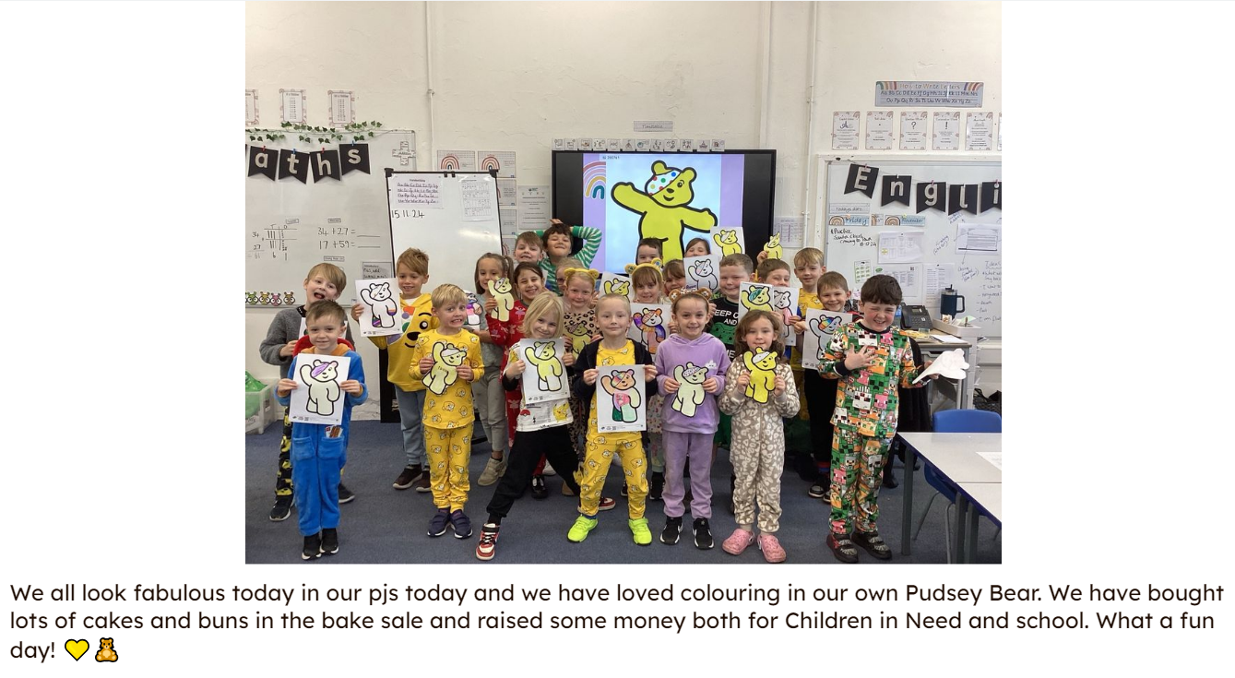
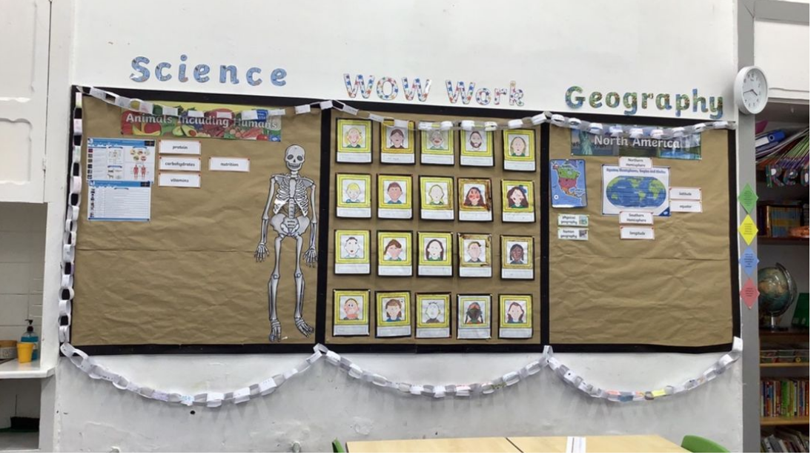
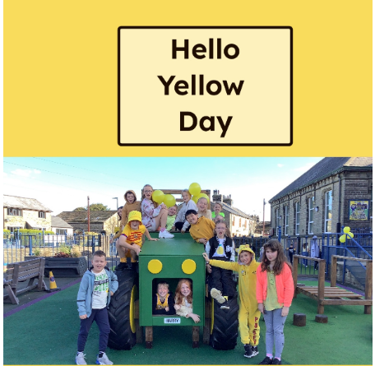
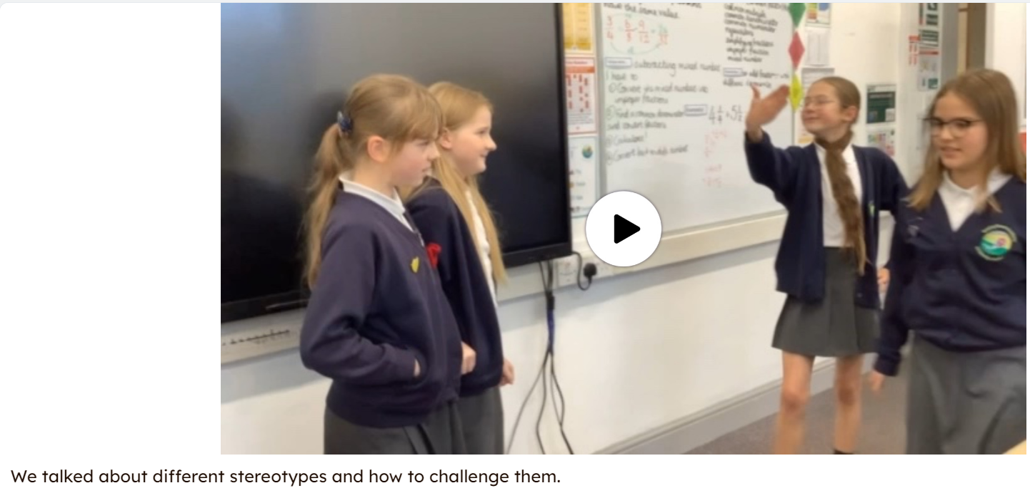
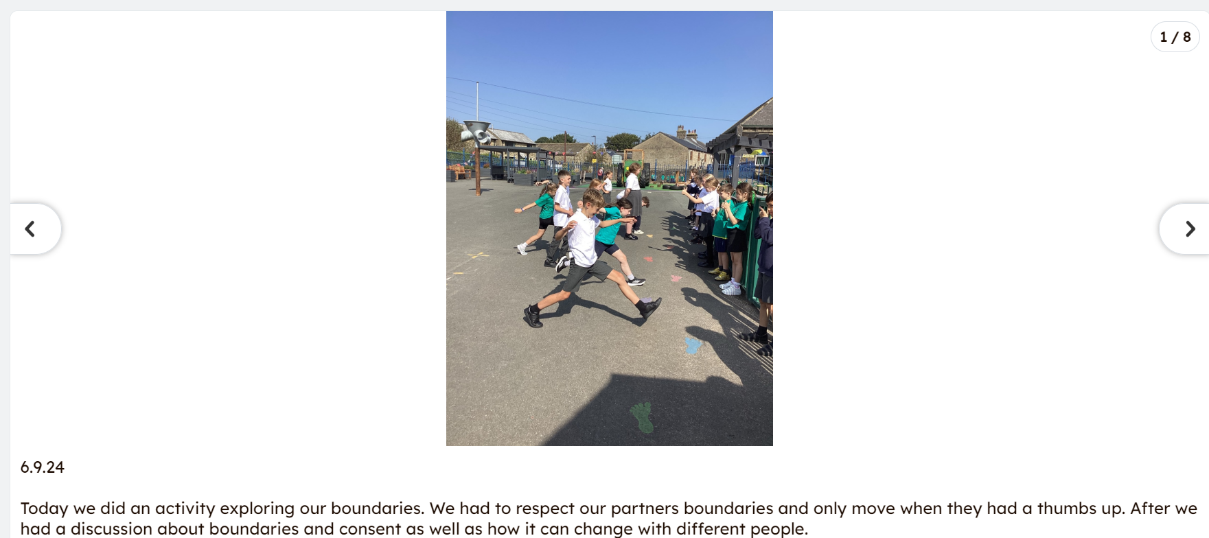
Examples of work

Slide 11
Assessment
At Bowling Green our curriculum is carefully planned to match the learning objectives set out in the National Curriculum for each year group. Therefore, we say that a child is ‘expected’ which means they are achieving their year groups objectives if they are keeping up with the learning detailed in our long term and medium term plans.
Whether a child is deemed to be keeping up with the learning is down to teacher judgement and knowledge of each individual child. To aid this decision each unit has a pre-learning task, this could check a child's understanding of the content up to this point i.e. have they recalled relevant information from previous year groups. This pre-learning task is used to inform planning, specifically thinking about additional support and challenge which may be needed in order to meet the needs of our pupils. Following the completion of a unit there is a post-learning task this checks a child's understanding of the content covered.
Each lesson has a flashback at the beginning of the lesson this is to support with retrieval of 'sticky knowledge' (knowledge we want children to remember).
Children are expected in each subject if they are keeping up with the learning detailed in the LTP/MTP.
Statutory Government assessments are undertaken in Year 1 with the Phonics Screening Check, Year 4 with the multiplication check and Year 6 with SATs.

Slide 12
What can I do as a parent to support my child in this subject?

Slide 13
Career Ideas
In PSHE we promote the idea that anyone can be anything. Here is a list of career paths for children that have a love of PSHE:
Teacher
Working with animals (E.g. Guide dog trainer)
Doctor
Policeman
Carer
Midwife

