Slide 1
Curriculum Marketplace
RE
Miss Ellie Binns

Slide 2
Long Term Planning – linking to pathways.

Slide 3
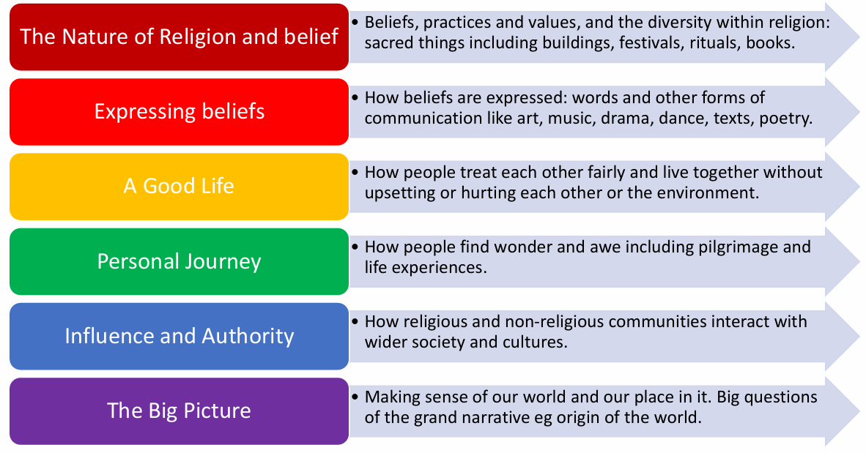
Long Term Planning – Pathways.

Slide 4
RE EYFS
RE in Foundation Stage is covered in the Understanding the World, PSE and Expressive Arts and Design parts of the EYFS curriculum. Stories are read by adults introducing key celebrations and ideas e.g Christmas, Easter, different families. It is continued through activities in continuous provision e.g diva lamps in the playdough area.
Term | Autumn 1 | Autumn 2 | Spring 1 | Spring 2 | Summer 1 | Summer 2
Theme | Who am I? All about me, my feelings, similarities and differences, my family, celebrations, past and present. |  | What am I? Evolution, human bodies, staying healthy, oral hygiene, amazing humans, plants vs humans, minibeasts and life cycles. |  | Where am I? Where I live, the UK, fossils/dinosaurs, the world, pirates, space, and how to care for the planet.
Personal, Social and Emotional Development | Managing Self: New beginnings See themselves as a valuable individual. Build constructive and respectful relationships with staff and peers. Being me in my world. Class rules and behaviours. Dreams and goals. Getting on and falling out How to deal with anger Feelings Self-confidence – to try new activities and experiences. Dealing with problems. Learning about qualities and differences. Celebrating differences. Manage their own needs (wants, toileting, dressing). Stranger Danger |  | Good to be me. Identify and moderate their own feelings socially and emotionally. Encourage them to think about their own feelings socially and emotionally. Encourage them to think about the feelings of others. What makes a good friend. Healthy me Random acts of kindness Giving children strategies to stay calm in the face of frustration. Talk them through why we take turns, wait politely, tidy up after ourselves and so on. Manage their own needs. Begin to be sensitive towards others needs. What to do if you get lost. |  | Looking after our planet. Looking after others. Friendships – being sensitive towards others needs. Dreams and goals. Show resilience and perseverance in the face of challenge. Discuss why we take turns, wait politely, tidy up after ourselves and so on. Taking part in sport day – winning and losing. Look how far I have come. PANTS.

Slide 5
RE EYFS
RE in Foundation Stage is covered in the Understanding the World, PSE and Expressive Arts and Design parts of the EYFS curriculum. Stories are read by adults introducing key celebrations and ideas e.g Christmas, Easter, different families. It is continued through activities in continuous provision e.g diva lamps in the playdough area.
Term | Autumn 1 | Autumn 2 | Spring 1 | Spring 2 | Summer 1 | Summer 2
Theme | Who am I? All about me, my feelings, similarities and differences, my family, celebrations, past and present. |  | What am I? Evolution, human bodies, staying healthy, oral hygiene, amazing humans, plants vs humans, minibeasts and life cycles. |  | Where am I? Where I live, the UK, fossils/dinosaurs, the world, pirates, space, and how to care for the planet.
Understanding the World | Navigating key locations in school e.g. hall. Where do we live? Explore via google maps. Identifying their family – commenting on photos of their family and naming who they can see and of what relation they are to them. Talk about what they do with their family and places they have been with their family. Introduce children to a range of fictional characters and creatures from stories to differentiate these characters from real people in their lives. Draw similarities and differences between other families. Life in the past – When I was a child book. Listen to fictional stories about families and start to tell the difference between real and fiction. SEASON – Autumn – explore the natural world looking for seasonal changes. Describe what they feel, see and hear whilst outside. Understand the effect of changing seasons on the natural world around them. Celebrations – birthdays, Christmas, Halloween, bonfire night, remembrance, Diwali – Rama and Sita Introduce children to places of worship and places of local importance to the community. Talk about experiences of past birthdays. Talk about what they have done with their families during Christmas’ past – using photographs. Show photos of how Christmas is celebrated all over the world – similarities and differences. Use the Jolly Postman to draw information from a map. |  | SEASON – Winter – explore the natural world looking for seasonal changes. Describe what they feel, see and hear whilst outside. Understand the effect of changing seasons on the natural world around them. Celebrations – epiphany, Chinese new year, valentines day, shivaratri, pancake day, Holi, Ramadan mothers day, easter. Listen to children describing and commenting on things they have seen whilst outside, including plants and animals. After close observation, draw pictures of the natural world, including animals and plants Care and concern for living things. Planting Sunflowers, beans and other flowers. Observing minibeasts. Looking after the caterpillars. Draw children’s attention to the immediate environment, introducing and modelling new vocabulary where appropriate. SEASON – Spring – explore the natural world looking for seasonal changes. Describe what they feel, see and hear whilst outside. Understand the effect of changing seasons on the natural world around them. |  | SEASON – Summer – explore the natural world looking for seasonal changes. Describe what they feel, see and hear whilst outside. Understand the effect of changing seasons on the natural world around them. Can children talk about their homes – where is it? and what there is to do near their homes? Look out for children drawing/painting or constructing their homes. Encourage them to comment on what their home is like. Show photos of the children’s homes and encourage them to draw comparisons. Environments – Physical and Human Features of local environment Maps of local area Comparing places on Google Earth – how are they similar/different? Introduce the children to NASA and America. Introduce children to significant figures who have been to space and begin to understand that these events happened before they were born. Celebrations – fathers day, pride month, eid, summer solstice. Life in the past - To understand where dinosaurs are now and begin to understand that they were alive a very long time ago. Learn about what a paleontologist is and how they explore really old artefacts. Introduce Mary Anning. Share non-fiction texts that offer an insight into contrasting environments. Create treasure hunts linking to pirates to find places/objects within the learning environment. Use bee-bots on simple maps. Encourage the children to use navigational language. Recognise the difference between life in this country and life in different countries. Introduce the children to recycling and how it can take care of our world. Look at what rubbish can do to our environment and animals. Create opportunities to discuss how we care for the natural world around us.

Slide 6
RE EYFS
RE in Foundation Stage is covered in the Understanding the World, PSE and Expressive Arts and Design parts of the EYFS curriculum. Stories are read by adults introducing key celebrations and ideas e.g Christmas, Easter, different families. It is continued through activities in continuous provision e.g diva lamps in the playdough area.
Term | Autumn 1 | Autumn 2 | Spring 1 | Spring 2 | Summer 1 | Summer 2
Theme | Who am I? All about me, my feelings, similarities and differences, my family, celebrations, past and present. |  | What am I? Evolution, human bodies, staying healthy, oral hygiene, amazing humans, plants vs humans, minibeasts and life cycles. |  | Where am I? Where I live, the UK, fossils/dinosaurs, the world, pirates, space, and how to care for the planet.
Expressive Arts and Design | Navigating key locations in school e.g. hall. Where do we live? Explore via google maps. Join in with a range of songs/nursery rhymes. Call and response songs. Use a variety of mark-making resources. Begin to select colours for a purpose. Beginning to mix colours. Create a collaborative art piece for display. Join in with role play games and use resources for props. Build models using construction equipment. Self portraits. Portraits of Family members. Junk modelling – houses. Movement dances (copy dance moves). Explore instruments. Firework pictures. Christmas decorations. Divas Christmas songs. Nativity. Listen to and talk about a range of different types of music – how does it make you feel. Stage in the outdoor area to engage in music making and dance. |  | Join in with role play and small world activities – incorporating stories into play. Join in with a range of songs/nursery rhymes. Movement dances. Explore instruments and begin to name some. Symmetrical Butterflies. Mix colours to create new ones. Observational Drawings of plants. Design homes for hibernating animals. Making lanterns for Chinese New Year. Watch and discuss Chinese New Year dragon dances – expressing feelings, likes/dislikes and responses. Drawing around each other. Shadow drawing. Junk Modelling Lifecycles. Printing patterns on Easter Eggs. Easter Cards. Mothers Day Cards. Stage in the outdoor area to engage in music making and dance. |  | Join in with role play and small world activities – incorporating stories into play. Join in with a range of songs/nursery rhymes. Movement Dances. Stage in the outdoor area to engage in music making and dance. Play an instrument to a simple beat. Design and make rockets. Creating outer space pictures. Design and make objects they need in space. Junk Modelling Exploration of other countries that have a contrasting life – dressing up in different costumes. Salt dough fossils. Treasure maps. Fathers Day Cards. Watercolour pictures – paint lines and circles to create an image. Making passports.

Slide 7
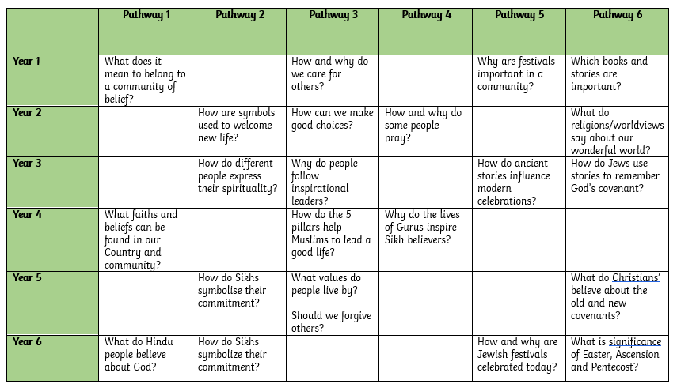
Curriculum Thread Documents

Slide 8
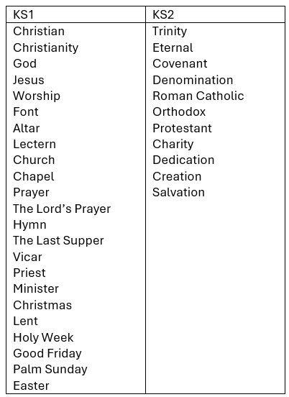
Vocabulary

Slide 9
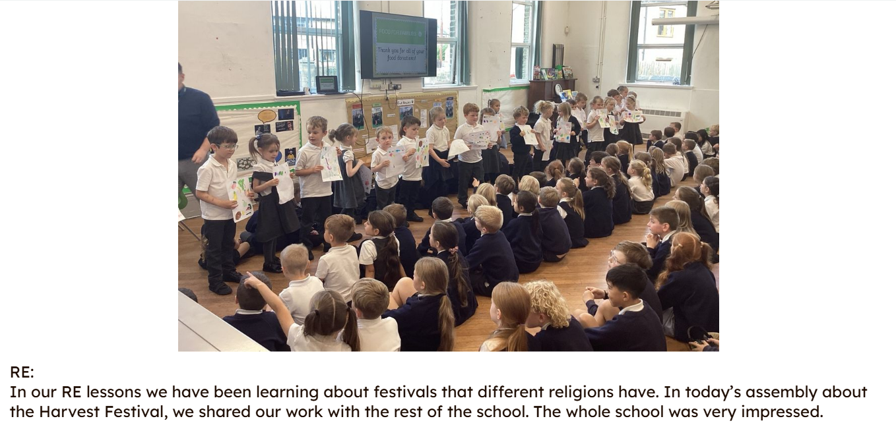
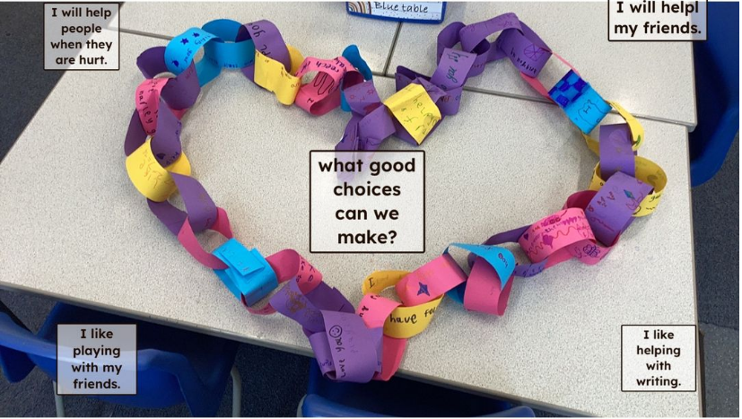
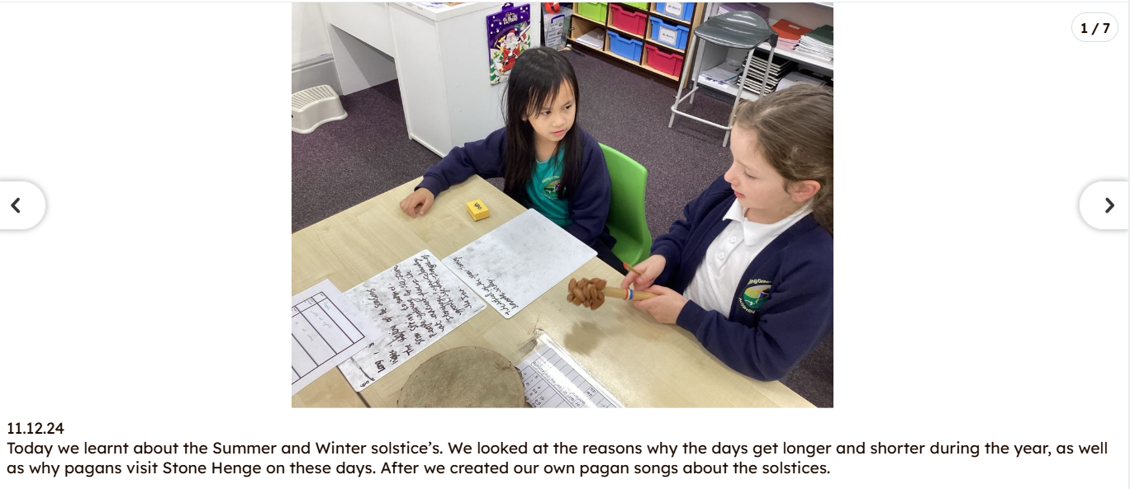
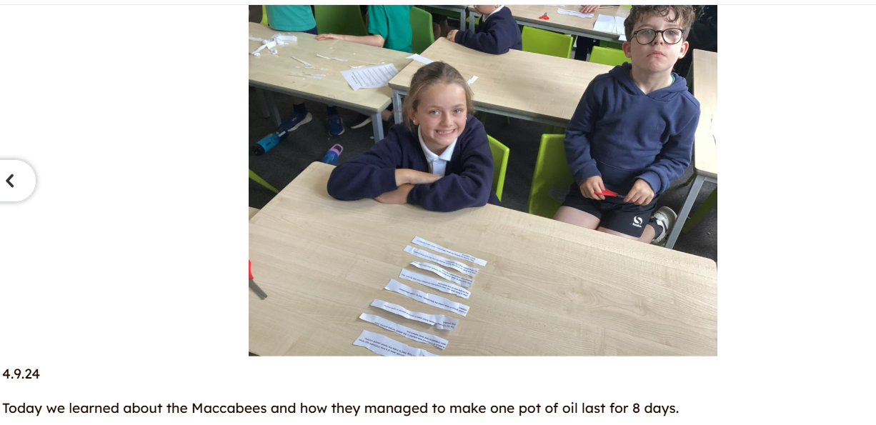
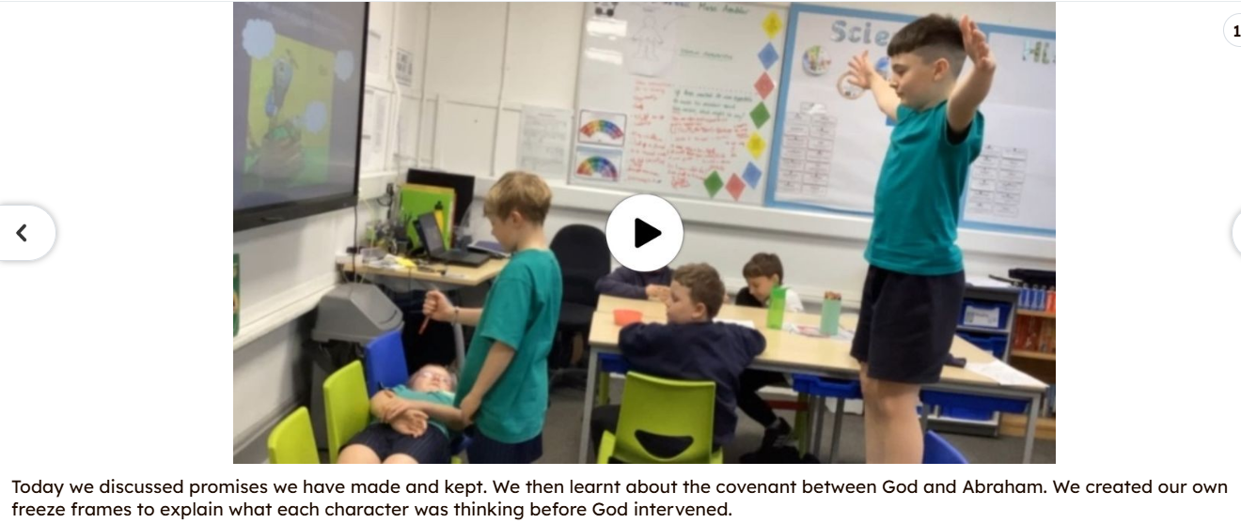
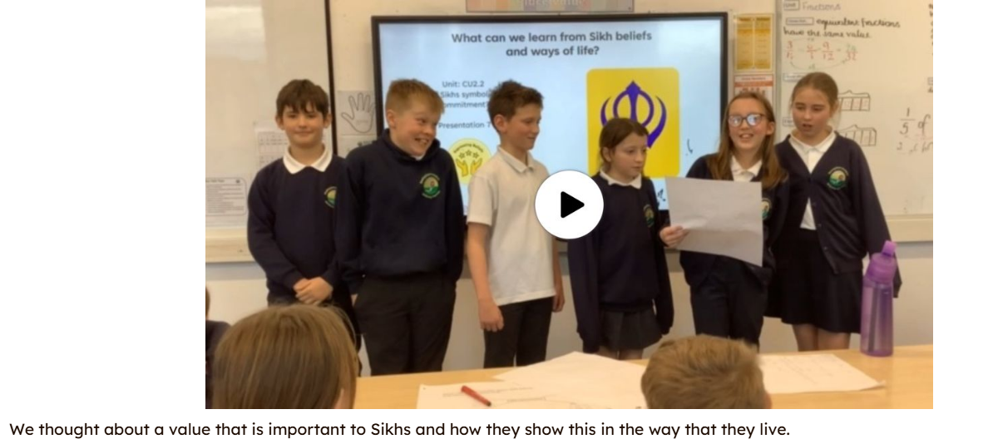
Examples of work

Slide 10
Assessment
At Bowling Green our curriculum is carefully planned to match the learning objectives set out in the National Curriculum for each year group. Therefore, we say that a child is ‘expected’ which means they are achieving their year groups objectives if they are keeping up with the learning detailed in our long term and medium term plans.
Whether a child is deemed to be keeping up with the learning is down to teacher judgement and knowledge of each individual child. To aid this decision each unit has a pre-learning task, this could check a child's understanding of the content up to this point i.e. have they recalled relevant information from previous year groups. This pre-learning task is used to inform planning, specifically thinking about additional support and challenge which may be needed in order to meet the needs of our pupils. Following the completion of a unit there is a post-learning task this checks a child's understanding of the content covered.
Each lesson has a flashback at the beginning of the lesson this is to support with retrieval of 'sticky knowledge' (knowledge we want children to remember).
Children are expected in each subject if they are keeping up with the learning detailed in the LTP/MTP.
Statutory Government assessments are undertaken in Year 1 with the Phonics Screening Check, Year 4 with the multiplication check and Year 6 with SATs.

Slide 11
What can I do as a parent to support my child in this subject?

Slide 12
Career Ideas
Doctors or nurses
Local government
Teaching roles
Financial and legal firms
Charities
Social services or other caring professions
Museums
Journalism

