Slide 1
Curriculum Marketplace
French
Mrs Saleha Hollingsworth

Slide 2
Long Term Planning

Slide 3
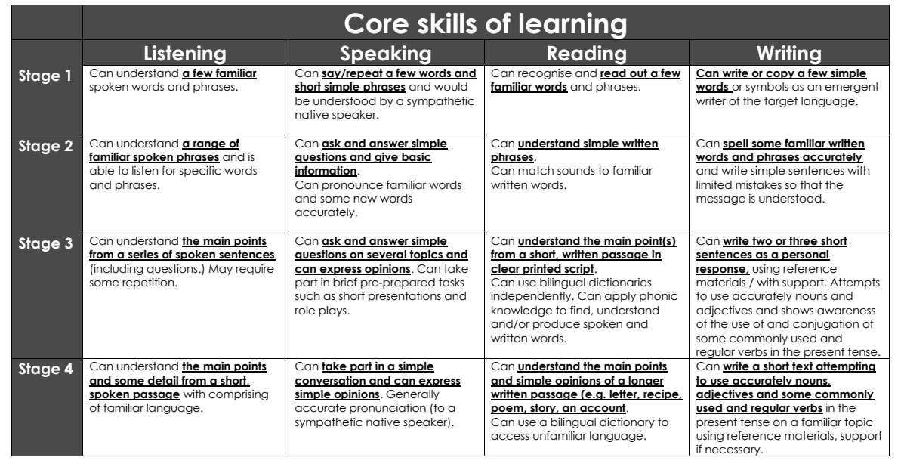
Curriculum Thread Documents

Slide 4
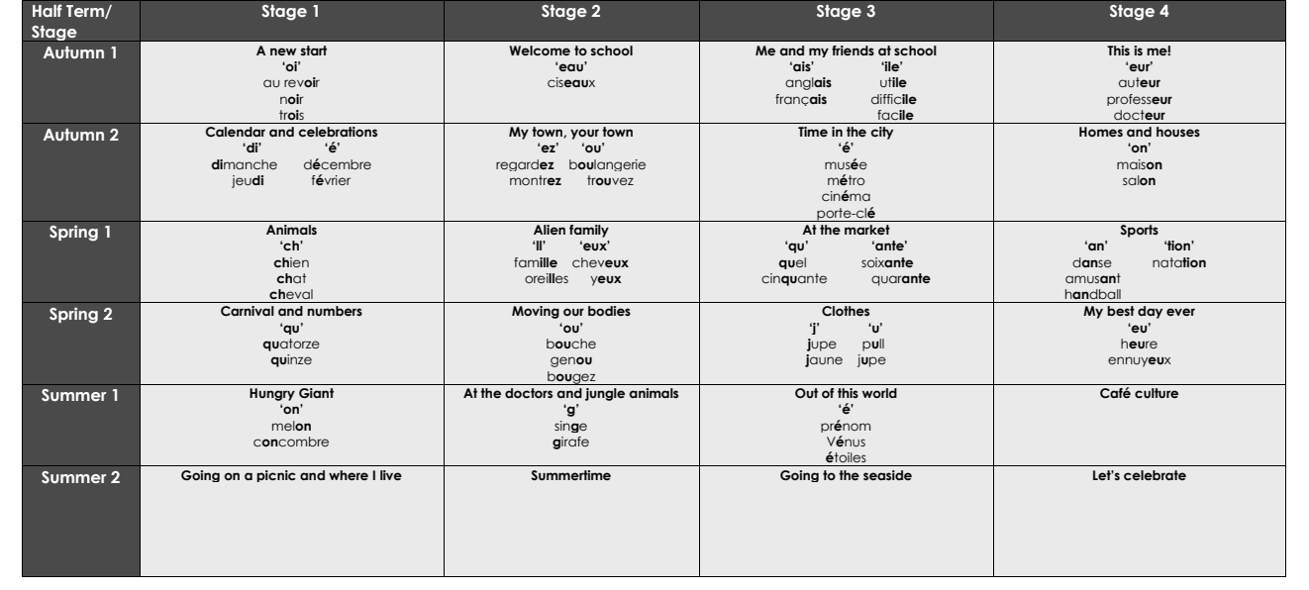
Vocabulary – Phonics Sounds

Slide 5
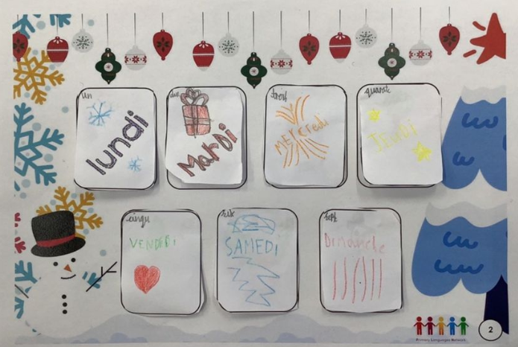
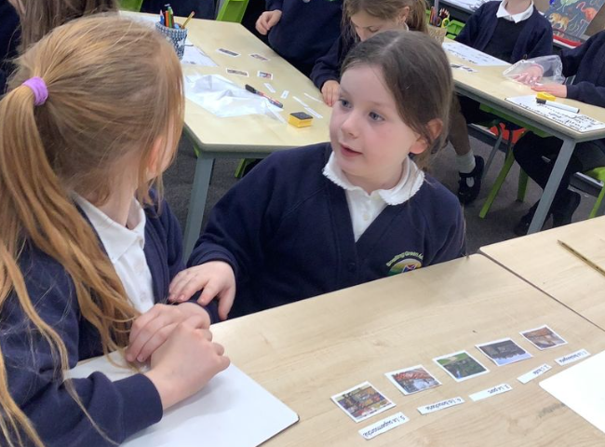
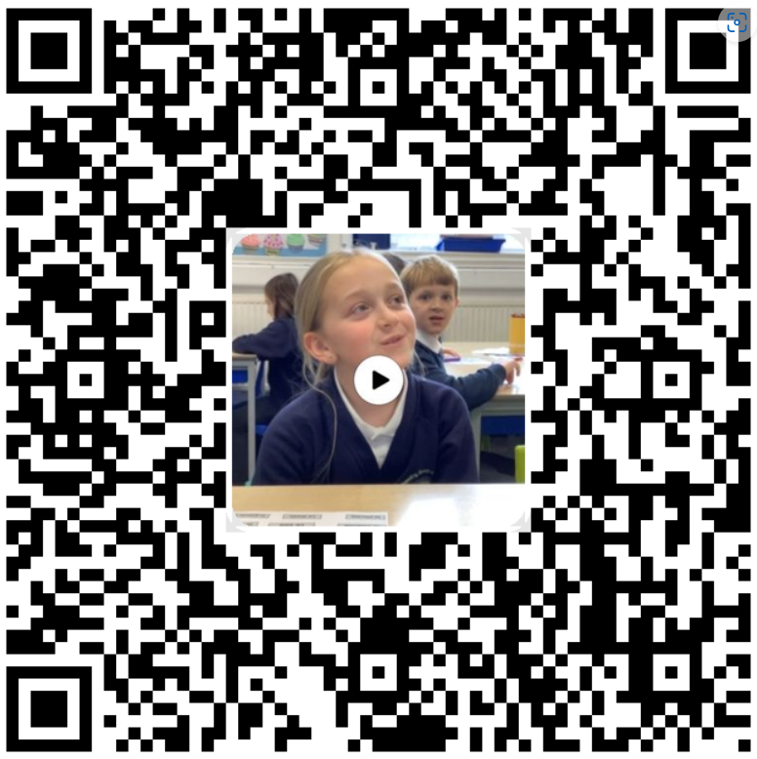
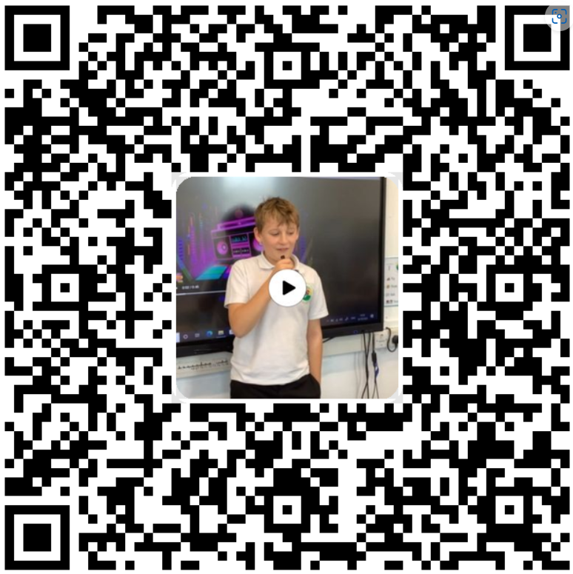
Examples of Work

Slide 6
Assessment
At Bowling Green our curriculum is carefully planned to match the learning objectives set out in the National Curriculum for each year group. Therefore, we say that a child is ‘expected’ which means they are achieving their year groups objectives if they are keeping up with the learning detailed in our long term and medium term plans.
Whether a child is deemed to be keeping up with the learning is down to teacher judgement and knowledge of each individual child. To aid this decision each unit has a pre-learning task, this could check a child's understanding of the content up to this point i.e. have they recalled relevant information from previous year groups. This pre-learning task is used to inform planning, specifically thinking about additional support and challenge which may be needed in order to meet the needs of our pupils. Following the completion of a unit there is a post-learning task this checks a child's understanding of the content covered.
Each lesson has a flashback at the beginning of the lesson this is to support with retrieval of 'sticky knowledge' (knowledge we want children to remember).
Children are expected in each subject if they are keeping up with the learning detailed in the LTP/MTP.
Statutory Government assessments are undertaken in Year 1 with the Phonics Screening Check, Year 4 with the multiplication check and Year 6 with SATs.

Slide 7
What can I do as a parent to support my child in this subject?
Learning a new language is a valuable skill that opens doors to new opportunities, cultures, and connections. As parents, you play a key role in supporting your child’s language-learning journey. Here are some tips and suggestions to help your child succeed:
Encourage Daily Practice Dedicate a small amount of time each day to language activities, such as practising vocabulary, listening to songs, or watching short videos in the language.
2. Use Fun and Interactive Resources Engage with language apps, games, and books designed for children. These make learning enjoyable and effective.
Incorporate the Language into Everyday Life Include the language in conversations, even if it’s just basic greetings or phrases. For example, you can say “Good morning” or “Thank you” in the target language.

Slide 8
Career Ideas
Learning additional languages can open up a wide range of career opportunities across various industries. Here are some examples of jobs that benefit from language skills:
1. Translation and Interpretation
2. Education
3. Travel and Hospitality
4. Business and Marketing
5. Media and Entertainment
6. Government and International Relations
7. Healthcare
8. Technology
9. Cultural Exchange
10. Legal and Law Enforcement

