Slide 1
Curriculum Marketplace
Science
Mrs Saleha Hollingsworth

Slide 2
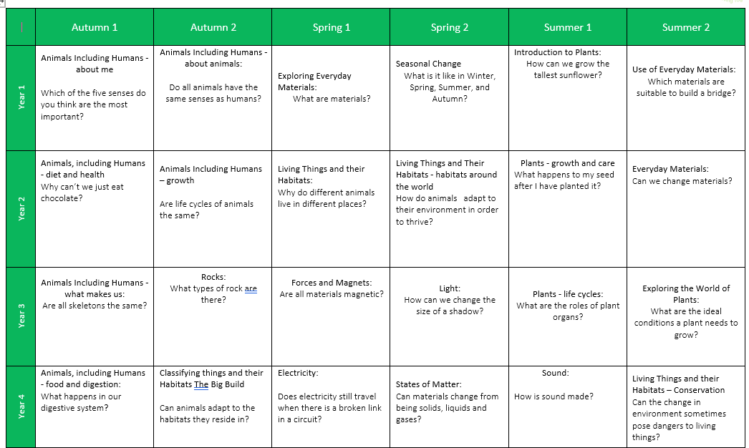
Long Term Planning

Slide 3
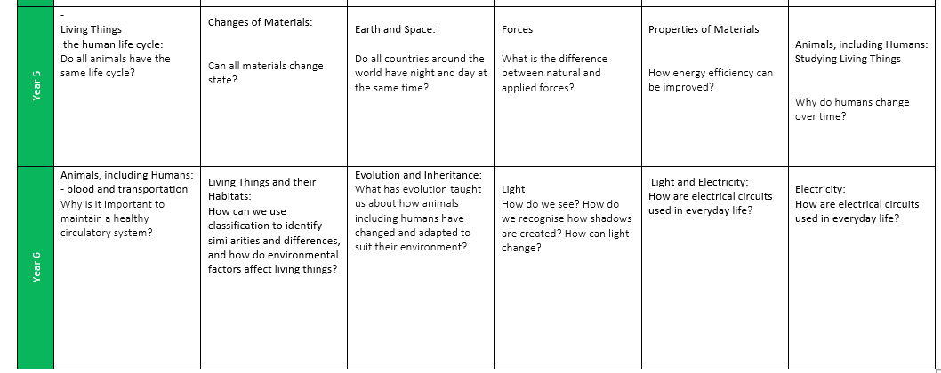
Long Term Planning

Slide 4
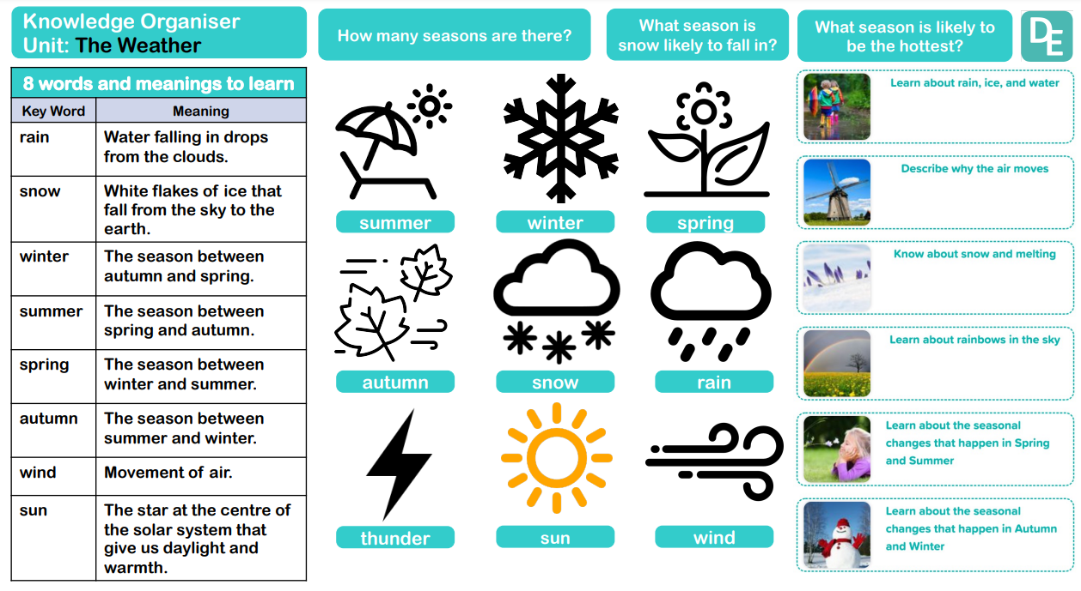
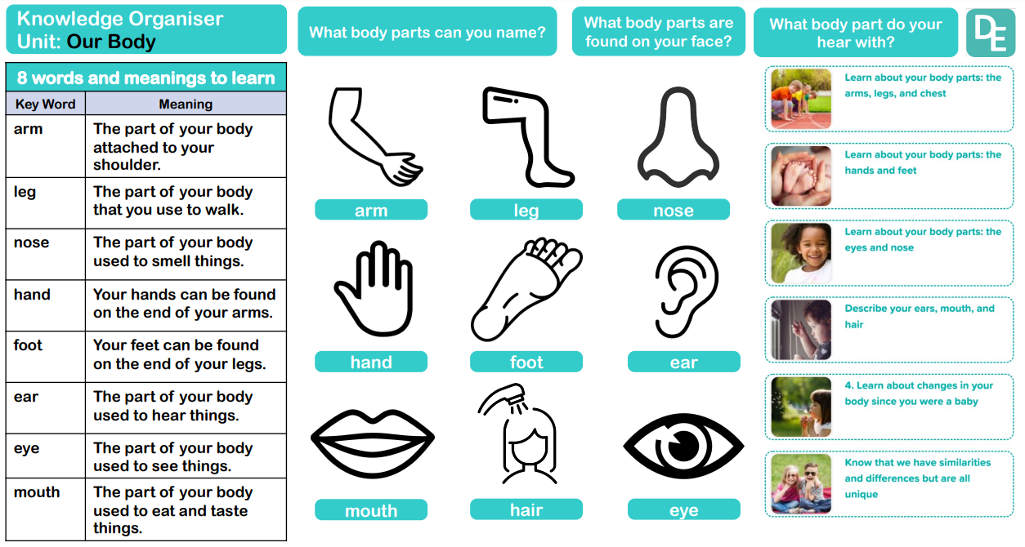
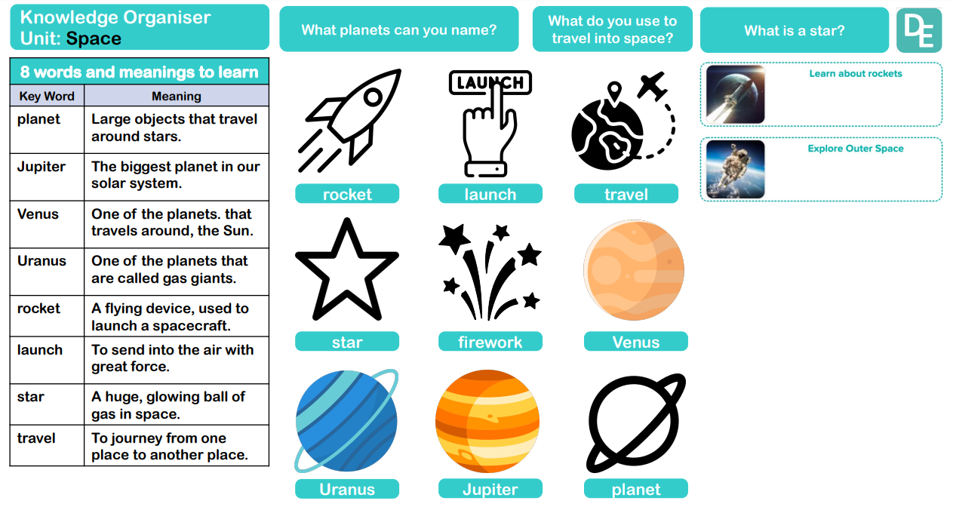
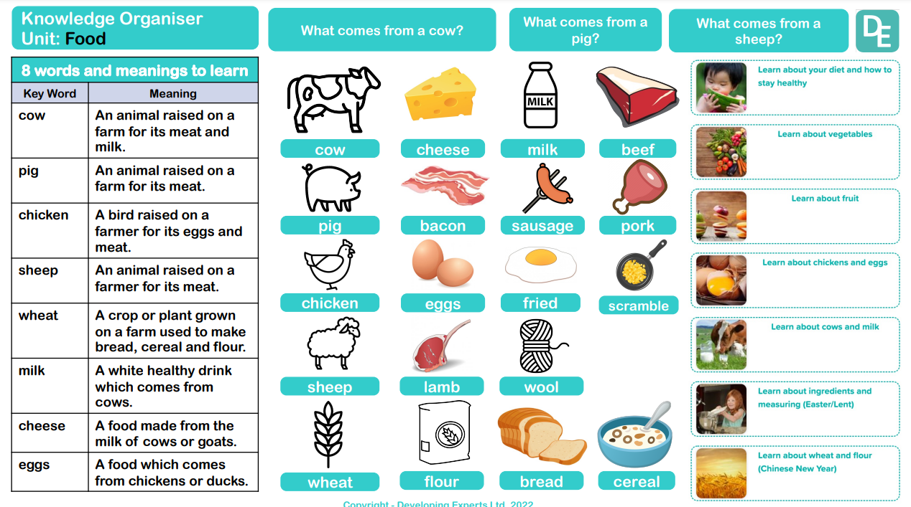
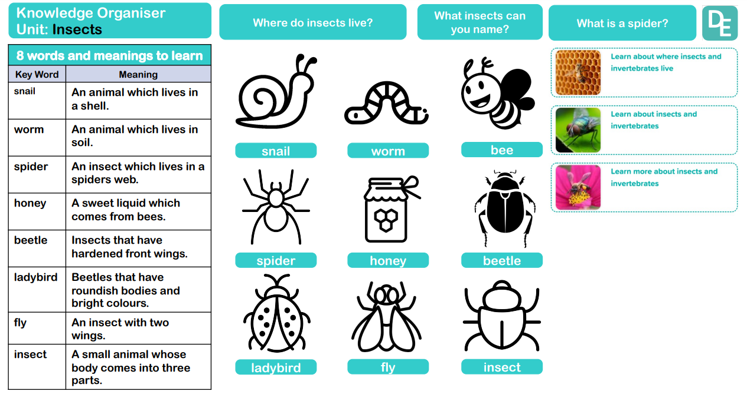
Science in EYFS
Science in Foundation Stage is explicitly introduced by an adult. It features in the communication and language, physical development and understanding the world parts of the EYFS curriculum. Adults introduce key knowledge e.g the importance of staying healthy. It is continued through activities in continuous provision e.g sorting foods onto healthy and unhealthy plates.
Term | Autumn 1 | Autumn 2 | Spring 1 | Spring 2 | Summer 1 | Summer 2
Theme | Who am I? All about me, my feelings, similarities and differences, my family, celebrations, past and present. |  | What am I? Evolution, human bodies, staying healthy, oral hygiene, amazing humans, plants vs humans, minibeasts and life cycles. |  | Where am I? Where I live, the UK, fossils/dinosaurs, the world, pirates, space, and how to care for the planet.
Understanding the World - Science

Slide 5
Science in EYFS
Science in Foundation Stage is explicitly introduced by an adult. It features in the communication and language, physical development and understanding the world parts of the EYFS curriculum. Adults introduce key knowledge e.g the importance of staying healthy. It is continued through activities in continuous provision e.g sorting foods onto healthy and unhealthy plates.
Term | Autumn 1 | Autumn 2 | Spring 1 | Spring 2 | Summer 1 | Summer 2
Theme | Who am I? All about me, my feelings, similarities and differences, my family, celebrations, past and present. |  | What am I? Evolution, human bodies, staying healthy, oral hygiene, amazing humans, plants vs humans, minibeasts and life cycles. |  | Where am I? Where I live, the UK, fossils/dinosaurs, the world, pirates, space, and how to care for the planet.
Communication and Language | Settling in Activities (Carpet Times, Getting to know you). Making friends Developing listening skills. Following instructions. Listening to stories. Super 6 – Repeated Texts. Talk through Stories – building vocabulary. Using new vocabulary. Retelling Stories orally. Discussing the curiosity cube – making observations. Children talking about things that are familiar to them: home, family, pets. Discussing similarities and differences. Talking about aspirations for the future. Talking about events that may be familiar: Halloween, Bonfire Night, Christmas. Taking part in the Nativity: listening to and singing songs. Listening to and joining in the Nursery Rhymes – Nursery Rhyme Week. Show and Tell Comparing life for us to life for Grandparents. |  | Listening to stories. Good Listening Skills. Super 6 – Repeated Texts – Building familiarity, understanding and increasing vocabulary. Talk through stories – building vocabulary, using new vocabulary, building familiarity with stories, retelling stories. Discussing the curiosity cube – asking what, where and who questions. Describing events in detail. Discussing how to stay healthy and what they do at home to stay healthy. Talking about how to keep teeth clean. Discussing the life cycle of a butterfly – asking questions to find out more. Using new vocabulary in different contexts. Story Invention – Talk it. Show and Tell Sharing Christmas Holiday news. Classifying Animals. Sharing our own ideas and opinions. |  | Listening to stories. Good Listening Skills. Super 6 – Repeated Texts – Building familiarity, understanding and increasing vocabulary. Talk through stories – building vocabulary, using new vocabulary, building familiarity with stories, retelling stories. Discussing the curiosity cube – asking how and why questions. Describing events in detail using connectives – Weekend News. Making up their own stories with a beginning, a middle and an end. Sharing Easter Holiday News. Discussing where we live. Comparing the UK to different countries. Talk around how to care for the environment. Sharing our own ideas and opinions and being able to give a reason why we think something.

Slide 6
Science in EYFS
Science in Foundation Stage is explicitly introduced by an adult. It features in the communication and language, physical development and understanding the world parts of the EYFS curriculum. Adults introduce key knowledge e.g the importance of staying healthy. It is continued through activities in continuous provision e.g sorting foods onto healthy and unhealthy plates.
Term | Autumn 1 | Autumn 2 | Spring 1 | Spring 2 | Summer 1 | Summer 2
Theme | Who am I? All about me, my feelings, similarities and differences, my family, celebrations, past and present. |  | What am I? Evolution, human bodies, staying healthy, oral hygiene, amazing humans, plants vs humans, minibeasts and life cycles. |  | Where am I? Where I live, the UK, fossils/dinosaurs, the world, pirates, space, and how to care for the planet.
Understanding the World | Navigating key locations in school e.g. hall. Where do we live? Explore via google maps. Identifying their family – commenting on photos of their family and naming who they can see and of what relation they are to them. Talk about what they do with their family and places they have been with their family. Introduce children to a range of fictional characters and creatures from stories to differentiate these characters from real people in their lives. Draw similarities and differences between other families. Life in the past – When I was a child book. Listen to fictional stories about families and start to tell the difference between real and fiction. SEASON – Autumn – explore the natural world looking for seasonal changes. Describe what they feel, see and hear whilst outside. Understand the effect of changing seasons on the natural world around them. Celebrations – birthdays, Christmas, Halloween, bonfire night, remembrance, diwali – Rama and Sita. Introduce children to places of worship and places of local importance to the community. Talk about experiences of past birthdays. Talk about what they have done with their families during Christmas’ past – using photographs. Show photos of how Christmas is celebrated all over the world – similarities and differences. Use the Jolly Postman to draw information from a map. |  | SEASON – Winter – explore the natural world looking for seasonal changes. Describe what they feel, see and hear whilst outside. Understand the effect of changing seasons on the natural world around them. Celebrations – epiphany, Chinese new year, valentines day, shivaratri, pancake day, Holi, Ramadan mothers day, easter. Listen to children describing and commenting on things they have seen whilst outside, including plants and animals. After close observation, draw pictures of the natural world, including animals and plants Care and concern for living things. Planting Sunflowers, beans and other flowers. Observing minibeasts. Looking after the caterpillars. Draw children’s attention to the immediate environment, introducing and modelling new vocabulary where appropriate. SEASON – Spring – explore the natural world looking for seasonal changes. Describe what they feel, see and hear whilst outside. Understand the effect of changing seasons on the natural world around them. |  | SEASON – Summer – explore the natural world looking for seasonal changes. Describe what they feel, see and hear whilst outside. Understand the effect of changing seasons on the natural world around them. Can children talk about their homes – where is it? and what there is to do near their homes? Look out for children drawing/painting or constructing their homes. Encourage them to comment on what their home is like. Show photos of the children’s homes and encourage them to draw comparisons. Environments – Physical and Human Features of local environment Maps of local area Comparing places on Google Earth – how are they similar/different? Introduce the children to NASA and America. Introduce children to significant figures who have been to space and begin to understand that these events happened before they were born. Celebrations – fathers day, pride month, eid, summer solstice. Life in the past - To understand where dinosaurs are now and begin to understand that they were alive a very long time ago. Learn about what a paleontologist is and how they explore really old artefacts. Introduce Mary Anning. Share non-fiction texts that offer an insight into contrasting environments. Create treasure hunts linking to pirates to find places/objects within the learning environment. Use bee-bots on simple maps. Encourage the children to use navigational language. Recognise the difference between life in this country and life in different countries. Introduce the children to recycling and how it can take care of our world. Look at what rubbish can do to our environment and animals. Create opportunities to discuss how we care for the natural world around us.

Slide 7
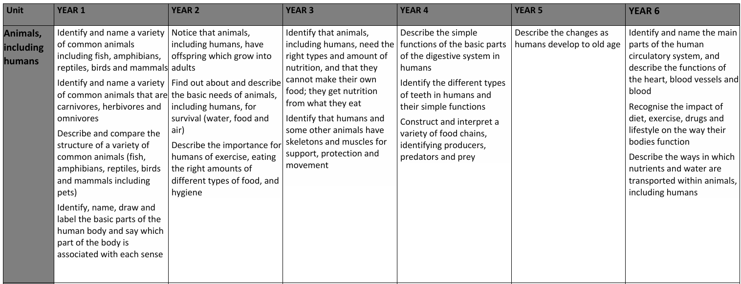
Curriculum Thread Documents - Knowledge

Slide 8
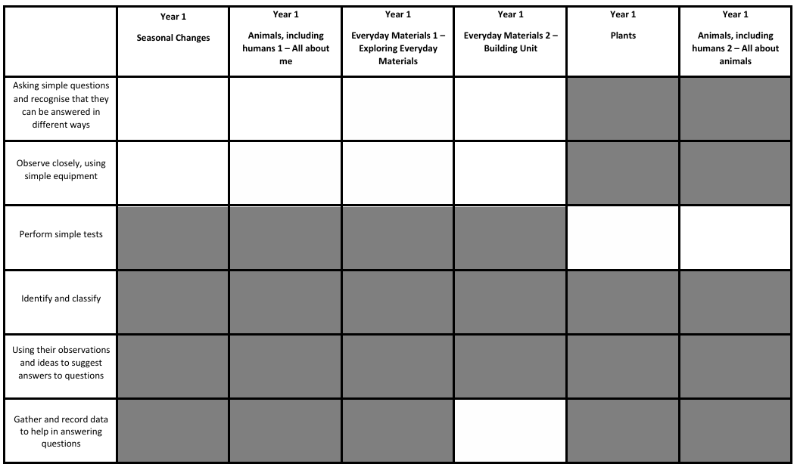
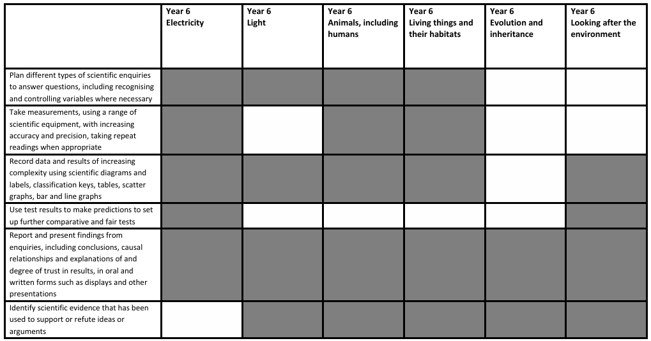
Curriculum Thread Documents - Skills

Slide 9
Vocabulary
EYFS | Year 1 | Year 2 | Year 3 | Year 4 | Year 5 | Year 6
leg nose hand foot ear eye mouth | head body brain pupil ear sound tongue taste | nutrition healthy protein carbohydrate dairy fat exercise hygiene | vitamin mineral nutrition label balanced endoskeleton exoskeleton radius tibia rib cage Spine hamstrings biceps | digestive system oesophagus saliva peristalsis stomach large intestines small intestines liver incisors molars enamel fluoride Consumer predator tundra hide | offspring foetus dependent adolescent puberty gestation pregnant toddler prenatal breeding embryo hormones | circulatory system diet Pulse BPM oxygenated deoxygenated atrium ventricle ventricle vessel valve diffusion osmosis
arm

Slide 10
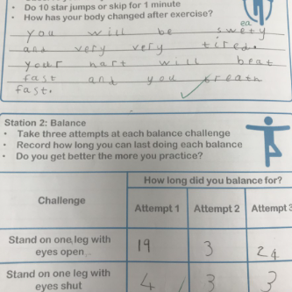
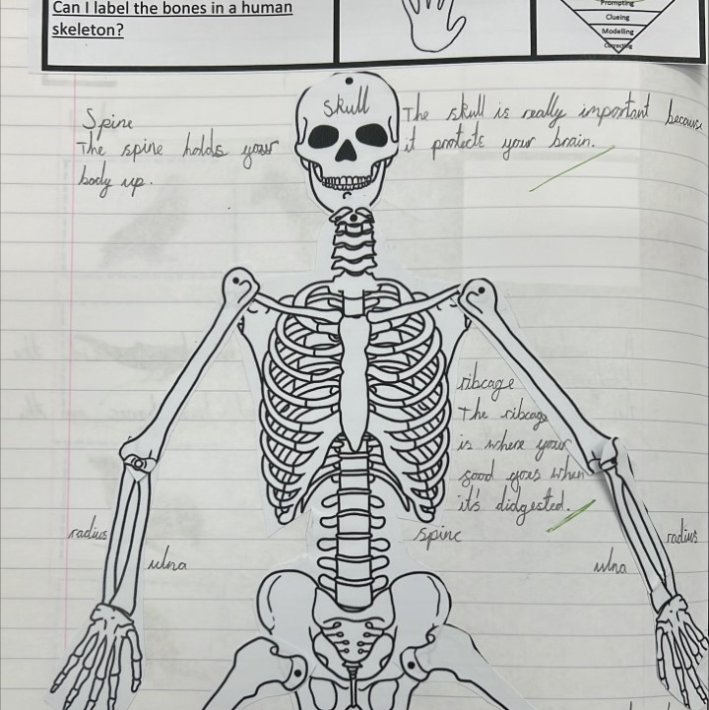
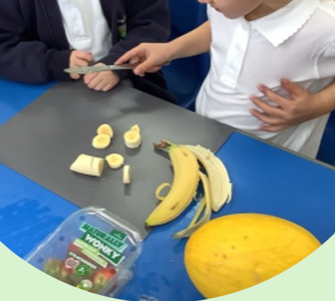
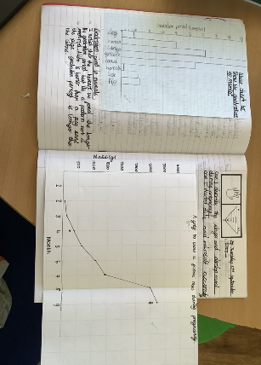
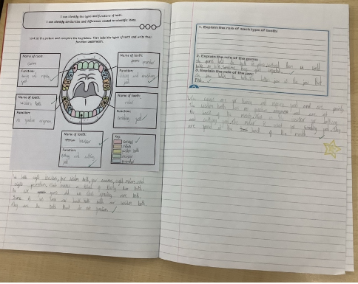
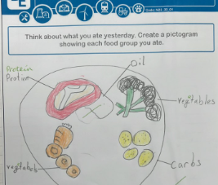
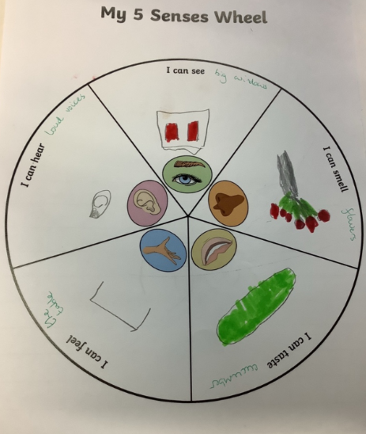
Examples of Work

Slide 11
Assessment
At Bowling Green our curriculum is carefully planned to match the learning objectives set out in the National Curriculum for each year group. Therefore, we say that a child is ‘expected’ which means they are achieving their year groups objectives if they are keeping up with the learning detailed in our long term and medium term plans.
Whether a child is deemed to be keeping up with the learning is down to teacher judgement and knowledge of each individual child. To aid this decision each unit has a pre-learning task, this could check a child's understanding of the content up to this point i.e. have they recalled relevant information from previous year groups. This pre-learning task is used to inform planning, specifically thinking about additional support and challenge which may be needed in order to meet the needs of our pupils. Following the completion of a unit there is a post-learning task this checks a child's understanding of the content covered.
Each lesson has a flashback at the beginning of the lesson this is to support with retrieval of 'sticky knowledge' (knowledge we want children to remember).
Children are expected in each subject if they are keeping up with the learning detailed in the LTP/MTP.
Statutory Government assessments are undertaken in Year 1 with the Phonics Screening Check, Year 4 with the multiplication check and Year 6 with SATs.

Slide 12
What can I do as a parent to support my child in this subject?
1. Foster Curiosity and Inquiry
Encourage your child to ask "why" and "how" questions about the world around them.
Show enthusiasm for their questions, even if you don’t know the answers – look for answers together.
Provide opportunities for hands-on exploration, such as experimenting with water, magnets, or plants.
2. Engage in Everyday Science
Talk about science in daily activities, such as cooking (e.g., how heat changes food), gardening (e.g., plant growth), or weather (e.g., clouds and rain).
Explore how things work around the house, like a flashlight, a washing machine, or a fan.
3. Encourage Outdoor Exploration Go on nature walks and observe plants, animals, and insects.
Visit parks, beaches, or forests to discuss ecosystems and the environment.
Collect and examine rocks, leaves, or shells, sparking discussions about their features and uses.
4. Do Simple Science Experiments at Home
Create fun experiments using household items, such as:
Mixing vinegar and baking soda to demonstrate chemical reactions.
Making a simple volcano with clay and food colouring.
Growing a plant from a seed to observe its lifecycle.
Look up age-appropriate science experiments together online or in books.
5. Read Science Books and Watch Educational Shows
Choose age-appropriate science books with colourful illustrations and engaging content.
Watch science-related programs or YouTube channels together to make learning visual and interactive.

Slide 13
Career Ideas
Doctor
Chemist
Scientist
Pharmacist
Nurse
Dentist
Ecologist
Archaeologist
Psychologist
Food Scientist
Medical Sales…

